Slide 1
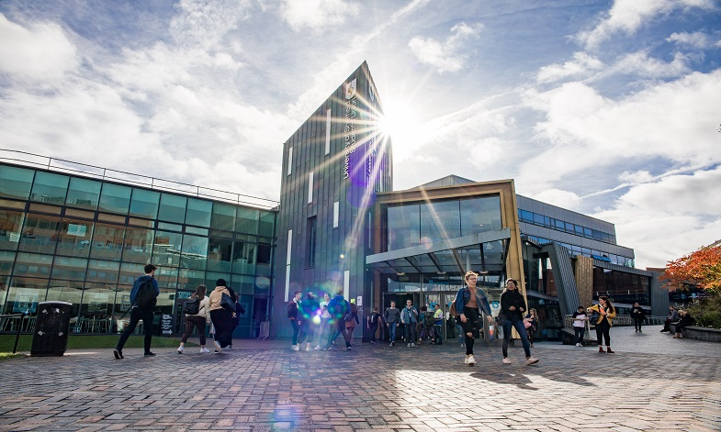
Careers and
Higher Education

Slide 2
These resources are provided by HeppSY
HeppSY stands for Higher Education Progression Partnership South Yorkshire.
HeppSY is part of a national programme which supports young people in Year 9 to Year 13.
We provide impartial information and advice and engage with all higher education opportunities to help young people make the best choices for them individually.

Slide 3
Outcomes
This presentation will help you:
Gain words and phrases that will help you talk about university level study and your thoughts about it.
Find roles or careers that inspire curiosity and offer scope for your future.

Slide 4

What is Higher Education?
Higher education is studied at Universities and Colleges. It is a programme of study at Level 4 and above.
This means it is studied after A Levels / BTECs / Level 3 qualifications.
Level 1 & 2 | GCSE
Level 3 | A-Levels / BTECs
Level 4-7 | Higher & Degree Level
Notes:
Higher education is a programme of study at level 4 and above.
GCSEs are level 2 and what you are doing now is level 3 (A levels or BTECs) and then above that is level 4.
This can be studied at universities and colleges.

Slide 5
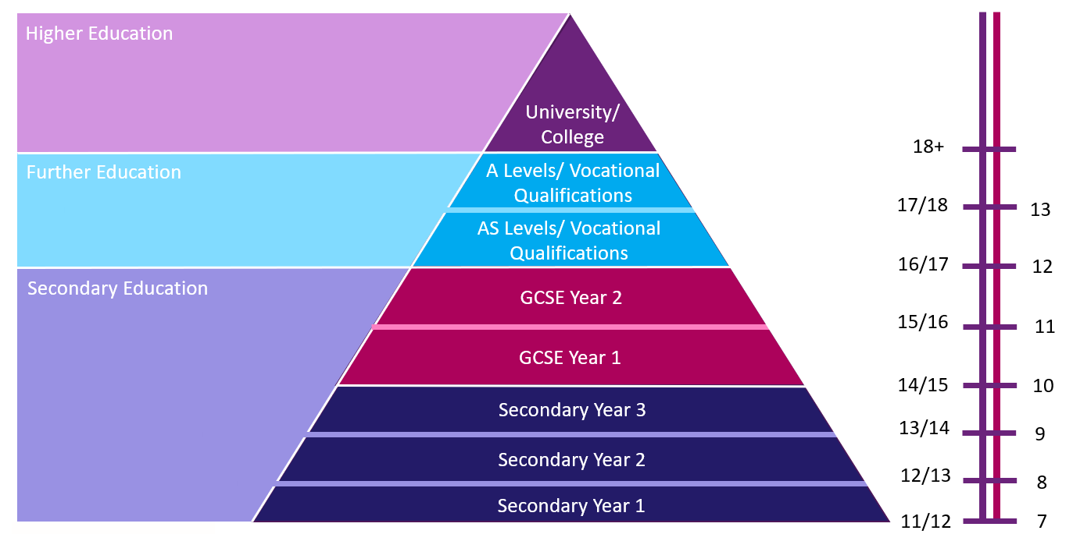
Level 4+
Education Pyramid
Level 3
Where are
you?
Level 1-2

Slide 6
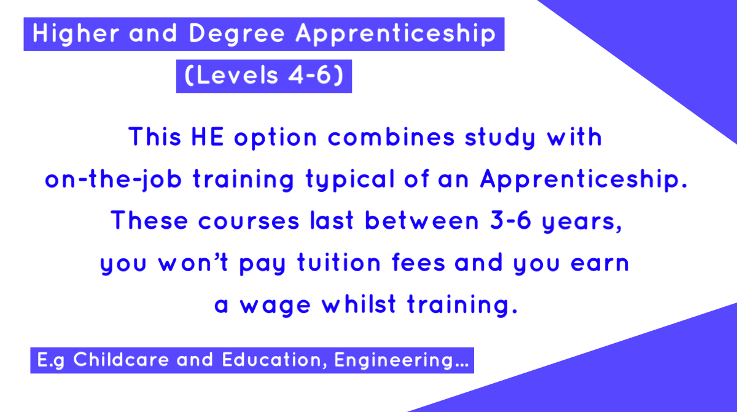
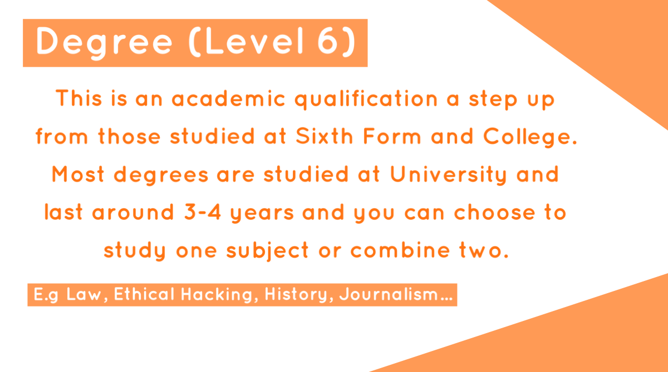
HE Qualification Flashcards

Slide 7
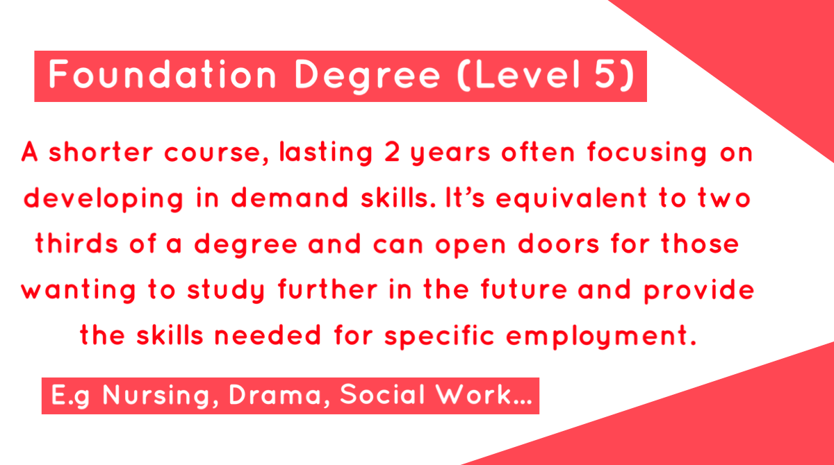
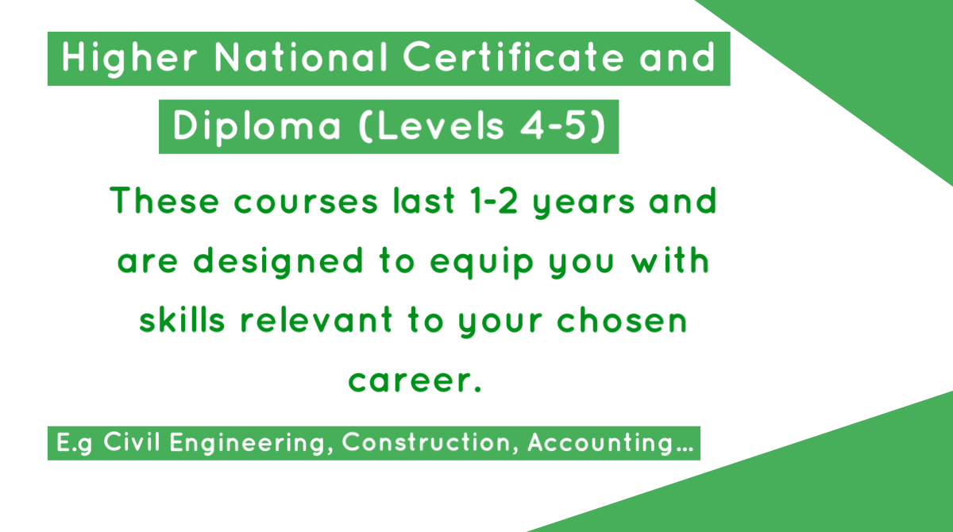
HE Qualification Flashcards

Slide 8


Degree or No Degree?
Do you think you can study the following subjects at university?

Slide 9

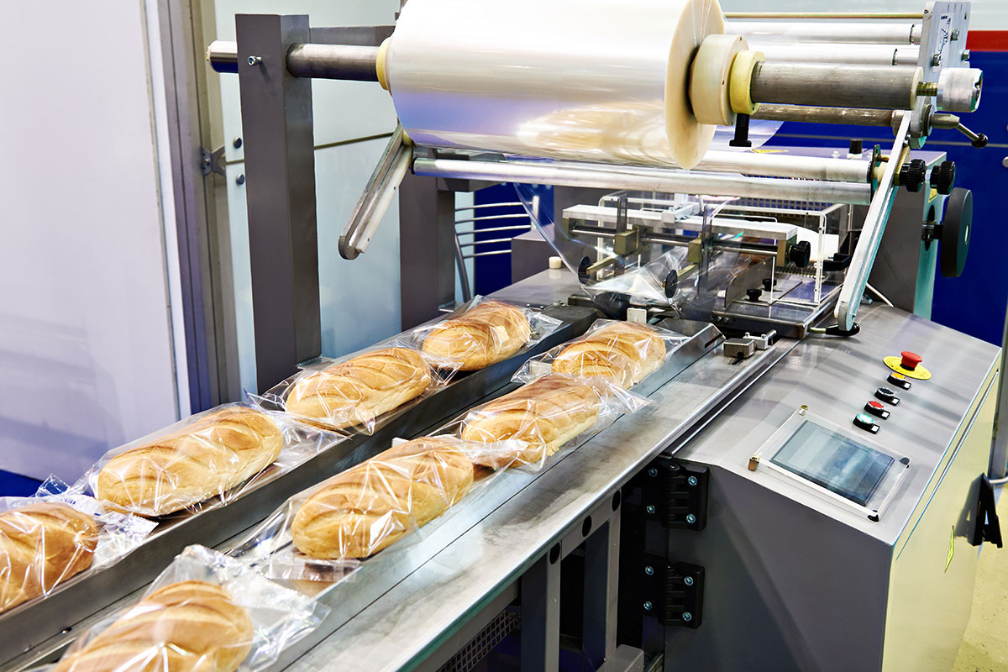
Degree or No Degree?
Baking Technology Management
Degree!
This degree can be studied at London Southbank University. It builds on existing technical skills and knowledge, introduces scientific and business methodology, and considers the industry’s social and economic contexts.

Slide 10
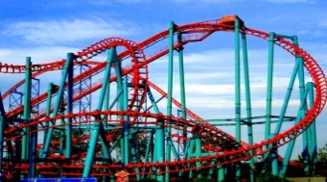
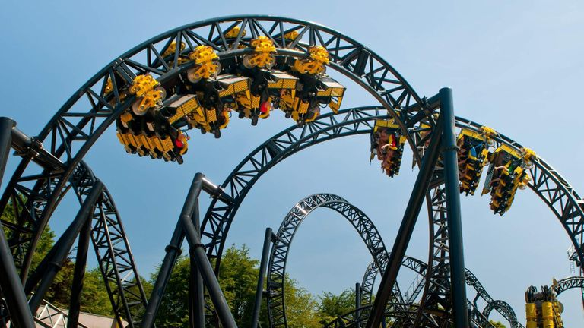
Degree or No Degree?
Rollercoaster Engineering
Not a Degree!
To become a Rollercoaster Engineer, you will need to have a degree in preferably mechanical, structural or electrical engineering. You can obtain many different qualifications for engineering and there are a diverse range of institutions to study at as well as apprenticeships in engineering.

Slide 11


Degree or No Degree?
Degree!
(Apprenticeship)
A Dental Practice Manager manages all non-clinical aspects of a dental surgery, leading the practice team and achieving excellent patient care and cost efficiency. This degree apprenticeship will teach the skills required through on-the-job training.
Dental Practice Managing

Slide 12
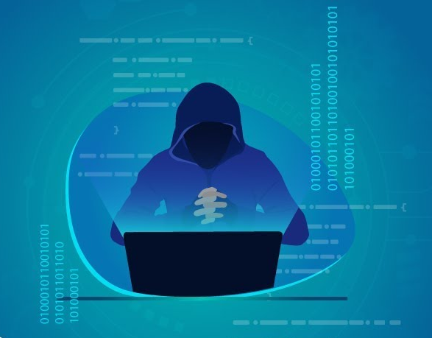

Degree or No Degree?
Ethical Hacking
Degree!
Abertay University's Ethical Hacking degree was the first in the world and is recognised as one of the UK's leading vocational security programmes. The programme takes an offensive approach to security, which means you will learn how to break systems and circumvent security defences - not just study encryption.

Slide 13


Degree or No Degree?
Not a Degree!
Wedding Planning
There are many universities that offer courses in event management which will help you develop the skills required to be a wedding planner.
E.g. Events Management (with Placement Year) Anglia Ruskin University
You will develop a wide range of professional and academic skills which you could then apply to organising live events throughout the course.

Slide 14
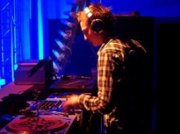

Degree or No Degree?
Music Production and DJ Practice
Degree!
Point Blank Music School (Hackney London) offers this programme to ensure your expertise in crucial areas of the music industry such as DJing, production, remixing, sound design, mastering, how to manage your career (or manage others) and more, allowing you to pursue a passion for music whilst gaining a full BA (Hons) degree validated by Middlesex University .

Slide 15
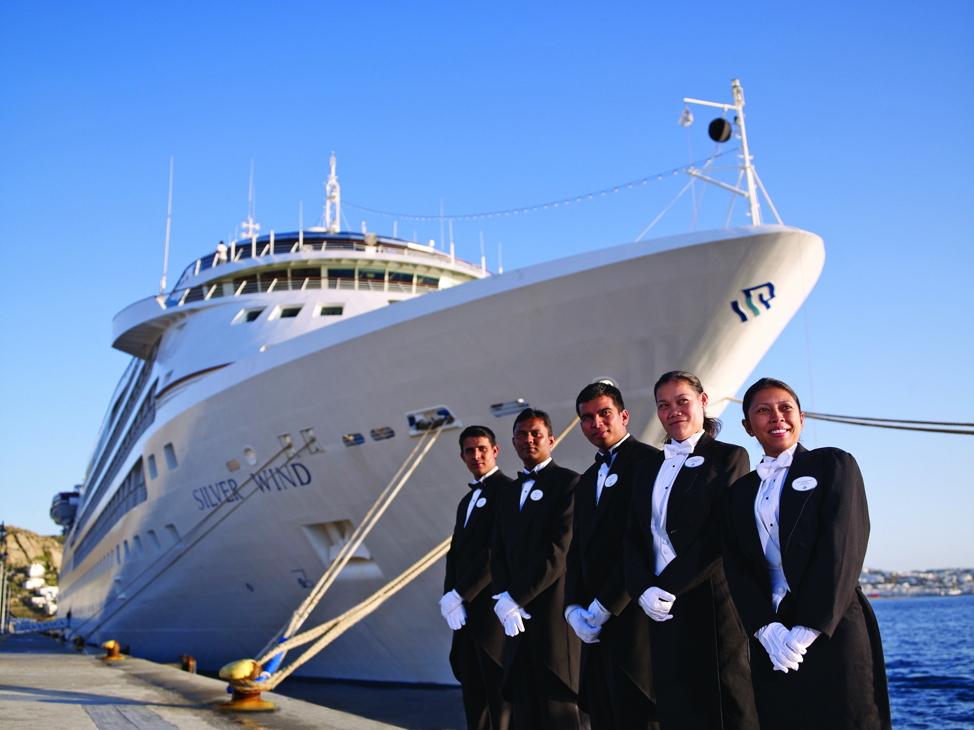

Degree or No Degree?
Cruise Management
Degree!
This degree from University of Plymouth develops professional hospitality management skills, helping to set you up for a career in the cruise industry. There is an optional placement year which is normally spent in paid employment with a cruise or hospitality organisation.

Slide 16

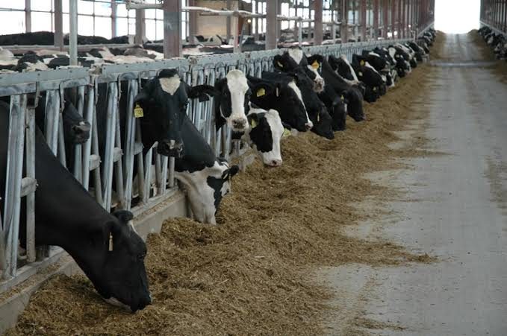
Degree or No Degree?
Dairy Herd Management
Degree!
This unique course from University Centre Reaseheath will enable you to develop an understanding of the technical, economic, legal and managerial principles relating to dairy farm businesses, identify the effects of environmental and ethical issues in the dairy industry and offer specialist practical skills associated with dairy farming.

Slide 17
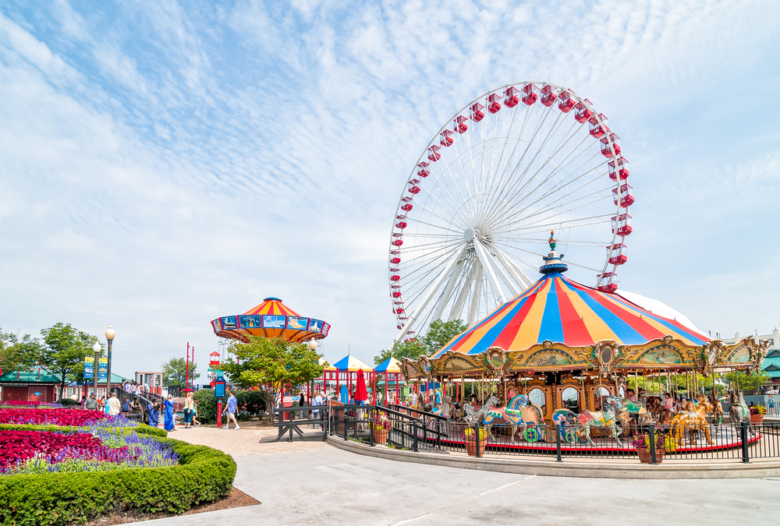

Degree or No Degree?
Not a Degree!
Theme Park Management
This is not a degree, but Staffordshire University have a similar option with their Visitor Attraction and Resort Management course. This is a foundation degree where students learn how to manage a theme park effectively with modules in accounting, leisure services, leadership and customer satisfaction monitoring.

Slide 18
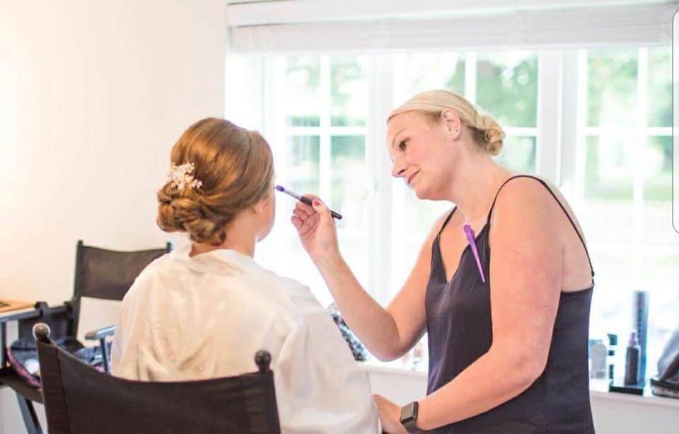

Degree or No Degree?
Makeup and
Hair Design
Degree!
Offered by University for the Creative Arts (Rochester), students on this course learn about this particular area of the fashion industry, where a make-up artist and hair designer fits within it and how the make-up/hair artist collaborates with a stylist, art director, fashion designer, catwalk producer, fashion director, photographer and filmmaker.

Slide 19
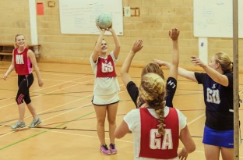

Degree or No Degree?
Not a Degree!
Netball Studies
Sports science degrees at various universities offer opportunities to study modules focussing on netball. You can also play netball for University competitively in British Universities and Colleges Sports (BUCS) or non-competitively in intra-mural leagues.

Slide 20


Degree or No Degree?
Radio Engineering
Degree!
(Apprenticeship)
As a Radio Telecommunications Engineer Apprentice you would attend customer sites to carry out surveys, ascertaining what equipment fits with their requirements, perform installations, reprogram radios and help diagnose any problems. Alongside this you would attend a college and complete a course.

Slide 21
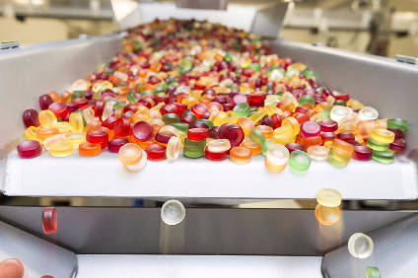
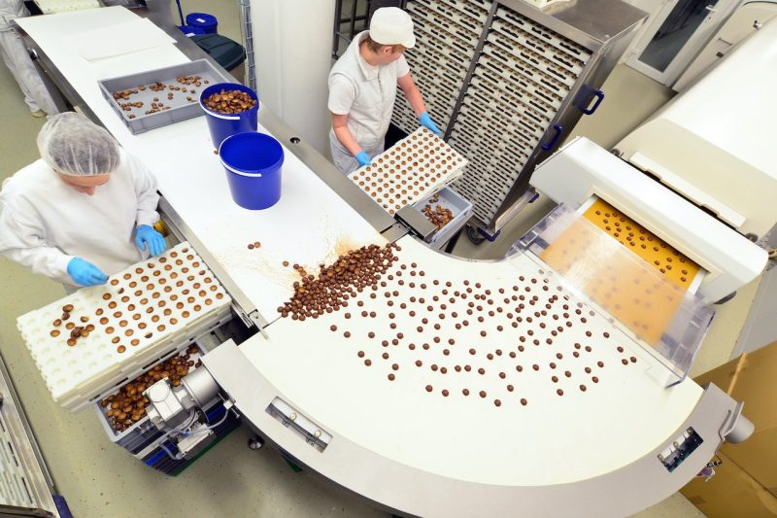
Degree or No Degree?
Not a Degree!
Confectionary Production
Although not a degree, University College Birmingham offers a Bakery and Patisserie Technology course which is ideal if you want to focus on the technical and managerial skills required to be successful in the baking industry. It will also appeal to students who want experience of working with a broad range of baking and confectionery processes.

Slide 22


Degree or No Degree?
Not a Degree!
Tattoo Design and Production
This is not a degree, but you can study Graphic Design (Tattoo Artists) at Kingston College. This is a Higher National Certificate to help you to progress into a career in Art and Design with a focus on the Tattoo Industry. It is aimed at dedicated learners who want, ultimately, to move into the Tattoo Industry via an industry Apprenticeship, or into further training, and are looking for practical training and a nationally recognised Level 4 qualification.

Slide 23
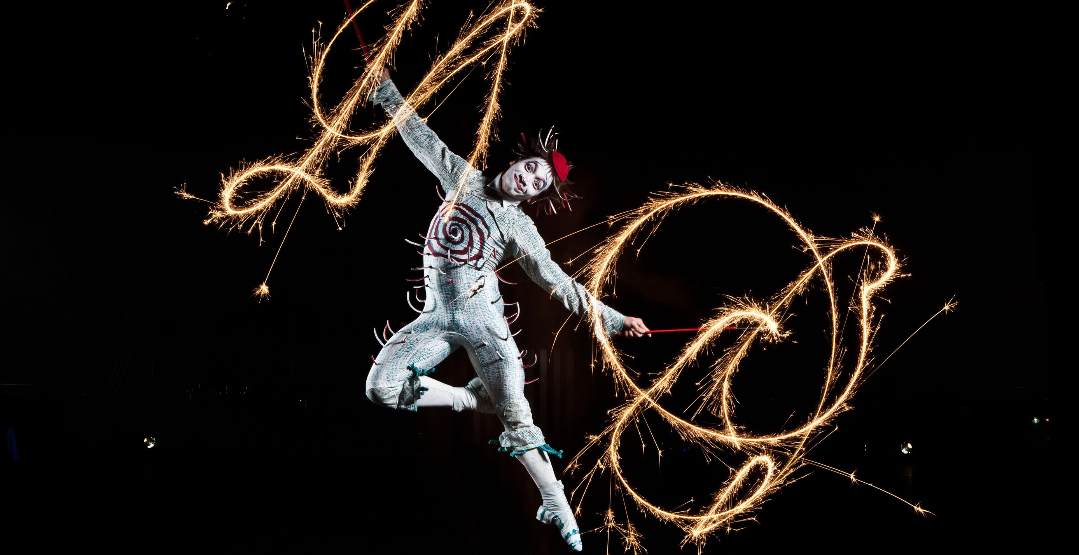
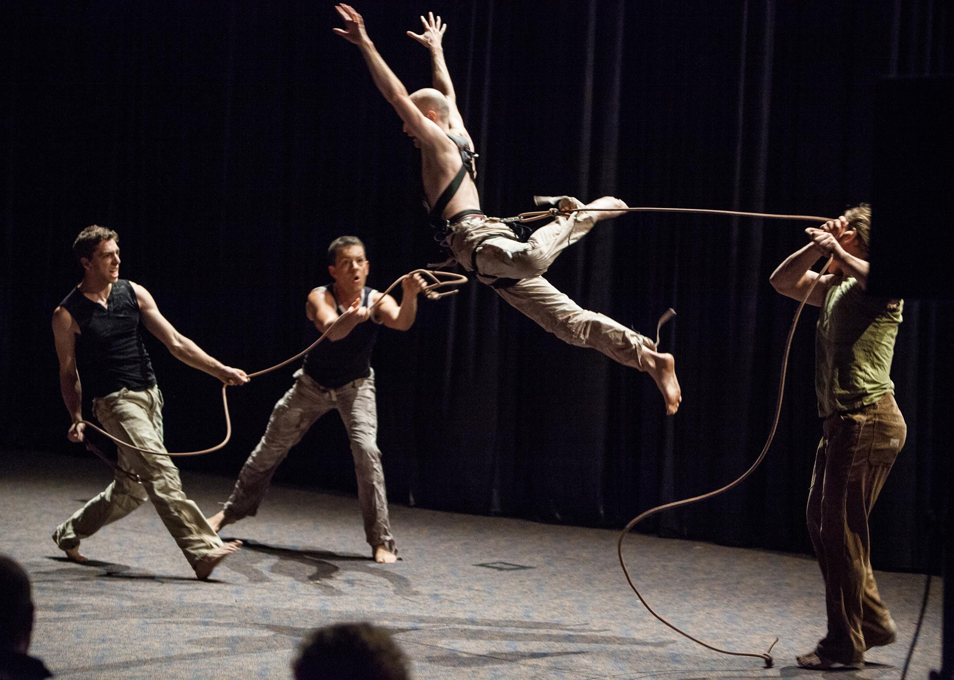
Degree or No Degree?
Contemporary Circus and Physical Theatre
Degree!
This intensive course from Bath Spa University is focused on helping you build the skills you need to become a strong, creative, and adaptable circus professional. The aim of the course is to integrate physical circus skills with theatrical performance. You will have regular opportunities to present your creative work through performance projects using specialist circus venues and equipment.

Slide 24


Degree or No Degree?
Viking and Old Norse Studies
Degree!
This four-year programme from University College London (UCL) aims to develop your knowledge and understanding of the Viking Age through study of the medieval and modern Scandinavian languages, Old Norse literature, and medieval history. The third year is spent abroad at a university in Denmark, Iceland, Norway or Sweden.

Slide 25


Degree or No Degree?
Professional Floristry and Floral Design
Degree!
This is a foundation degree that can be topped up to a full degree from University Centre Myerscough. It explores all aspects of floral design to a professional standard - traditional, period, contemporary and experimental designs. Work experience is encouraged as an integral part of the course, giving students a valuable insight into the professional floristry industry.

Slide 26
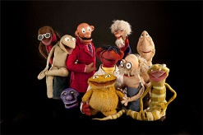
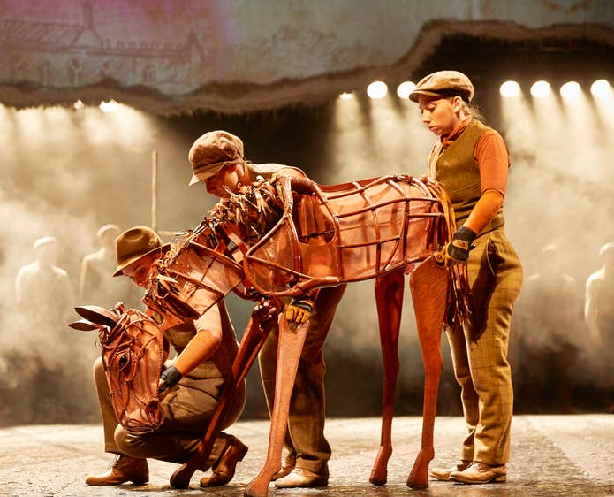
Degree or No Degree?
Not a Degree!
Puppetry Design and Performance
This used to be a degree but is no longer available. Instead, you could study Prop Making and Special Effects at Greater Brighton Metropolitan College. The course explores a wide range of creative techniques such as wood and metal work, sculpting, moulding and casting, decorative finishes, model making and soft props/puppetry to create a broad creative skill set that will support your development as a prop maker.

Slide 27
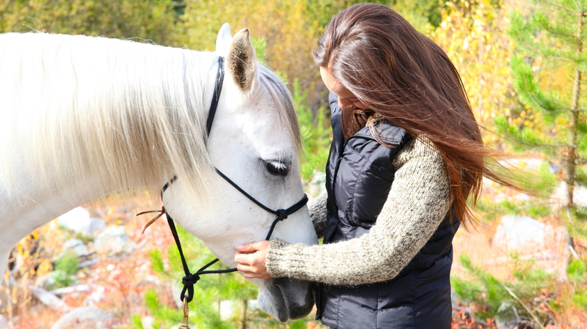
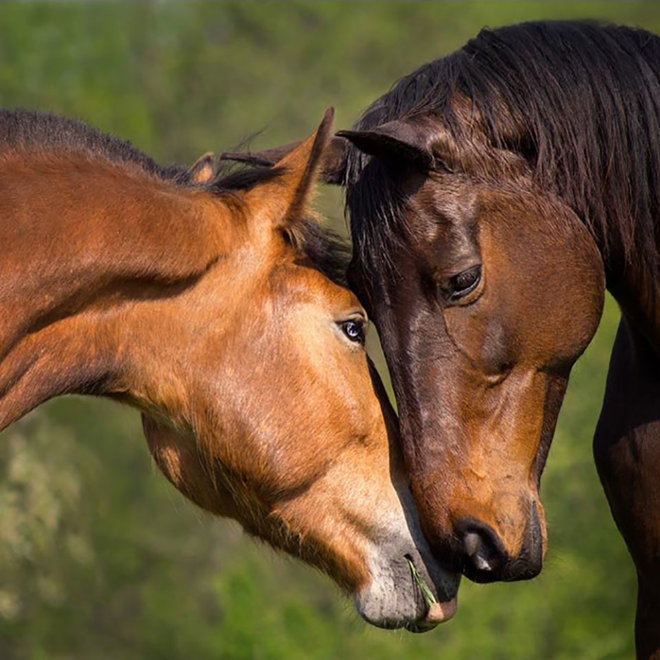
Degree or No Degree?
Equestrian Psychology and Sport Science
Degree!
This course from Nottingham Trent University, involves studies to develop a greater understanding of equine behaviour and the horse-human relationship. The course is based in rural Nottinghamshire, with a 200 hectare estate for outdoor fieldwork and research.

Slide 28


Degree or No Degree?
Not a Degree!
Disney Studies
This is not a degree, but you can take part in the 'Disney college program' (Lake Buena Vista, Florida Anaheim, California) as part of a placement year or a semester whilst studying on a full degree. You’ll gain valuable, on-the-job experience working in the parks and resorts, participate in college coursework, and have the opportunity to meet and live with people from all over the country and potentially the world in company-sponsored housing.

Slide 29
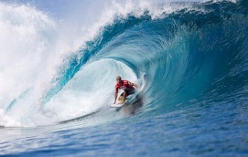
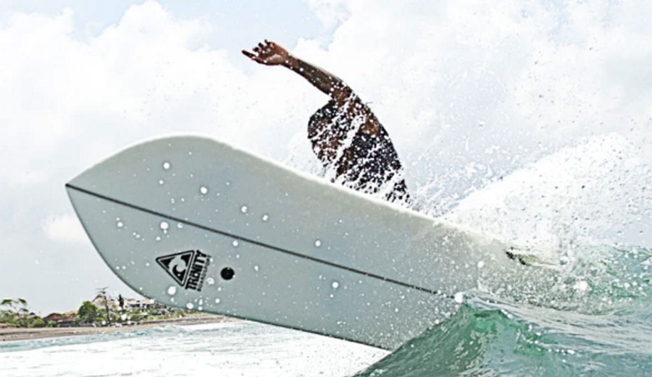
Degree or No Degree?
Surf Science and Technology
Degree!
During the programme at Cornwall College you will study: the sport of surfing as well as surfing businesses; business planning relating to the surfing industry; event management; environmental science; human exercise science; principles of psychology and coaching; design and manufacture of surf boards; the environment and human impacts on it; the development of surfing culture and history; sport-related media and politics; the geographical and climatic influences on surfing.

Slide 30




Performing Arts
Sports Studies
What do you need for a degree?
Forensic Science
Information Technology

Slide 31
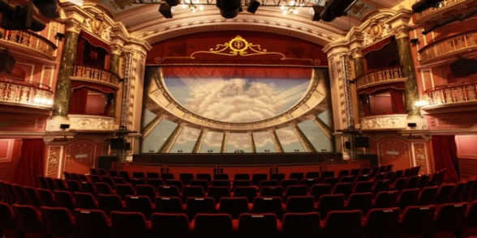
GCSEs
English and Maths (Grade 4)
A Levels/BTECs
2-3 A Levels
Extracurricular
(optional)
Potential interview
Performing Arts Degree
May ask for 5 GCSEs
BTECs
Examples of relevant subjects: dance, film, media, drama, performing arts
Potential portfolio of previous experience and performances
Shows interest in subject area
This shows one potential route to a higher education qualification.
You need these to go onto the next stage in every route
English and Maths (Grade 4)
These may not always be linked directly to the subject you want to study, but can help demonstrate skills that you will need and use at HE e.g. teamwork

Slide 32
What jobs could you do with this degree?
Try to think of some different jobs that a person with a performing arts degree may go into!
Some answers are on the next slide...

Slide 33

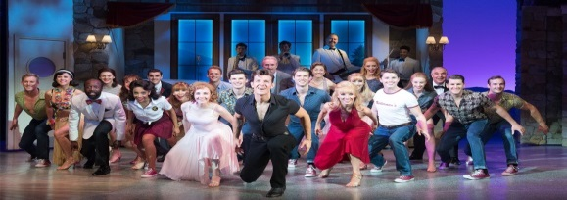
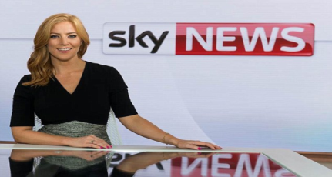
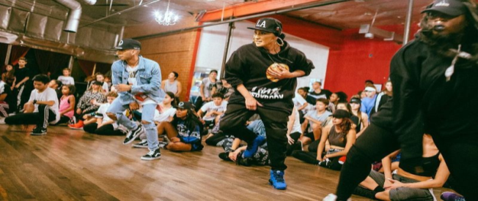
Choreographer
Actor/Actress
TOP TIP!
If you’re not sure what any of the jobs are, look them up on prospects.ac.uk!
Lecturer
Presenter
Dance Teacher
Performing Arts
Music Therapist
Producer
Director
Dancer
Theatre Stage Producer

Slide 34
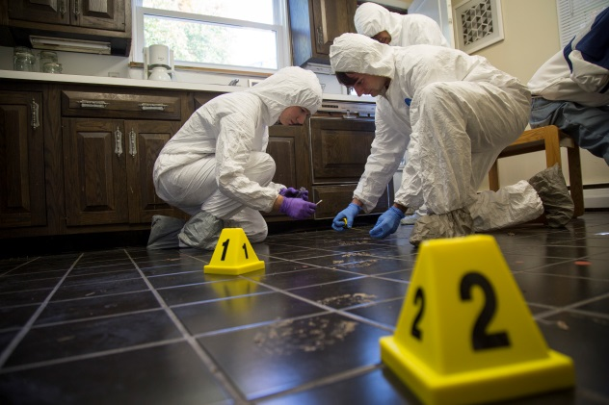
GCSEs
English and Maths (Grade 4)
A Levels/BTECs
2 A Levels (1 in science subject)
Extracurricular
(optional)
Show interest in forensic science
Forensic Science Degree
BTEC in science subject
Potential laboratory experience
e.g.
Forensic science uses science to investigate crimes e.g. DNA at a crime scene and lab analysis

Slide 35
What jobs could you do with this degree?
Try to think of some different jobs that a person with a forensic science degree may go into!
Some answers are on the next slide...

Slide 36

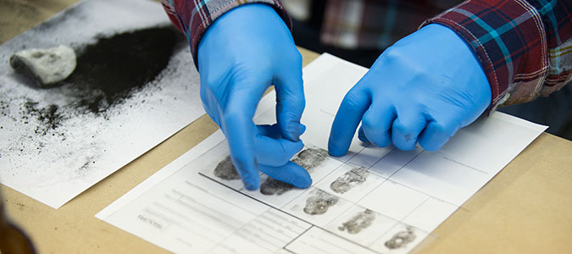
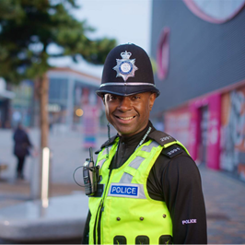

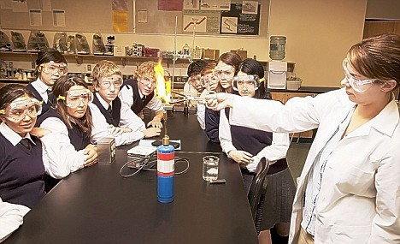
Science Journalist
Civil Servant
Detective
Lecturer
Laboratory Manager
Forensic Scientist
Forensic Science
TOP TIP!
If you’re not sure what any of the jobs are, look them up on prospects.ac.uk!
Science Teacher
Police Officer
Analyst

Slide 37
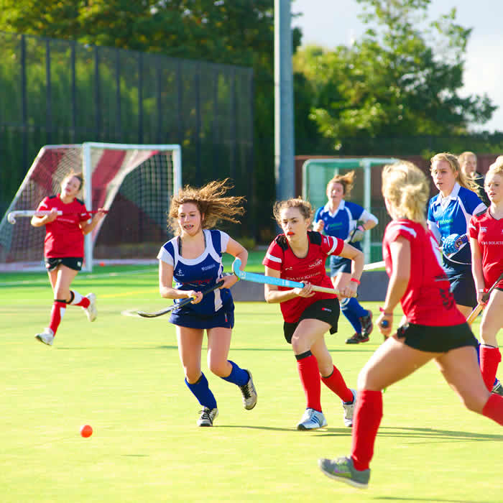
GCSEs
English and Maths (Grade 4)
A Levels/BTECs
2-3 A Levels
Extracurricular
(optional)
Shows interest in sports
Sports Studies Degree
May ask for 5 GCSEs
BTECs
Examples of relevant subjects: physical education, psychology, science
Playing in a sports team
Coaching experience
e.g.
This isn’t just playing sports! Sports studies involves other subjects like biology and psychology as it looks at the body and mind during exercise!

Slide 38
What jobs could you do with this degree?
Try to think of some different jobs that a person with a sports studies degree may go into!
Some answers are on the next slide...

Slide 39
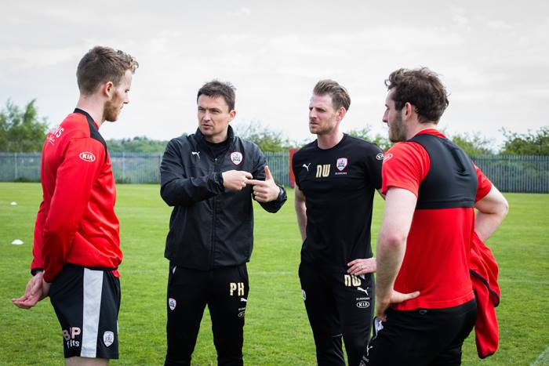

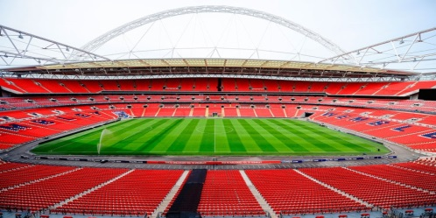
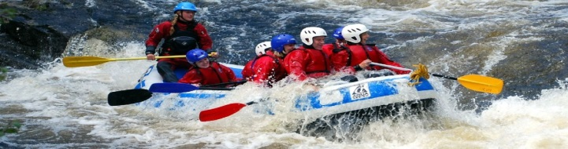

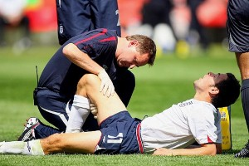
Sport Journalist
Sports Coach
Stadium Manager
TOP TIP!
If you’re not sure what any of the jobs are, look them up on prospects.ac.uk!
Sport Psychologist
Nutritionist
Sport Studies
Events Manager
PE Teacher
Physiotherapist
Outdoor Activities Manager

Slide 40

GCSEs
English and Maths (Grade 4)
A Levels/BTECs
2-3 A Levels
Extracurricular
(optional)
Computer programming or coding experience
Information Technology Degree
May ask for 5 GCSEs
BTECs
Examples of relevant subjects: Maths, IT, psychology or sociology
Show interest in computing
e.g.
In information technology you can look at developing IT products and computer systems, in both theoretical and practical settings

Slide 41
What jobs could you do with this degree?
Try to think of some different jobs that a person with an information technology degree may go into!
Some answers are on the next slide...

Slide 42




Data and IT analyst
Animator
Programmer
Multimedia specialist
Video Game Designer
TOP TIP!
If you’re not sure what any of the jobs are, look them up on prospects.ac.uk!
Information Technology
Website developer
App developer
Ethical hacker

Slide 43

GCSEs
English and Maths (Grade 4)
A Levels/BTECs
2-3 A Levels
Extracurricular
(optional)
Potential lab or healthcare experience
Biomedical Science Degree
May ask for 5 GCSEs
BTECs
Examples of relevant subjects: Biology, Chemistry
Show interest in science
e.g.
Biomedical science uses science in healthcare e.g. creating new medicines, supporting diagnosis of patients

Slide 44
What jobs could you do with this degree?
Try to think of some different jobs that a person with a biomedical science degree may go into!
Some answers are on the next slide...

Slide 45
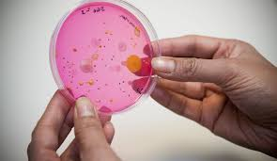


Environmental engineer
Biomedical scientist
Biology teacher
Dental therapist
Biomedical Science
TOP TIP!
If you’re not sure what any of the jobs are, look them up on prospects.ac.uk!
Science journalist
Science technician
Science researcher

Slide 46
Summary
1.
There are lots of different HE courses and whatever you are interested in, there will be something related to it that you can study!
2.
There are lots of potential routes to HE, but you will always need to have English and Maths GCSE Grade 4, and some Level 3 qualifications. Extracurricular activities can also help show your interest and skills!
3.
Whatever you study at HE, there are lots of jobs that you can do because every HE course will give you lots of different skills!
Next
steps?
If you know a job you might be interested in have a look on prospects.ac.uk to find out more about it and how to get there!
You can also research courses on ucas.com

Slide 47





Where next...
Ask!
Talk!
Research!
Follow!
About:
Life at university
Applying to courses
Student finance
Careers and skills
To:
Parents/ Guardians
Teachers
Careers advisors
At:
prospects.ac.uk
ucas.com
discoveruni.org.uk
heppsy/learners
On:
Twitter: @HeppSYbustour
Instagram: @heppsy_bus_tour
For updates, HE information and activities

