Slide 1
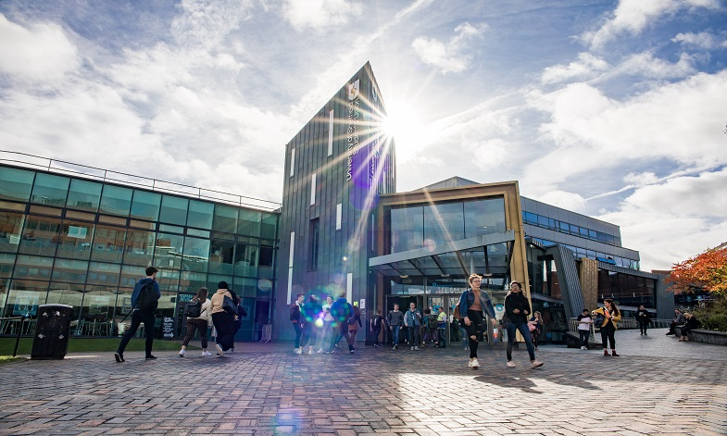
Careers and
Higher Education

Slide 2
These resources are provided by HeppSY
HeppSY stands for Higher Education Progression Partnership South Yorkshire.
HeppSY is part of a national programme which supports young people in Year 9 to Year 13.
We provide impartial information and advice and engage with all higher education opportunities to help young people make the best choices for them individually.

Slide 3
Outcomes
This presentation will help you:
Gain words and phrases that will help you talk about university level study and your thoughts about it.
Find roles or careers that inspire curiosity and offer scope for your future.

Slide 4

What is Higher Education?
Higher education is studied at Universities and Colleges. It is a programme of study at level 4 and above.
This means it is studied after A Levels / BTECs / level 3 qualifications.
Level 1 & 2 | GCSE
Level 3 | A-Levels / BTECs
Level 4-7 | Higher & Degree Level
Notes:
Higher education is a programme of study at level 4 and above.
GCSEs are level 2 and what you are doing now is level 3 (A levels or BTECs) and then above that is level 4.
This can be studied at universities and colleges.

Slide 5
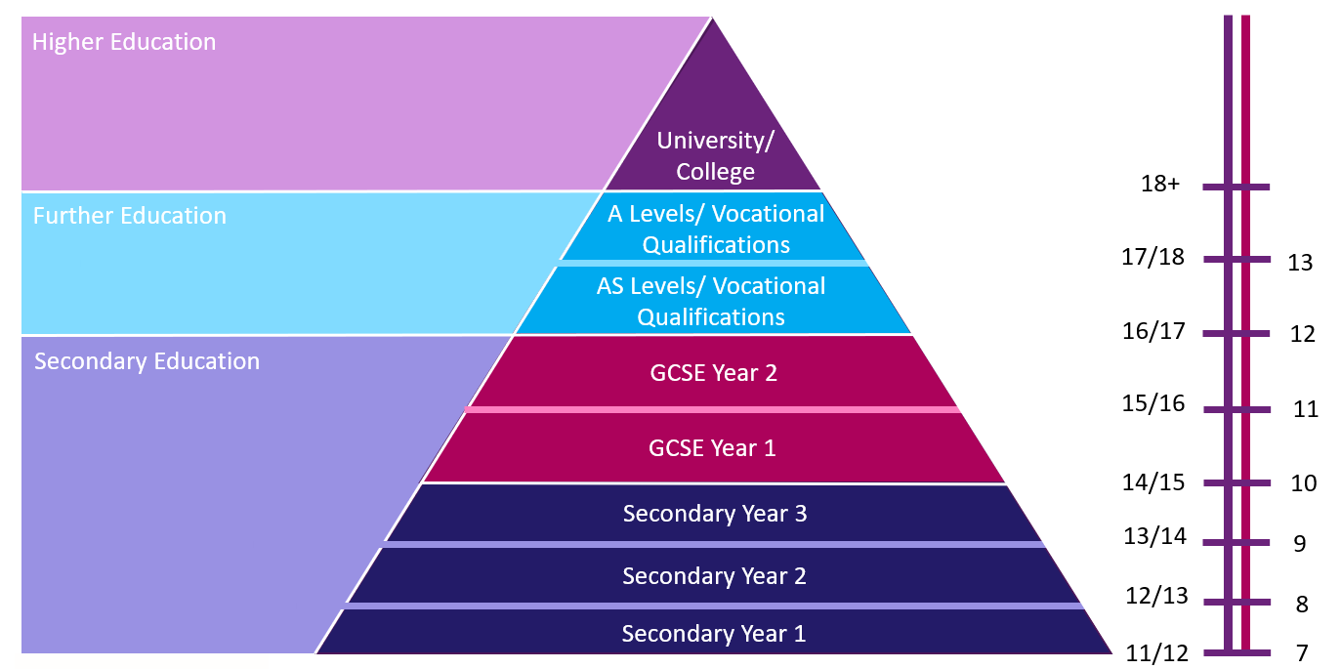
Level 4+
Education Pyramid
Level 3
Where are
you?
Level 1-2

Slide 6
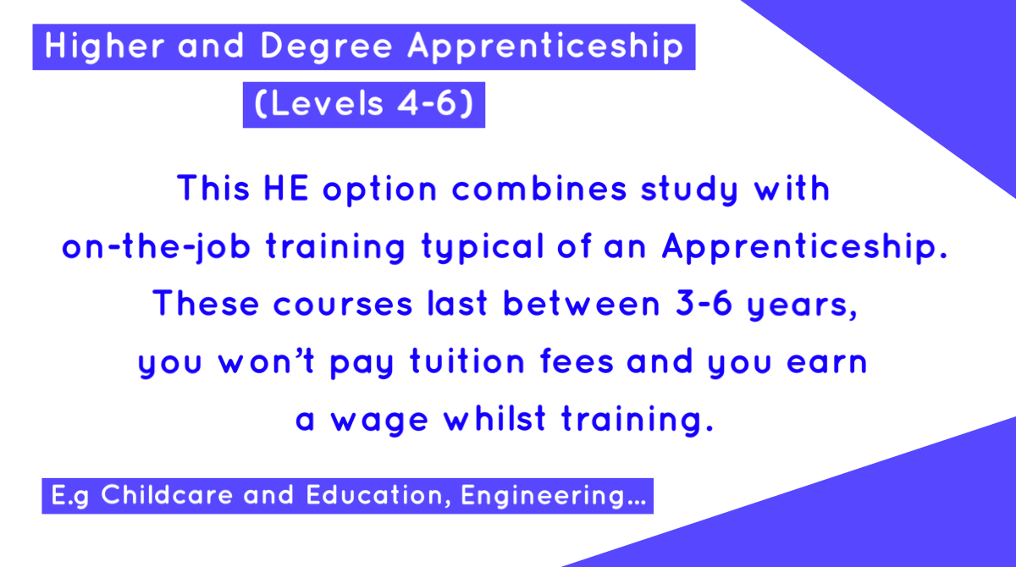
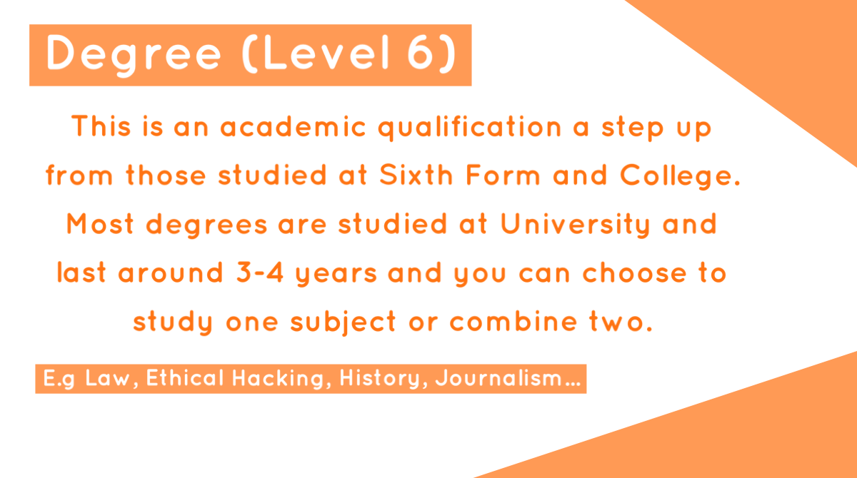
HE Qualification Flashcards

Slide 7
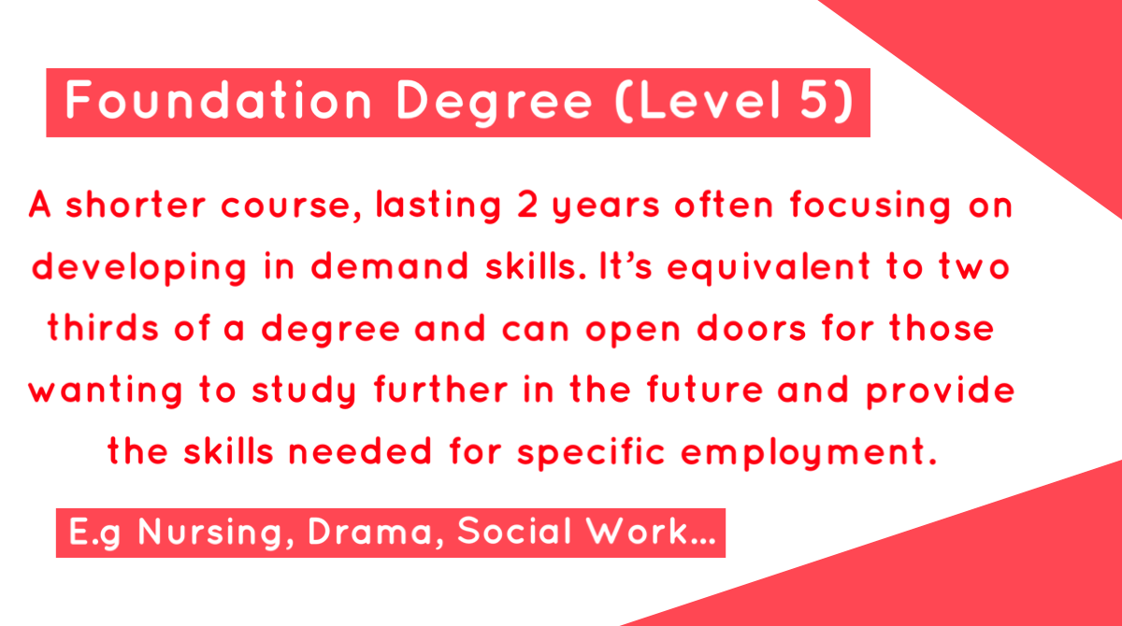

HE Qualification Flashcards

Slide 8


Case Studies
What did these real graduates study at university?

Slide 9
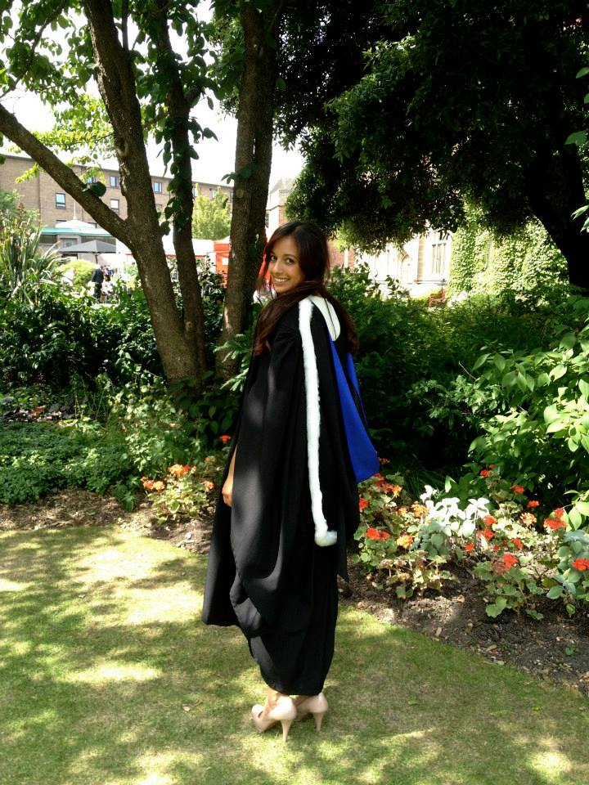

Alesha
Over the next few slides, you will see a graduate case study, just like this one!
Trainee Accountant
Communication
Team working
Initiative
Presentation skills
Networking
Confidence
Report writing
The case study includes the job they currently do,
Ready...
Steady...
GO!
the skills they use in that job,
and a picture of where they work OR to explain their job!
You need to work out what they studied at university from a list of degrees that will appear on this side of the slide!
Notes:
Biochemistry Degree - Newcastle University
Edelman clients - Snickers, Persil, Microsoft, Xbox, treseme, HP laptops
Spent time on business related modules

Slide 10
Alesha
Psychology – University of Leeds
Transferable skills: Skills you can use in multiple job roles e.g. teamwork, communication
Accountant: a person whose job is to keep or inspect financial accounts
Fine Art – University of Liverpool
Trainee Accountant
Lab Scientist Degree Apprenticeship - Manchester Metropolitan University
Communication
Team working
Initiative
Presentation skills
Networking
Confidence
Report writing
Civil Engineering – Newcastle University
English with Philosophy – University of Sheffield
Even though Alesha studied Civil Engineering, she is now a trainee accountant. Not everybody works in the field they studied in, but they are able to use the transferable skills they gained whilst studying HE in any career!
Finance – University of Leicester
Event Management – Sheffield Hallam University
Media and Communications - Birmingham City University
Notes:
Biochemistry Degree - Newcastle University
Edelman clients - Snickers, Persil, Microsoft, Xbox, treseme, HP laptops
Spent time on business related modules

Slide 11
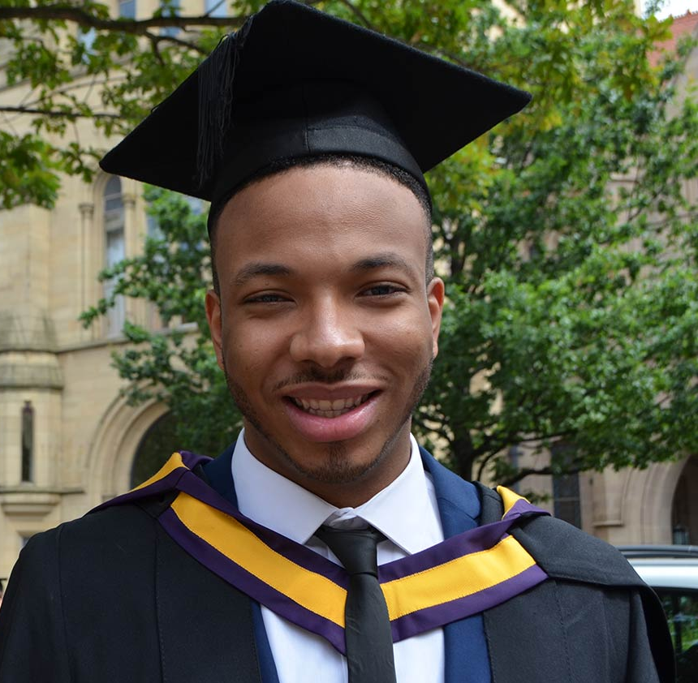

Maxwell
Psychology – University of Leeds
A production runner works on production sets, helping where they are needed. This may involve tidying the set, office administration, arranging transport, and a whole host of other duties. It is a very varied role!
Fine Art – University of Liverpool
Production Runner - Working on the BBC News broadcast
Lab Scientist Degree Apprenticeship - Manchester Metropolitan University
Camera operation
Creativity
Time management
Research skills
Confidence
IT Literacy
Civil Engineering – Newcastle University
English with Philosophy – University of Sheffield
Maxwell studied Media and Communications and is now working in media as a production runner. His degree relates directly to his career!
Finance – University of Leicester
Event Management – Sheffield Hallam University
Media and Communications - Birmingham City University
Notes:
Biochemistry Degree - Newcastle University
Edelman clients - Snickers, Persil, Microsoft, Xbox, treseme, HP laptops
Spent time on business related modules

Slide 12
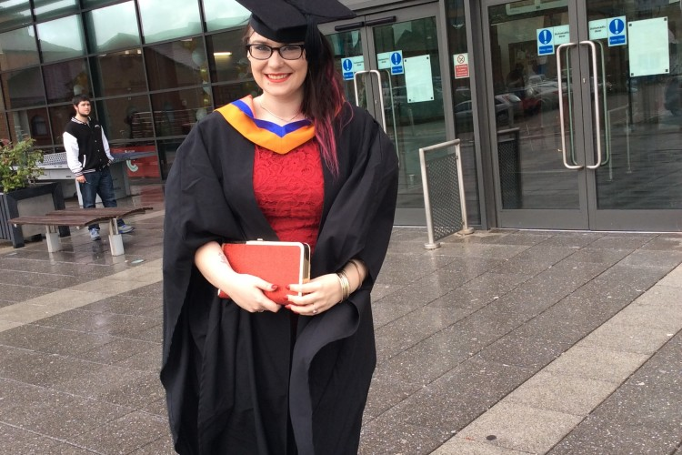

Jasmin
If you want to become a teacher you can do a degree related to teaching, or do any degree you like followed by a postgraduate teaching course!
Psychology – University of Leeds
Fine Art – University of Liverpool
Economics Teacher
Lab Scientist Degree Apprenticeship - Manchester Metropolitan University
Teaching experience
Core knowledge
Time management
Organisation
Confidence
Creativity
Presentation skills
Jasmin’s degree in finance relates to her job as an economics teacher. However, any degree can open the door to teaching!
Civil Engineering – Newcastle University
English with Philosophy – University of Sheffield
Finance – University of Leicester
Event Management – Sheffield Hallam University
Media and Communications - Birmingham City University
Notes:
Biochemistry Degree - Newcastle University
Edelman clients - Snickers, Persil, Microsoft, Xbox, treseme, HP laptops
Spent time on business related modules

Slide 13
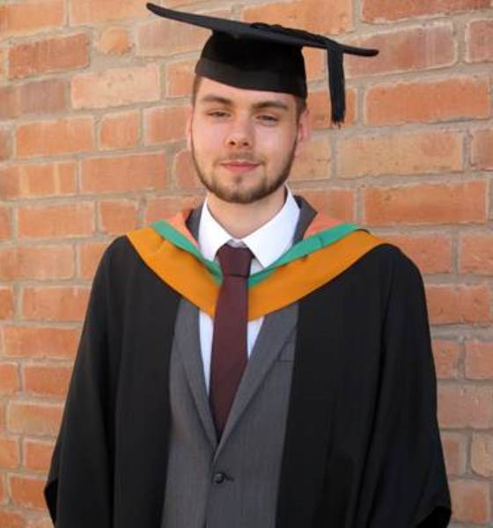

James
Psychology – University of Leeds
Fine Art – University of Liverpool
Freelance Web Developer
Lab Scientist Degree Apprenticeship - Manchester Metropolitan University
James’ degree does not relate directly to his job but, like Alesha, the skills he learnt whilst studying are used in his job to help him succeed!
Coding
Professionalism
Time management
Creativity and design
IT Literacy
Finance
Work to deadlines
Civil Engineering – Newcastle University
English with Philosophy – University of Sheffield
Finance – University of Leicester
A freelancer is self-employed and takes on contract work for different companies! For example, a freelance artist can be hired by someone to complete a piece of art for them.
Event Management – Sheffield Hallam University
Media and Communications - Birmingham City University
Notes:
Biochemistry Degree - Newcastle University
Edelman clients - Snickers, Persil, Microsoft, Xbox, treseme, HP laptops
Spent time on business related modules

Slide 14
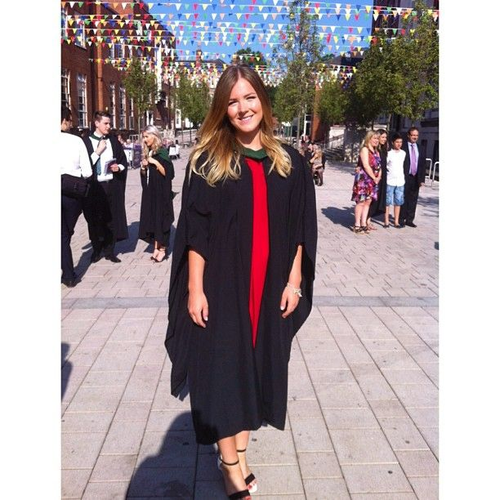

Rosie
Networking is particularly important in event management but is a useful skill in all jobs. It means being able to interact with others to exchange information and develop professional or social contacts.
Psychology – University of Leeds
Fine Art – University of Liverpool
Festival Promoter
Lab Scientist Degree Apprenticeship - Manchester Metropolitan University
Organisation
Professionalism
Time management
Core
knowledge
Confidence
Networking
Marketing
Civil Engineering – Newcastle University
Rosie’s degree is directly related to her job. Other related jobs may have included wedding planner, hotel manager, public relations officer!
English with Philosophy – University of Sheffield
Finance – University of Leicester
Event Management – Sheffield Hallam University
Media and Communications - Birmingham City University
Notes:
Biochemistry Degree - Newcastle University
Edelman clients - Snickers, Persil, Microsoft, Xbox, treseme, HP laptops
Spent time on business related modules

Slide 15
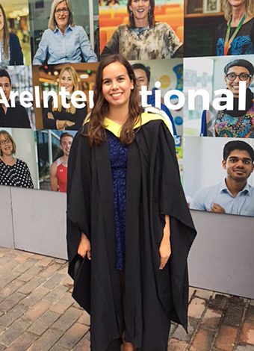

Mila
Psychology – University of Leeds
Internships allow graduates to gain practical experience in a professional setting!
Fine Art – University of Liverpool
Publishing Intern
Lab Scientist Degree Apprenticeship - Manchester Metropolitan University
Organisation
Professionalism
Time management
Written and verbal communication
IT proficiency
Proofreading
Civil Engineering – Newcastle University
English with Philosophy – University of Sheffield
Finance – University of Leicester
Mila studied two subjects at university, and both can be related to her job, but English is more closely related to her job!
Event Management – Sheffield Hallam University
Media and Communications - Birmingham City University
Notes:
Biochemistry Degree - Newcastle University
Edelman clients - Snickers, Persil, Microsoft, Xbox, treseme, HP laptops
Spent time on business related modules

Slide 16


Leo
Degree apprenticeships allow you to gain work experience alongside studying. You also earn a wage!
Psychology – University of Leeds
Fine Art – University of Liverpool
Research Technician
Lab Scientist Degree Apprenticeship - Manchester Metropolitan University
Communication
Team
working
Initiative
Report writing
Lab
experience
Technical Knowledge
Civil Engineering – Newcastle University
Leo may have been employed by the same company he trained with during his degree apprenticeship after he graduated! His work experience and training would have allowed him to make contacts with other professionals in the field.
English with Philosophy – University of Sheffield
Finance – University of Leicester
Event Management – Sheffield Hallam University
Media and Communications - Birmingham City University
Notes:
Biochemistry Degree - Newcastle University
Edelman clients - Snickers, Persil, Microsoft, Xbox, treseme, HP laptops
Spent time on business related modules

Slide 17


Eric
Psychology – University of Leeds
Fine Art – University of Liverpool
Gallery Manager
Lab Scientist Degree Apprenticeship - Manchester Metropolitan University
Eric’s degree relates to his job as a gallery manager. However, he could have also gone into related jobs such as an arts therapist, illustrator or graphic designer!
Communication
Team
working
Initiative
Networking
Confidence
Creativity
Civil Engineering – Newcastle University
English with Philosophy – University of Sheffield
Finance – University of Leicester
Artists don’t need formal qualifications to work in their field. However, studying a degree such as fine art means they have evidence of their skills and experience, and it can be a useful way to make contacts!
Event Management – Sheffield Hallam University
Media and Communications - Birmingham City University
Notes:
Biochemistry Degree - Newcastle University
Edelman clients - Snickers, Persil, Microsoft, Xbox, treseme, HP laptops
Spent time on business related modules

Slide 18
How can you get a higher education qualification?
The next slide will show you one potential route to a higher education qualification. You can take other routes but this is a common one!

Slide 19

GCSEs
English and Maths (Grade 4)
A Levels/BTECs
2-3 A Levels
Extracurricular
(optional)
Computer programming or coding experience
Information Technology Degree
May ask for 5 GCSEs
BTECs
Examples of relevant subjects: Maths, IT, psychology or sociology
Show interest in computing
e.g.
You need these to go onto the next stage in every route
English and Maths (Grade 4)
These may not always be linked directly to the subject you want to study, but can help demonstrate skills that you will need and use at HE e.g. teamwork
In information technology you can look at developing IT products and computer systems, in both theoretical and practical settings

Slide 20


What can you do with a degree?
Try to think of some different jobs that a person with a business studies degree may go into!
Some answers are on the next slide...

Slide 21




Human resources officer
Life coach
Marketing executive
TOP TIP!
If you’re not sure what any of the jobs are, look them up on prospects.ac.uk!
Lecturer
Data scientist
Stockbroker
Project manager
Business Studies
Risk manager
Operational researcher
Social media manager
Forensic accountant

Slide 22


What can you do with a degree?
Try to think of some different jobs that a person with a chemistry degree may go into!
Some answers are on the next slide...

Slide 23
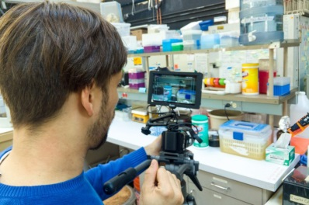




Researcher
Teacher
Chemical engineer
Pharmacologist
Forensic Scientist
TOP TIP!
If you’re not sure what any of the jobs are, look them up on prospects.ac.uk!
Lecturer
Chemistry
Healthcare scientist
Toxicologist
Science writer
Environmental consultant

Slide 24


What can you do with a degree?
Try to think of some different jobs that a person with a languages degree may go into!
Some answers are on the next slide...

Slide 25


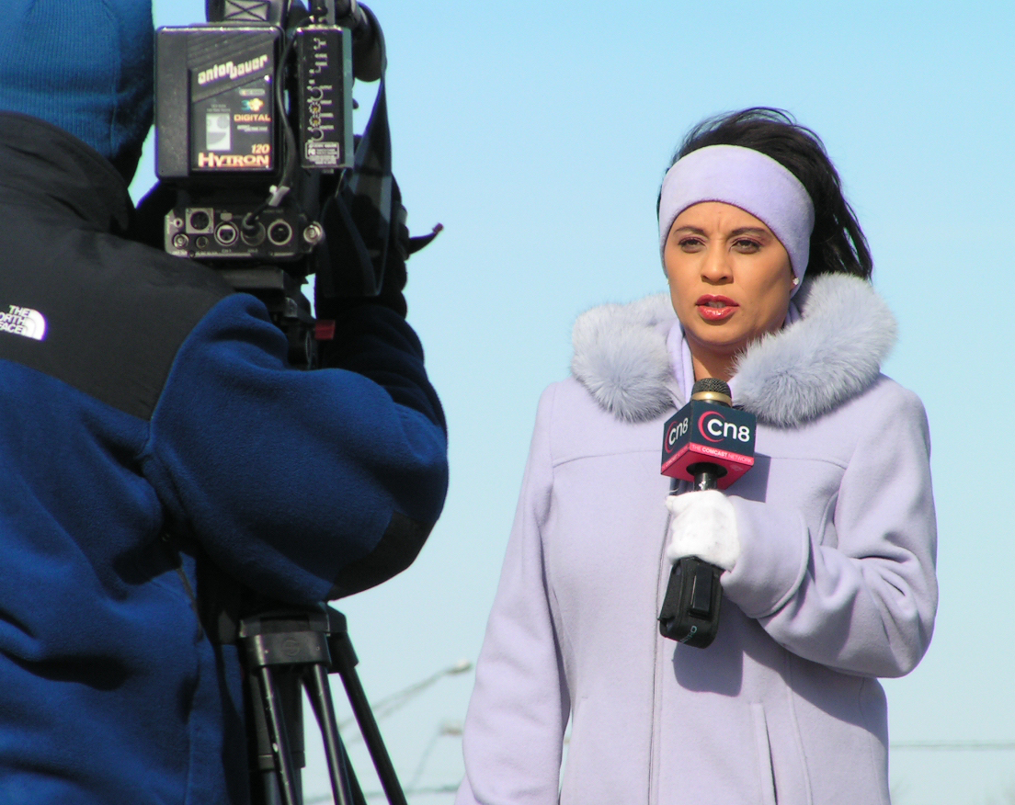

International aid worker
Diplomatic service officer
Distribution manager
TOP TIP!
If you’re not sure what any of the jobs are, look them up on prospects.ac.uk!
Detective
Languages
Interpreter
Government worker
Translator
Broadcast journalist
Tour manager
Teacher

Slide 26


What can you do with a degree?
Try to think of some different jobs that a person with a history degree may go into!
Some answers are on the next slide...

Slide 27
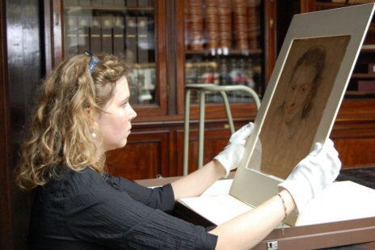
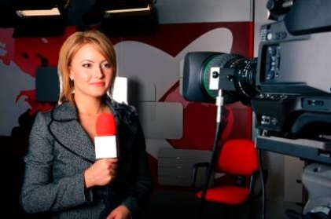
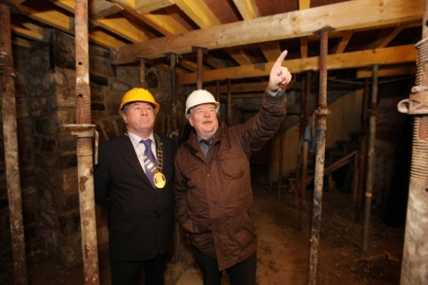

Broadcast
journalist
TOP TIP!
If you’re not sure what any of the jobs are, look them up on prospects.ac.uk!
Heritage manager
Politician
Events manager
Conservation officer
History
Teacher
Curator
Exhibition officer
Lecturer
Museum education officer

Slide 28
Summary
1.
Studying higher education will give you lots of transferable skills (skills that you can use in lots of different jobs/roles) e.g. problem solving
2.
Whatever you study at HE, there are lots of career options!
3.
There are lots of potential routes to HE, but you will always need to have English and Maths GCSE Grade 4, and some Level 3 qualifications. Extracurricular activities can also help show your interest and skills!
Next
steps?
If you know a job you might be interested in have a look on prospects.ac.uk to find out more about it and how to get there!
You can also research courses on ucas.com

Slide 29





Where next...
Ask!
Talk!
Research!
Follow!
About:
Life at university
Applying to courses
Student finance
Careers and skills
To:
Parents/ Guardians
Teachers
Careers advisors
At:
prospects.ac.uk
ucas.com
discoveruni.org.uk
heppsy/learners
On:
Twitter: @HeppSYbustour
Instagram: @heppsy_bus_tour
For updates, HE information and activities

