Slide 1
Applied Ethics: Utilitarianism
General Guidance
In an answer on utilitarianism, always write about Bentham’s utilitarianism. Write about the principle of utility and include the idea that the right action is decided on a case by case basis, depending on whether it produces the most happiness. It is worth exploring a range of scenarios, some in which the action could be right and others in which the action would be wrong, depending on the amount of happiness produced.
Include at least one other form of utilitarianism (either Mill or Singer). It is wise to write about Singer when writing about animals as he had a lot to say about animals.
Eating animals
For an act utilitarian, eating animals would be morally good if the happiness gained from participating in eating animals outweighs the pain caused. The fact that many humans gain pleasure from eating animals, suggests it is a good thing to do. On the other hand, the environmental impact of eating animals may suggest it doesn’t bring the most pleasure to the most number.
Moreover, Bentham did not only include humans in a consideration of maximizing pleasure, he famously said, “The question is not, ‘Can they reason?’ nor, ‘Can they talk?’ but, ‘Can they suffer?’” Simply put, all suffering creatures — human or not — are part of the group of morally relevant beings.
Thus, if the total pain (including pain suffered by animals) associated with acts of meat-eating were to outweigh the total pleasure associated with such acts, then Bentham would be forced to conclude that those instances of meat-eating were morally wrong.
However, it is important to remember that Bentham would always think about morality on a case by case basis. They would not make the statement that eating meat is always wrong. Meat-eating may be morally acceptable, for example, if a research scientist, close to curing cancer, needs to eat a healthy dog in order to survive long enough to pass his research on. On the other hand, eating a turkey burger produced cheaply and with much suffering to the animal may not be justifiable because the pleasure associated with consumption is so minimal.
Preference utilitarians seek to maximise the preferences of the most number. Actions should not be judged on their simple pain-and-pleasure outcomes, but on how they affect the preferences, of all beings involved. Singer argued through his argument from marginal cases that the preferences of any beings with consciousness should be taken into account. However, he believed animals do not have a conscious preference to stay alive, as they cannot conceive of non-existence. They do, however, have a conscious preference to avoid pain. This means painlessly killing animals is not wrong. However, most forms of farming cause suffering to animals, so it would be wrong to eat meat if we could gain our food in other ways. If farms treated animals well, however, there would be nothing wrong with eat animals.
Simulated Killing
For an act utilitarian, simulated killing would be morally good if the happiness gained from participating in simulated killing outweighs the pain caused. In this sense, such entertainments are not intrinsically wrong. These entertainments produce a lot of pleasure and are very popular. There are often secondary pleasures gained from engaging in them e.g. chatting with friends about the games. They are also part of successful industries that supply jobs, create wealth and advance technology. Video games can have beneficial effects in terms of motor skills. In the last twenty years, violent crime has decreased in the UK, whilst violent video games and films have boomed. This suggests that any causal link between video games and violence cannot be strong. On the other hand, violent films and games have been linked to increased antisocial behaviour, although there is other evidence that does not suggest a link. Too much time spent watching/ playing can have harmful effects on health in terms of a more sedentary lifestyle.
For Mill, such entertainments may be classed as lower pleasures, which, though still good, are of lower worth. Mill may argues that such pleasures appeal to our baser, animal side and not to our progressive, intellectual side. Mill also argued passionately that the secondary principle of liberty should play a central role in utilitarianism. We should all be free to pursue our own pleasure, as long as we do not harm others. This maximizes happiness in the long-term.

Slide 2
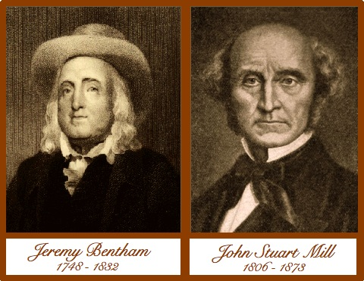
Applied Ethics: Utilitarianism
Stealing
For an act utilitarian, stealing would be morally good if the happiness gained from the theft outweighs the pain caused. For an act utilitarian, the end (happiness) can justify the means, even when the ‘means’ is illegal.
Theft, though, is generally regarded as wrong, as the pain caused to the victim far outweighs the pleasure gained by the thief. Also, stealing is usually illegal and people get upset when others break the law, so this adds to the total pain caused.
Having laws around property ownership makes us all feel more secure, and this this increases happiness. Because of the strong disapproval of law-breaking, the default position of an act utilitarian is that law-breaking is morally wrong. As stealing is illegal, if you are caught, you may well be punished, and this too adds to the pain in the world.
An act utilitarian might say stealing from the rich to give to the poor is a good act as it adds happiness to the world. However, oddly, were the thief to be caught, it would become a bad act, as the money might be reclaimed and the victim and the criminal will suffer. The moral worth of the act seems to depend on the thief getting away with it.
Rule utilitarians believe stealing is wrong, as in most situations stealing does not maximize happiness (for the reasons given above). A weak rule utilitarian believes the moral value of an act comes from its observance of the rule, However, they would be willing to break the rule ‘do not steal’ if stealing in this instance maximized happiness. A strong rule utilitarian believes it is always wrong to break a rule as long as the law is one which overall maximizes happiness.
Telling lies
For an act utilitarian, telling lies would be morally good if the happiness gained from telling a lie outweighs the pain caused. For an act utilitarian, the end (happiness) justifies the means.
Lying, though, is generally regarded as wrong, as in general people do not like being lied to. People want to be trusted and lying undermines this and weakens people’s general faith in humanity. Lying frequently causes hurt when discovered and lying often causes stress to the liar. For these reasons, lying has an inbuilt negative outcome, so the benefits of any ‘good’ need to outweigh these negatives.
Rule utilitarians believe lying is wrong, as telling the truth will generally maximize utility. So, for a strong rule utilitarian, it is always wrong to tell a lie (the moral value of an act depends on whether it is in accordance with the rule). A weak rule utilitarian would, in general, tell the truth, but occasionally lie if it was clear that lying would maximize happiness.
Preference utilitarians focus on whether a lie would satisfy more preferences. Most people have a preference to be told the truth, which further justifies the default position of truth-telling. However, there are times (e.g. do you like my new hair cut?) when the questioner may prefer to be lied to, in which case, lying is the right thing to do.
For an act utilitarian a lie that goes undiscovered (for example, having an affair) may cause no harm. However, for a preference utilitarian the lie would go against someone’s preference to be told the truth, regardless of whether the person finds out they are being lied to or not.
Key Term
Simulated killing:The dramatisation of killing in a fantasy setting, this can be in video games, films, the theatre

Slide 3
Applied Ethics: Kantian Ethics
General Guidance
In answering any question about Kant, always ensure you write about the two formulations of the categorical imperative, using key terminology:
1st Formulation: (universal law formulation), write about whether there is a:
Contradiction of conception (which leads to a perfect duty)
Contradiction of will (which leads to an imperfect duty)
Only refer to contradiction of will if there is no contradiction of conception.
2nd Formulation: (humanity formulation). Write about what it means to treat people as ends not means. Make reference to consent and autonomy.
Simulated Killing
Kant would first consider whether it is possible to universalize the maxim: ‘Engage with simulated killing when I want to be entertained.’ On the face of it, it is both conceivable and consistent to will this to be a universal law. This would make simulated killing morally permissible. However, Kant argued that we have an imperfect duty to cultivate compassionate feelings in ourselves. After all, we cannot consistently will things that make us less compassionate as we have all benefited from the compassion of others. So, if simulated killing makes us less compassionate, then we have an imperfect duty to not engage in it.
Kant would then consider whether simulated killing treats people as ends not means. He believed people should be treated as ends, by which he means that their autonomy should not be overridden. In the case of simulated killing, their autonomy is not overridden. The actors/ players choose to participate; the pixels on the screen are not real people; So long as it is not being broadcast publicly people choose to watch / participate. However, if simulated killing makes us less compassionate then it is not consistent with the humanity formulation.
The argument hinges on whether there is a causal connection between simulated killing and being less compassionate to humans. However the evidence is mixed. Although society has become less violent in the last twenty years, studies have shown that general empathy levels have decreased during this time. The cause of this is not clear and commentators are keener to suggest that wider societal changes in capitalism and parenting are bigger factors than films/video games. Moreover, even if a link were identified, correlation is not the same as causation.
Eating animals
In terms of the 2nd formulation of the categorical imperative, Kant would consider whether eating animals treats people as ends not means. As the focus is animals and not humans this question is irrelevant. He believed animals and humans differ in significant ways. He believed animals were driven by natural instincts, whereas reason enables human beings to transcend their animal instincts.
In terms of the first formulation, Kant would consider whether it is possible to universalize the maxim: ‘eat animals when I want to be fed.’ This does not break the law of contradiction, as I can conceive a world in which everyone ate meat. However, Kant would argue that it is not consistent to will this to be a universal law. Kant argued that we have an imperfect duty to cultivate compassionate feelings in ourselves. After all, we cannot consistently will things that make us less compassionate as we have all benefited from the compassion of others. So, if eating animals makes us less compassionate, then we have an imperfect duty to not engage in it.
The argument hinges on whether there is a causal connection between eating animals and being less compassionate to humans. Certainly, eating animals on its own, without killing the animal or being aware of how it is killed is unlikely to cultivate less compassionate feelings in others. This may rule out some particularly cruel farming methods, but only for the farmer. It would not be morally wrong for the consumer to eat the meat. Some research does show that those who are violent towards animals are more likely to be violent towards humans. However, establishing a link does not show that being cruel to animals causes the cruelty both to animals and humans.

Slide 4
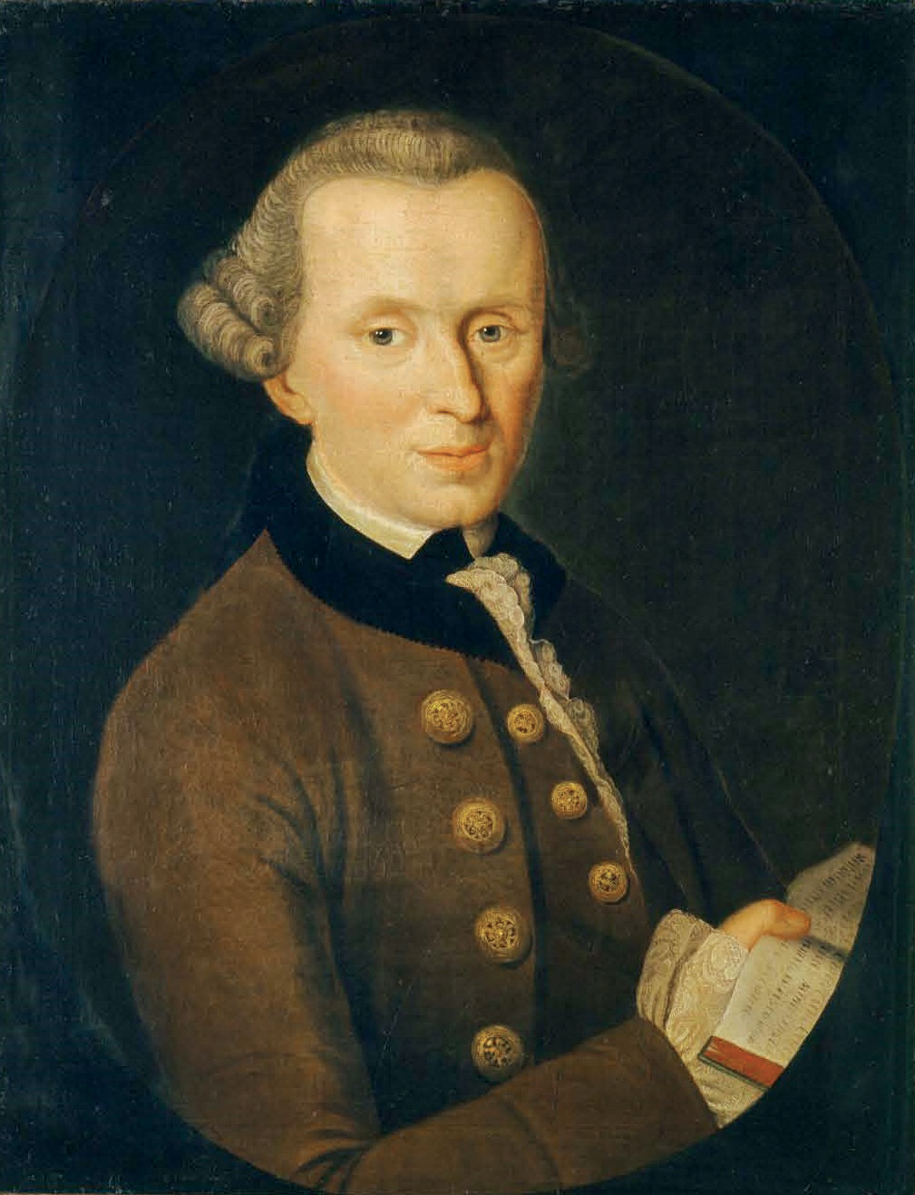
Applied Ethics: Kantian Ethics
Stealing
Kant would regard stealing as morally wrong in all situations. He believed this for the following reasons:
Firstly, it contradicted the first formulation of the categorical imperative (the universal law formulation). According to Kant, stealing is a contradiction in conception and so there is a perfect law not to steal. If everyone stole, the concept of property and ownership would break down, so stealing, as such, would not exist. In acting on this maxim you would be simultaneously willing that there is a world in which property (and so stealing) does exist and also a world in which property (and stealing) does not exist. It is therefore inconceivable to act on this maxim.
Secondly, it contradicts the second formulation of the categorical imperative (the humanity formulation) to treat people as ends not means. By stealing, you are bypassing the owner’s autonomy, so treating them as a means to an end.
Finally, Kant believed we should not seek ‘a state of nature’. This is a world without laws. He believed such a state is unsafe. We would lack freedoms and have no natural means of settling disputes other than violence. Instead, Kant believed we should seek to live in a civil society (‘a rightful condition’). We have laws which enable us to co-exist and we can settle disputes with reason, not violence. As rational beings we have a duty to seek to live in a rightful condition. If you choose to break the law and steal, you move society towards a state of nature. This cannot be consistently willed.
Telling lies
Kant would first consider whether it is possible to universalize the maxim: ‘tell lies to gain an advantage’. Kant argued that if everyone lied, then lies would not deceive. Thus, it is not conceivable to will a world in which there are no lies (as everything is deception), but also relying on the existence of lies. As a result, we have a perfect duty not to lie.
Kant also believed lying undermines the autonomy of the listener, as I cannot consent to be lied to. As such, it contradicts the second formulation of the categorical imperative: to treat people as ends not means.
Kant gave us the example of an axe wielding man. He claimed that should a man carrying an axe knock on your door demanding to know the location of your friend, you are obliged to tell him only the truth. There is, of course, no moral requirement to speak at all. You could simply stay quiet and so avoid lying. However, in Kant’s version he stipulated that you are forced to answer by the axeman.
Others might argue that we can universalise the maxim: ‘lie if it saves an innocent person’s life’. However, Kant says that maxims should be as general as possible.
Key Terms
State of nature: This is a world without laws. Kant believed such a state is unsafe. We would lack freedoms and have no natural means of settling disputes other than violence.
A civil society (‘a rightful condition’) This is a society based on laws which enable us to co-exist and settle disputes with reason, not violence. As rational beings we have a duty to seek to live in a rightful condition.

Slide 5
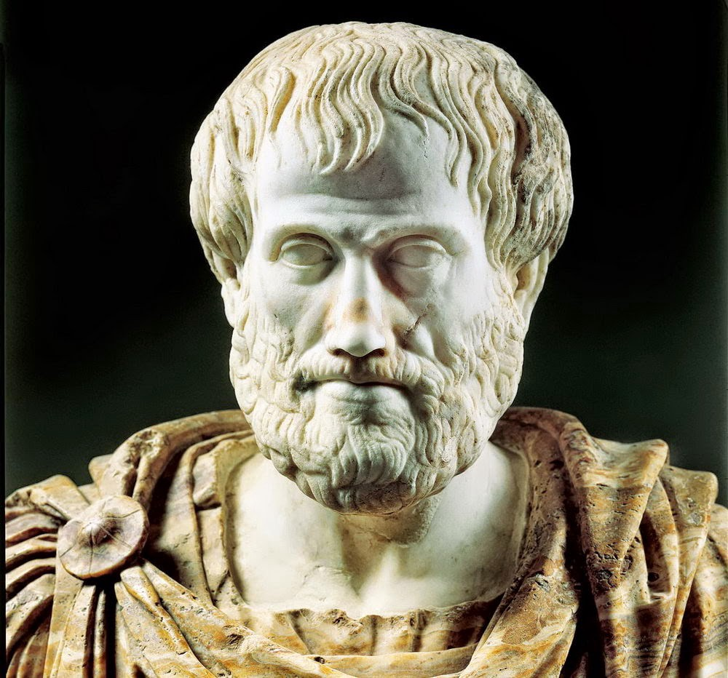
Applied Ethics: Aristotle
General Guidance
Aim to include key terminology in explaining Aristotle’s approach. In particular: mean, excess, deficiency, habitual, practical wisdom, virtue, vice
Aim to include more than perspective on virtue ethics. On the one hand… On the other hand…
Telling lies
In his analysis of truthfulness, Aristotle describes it as a mean between someone who boasts and someone who is too self-deprecating. Here Aristotle is thinking of ‘truthful’ about ourselves.
But when we are discussing the morality of lying we are usually interested in dishonesty when talking about the world.
He believed we flourish as a character if we are honest and we flourish together as a community if we are honest and can be trusted in the information of exchange and trusted in the promises we make.
Every day we should build our moral character by practising honesty and avoiding dishonesty and telling lies. Aristotle sees virtue as habits emerging from actions that are ‘voluntary’ (intended). If our understanding of the situation is based on lies, then it is more difficult to make an action that is voluntary.
On occasion, the right thing entails telling a lie. Practical wisdom will enable us to determine when the general rule can be bent or broken. The Kantian example of your neighbour the axe-murderer is easily solved by virtue ethics. In this situation, the virtuous thing is to tell a lie, so long as it doesn’t become a habit.
Stealing
In every action, Aristotle thought a virtuous person should consider the mean between excess and deficiency and believed we should judge the appropriate thing to do on a case-by-case basis.
However, in the case of stealing, Aristotle said that there is no right time for stealing. Theft is never in the mean. It contradicts one of Aristotle’s virtues of justice as it deprives other people of what is their fair share. As a result, stealing is never just.
A more modern virtue ethicist might address the issue of theft with more flexibility, however. they might be inspired by Aristotle’s comments that we should judge the appropriate thing to do on a case-by-case basis and that sometimes even the mean (appropriate) thing to do can be an extreme.
If we take the case of stealing in order to provide a loved one with much-needed medical treatment, they steal as an act of benevolence to help your loved one. However, a single action is not enough to judge whether you are benevolent – a virtue ethicist would want to know whether benevolence is part of your character, whether it is habitual. It is possible that they are acting benevolently in this case because it is their partner who is at risk, but generally they are thoughtless and inconsiderate.
A person’s honesty and thoughtfulness (consideration of those who would be affected by the theft) are competing with your disposition for benevolence. Partiality is accepted in virtue ethics, but should it outweigh consideration of other people in the community? They may have to utilize practical wisdom to avoid needing to steal.

Slide 6
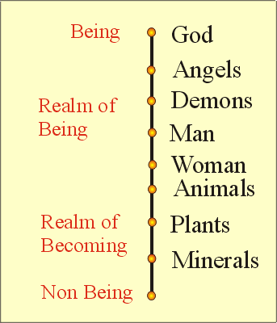
Applied Ethics: Aristotle
Eating animals
In every action, Aristotle thought a virtuous person should consider the mean between excess and deficiency and believed we should judge the appropriate thing to do on a case-by-case basis.
In the case of eating animals, however, his answer is quite straightforward. Although he recognized a continuum between humans and other animals (like animals we grow, eat and perceive, unlike animals we have the capacity for reason and virtue. So, in his hierarchy of living things, he places humans above other animals and argued that, “plants exist for the sake of animals, and other animals for the good of humans… for our service and food.”
A more modern virtue ethicist, Hursthouse, argues that the practice of factory farming is cruel and our failure to show compassion in this case is a vice, as is this greed behind it. So, for Hursthouse, eating factory-farmed animals is not a virtue.
Simulated Killing
In every action, Aristotle thought a virtuous person should consider the mean between excess and deficiency and believed we should judge the appropriate thing to do on a case-by-case basis.
In some ways, we might imagine that watching characters die on screen or on stage does not develop courage. In real life (e.g. in war) courage is needed to kill enemies. In video games, however, courage is not required. Maybe martial arts or sport might better develop courage and self-discipline.
However, Aristotle wrote that watching a tragedy is cathartic for the audience. Emotions in the audience build up throughout the play until there is a climatic scene triggering a cathartic release and the emotion is gone. This safe ‘cleansing’ of negative emotions is seen by Aristotle as part of the education of our character. By watching tragedy and killings on stage/screen we can practice feeling the right emotion, at the right time and so help the development of virtue.
Other virtue ethicists, however, might argue that playing and enjoying violent video games is morally problematic. As computer games have become more realistic, the possibilities for simulated killing have become more graphic, more numerous and for many people, more upsetting. They might argue that the approaches of Kant and utilitarianism are inadequate, as they only focus on the real-world impact of simulated killing, rather than the impact of such activity on one’s character. In virtue ethics, building a virtuous character requires careful cultivation and the habitual, cruel or callous behavior of killing in video games moves people away from virtue, not towards it.
Aristotle’s hierarchy of being
Key Term
Cathartic: providing psychological relief through the open expression of strong emotions

