Slide 1
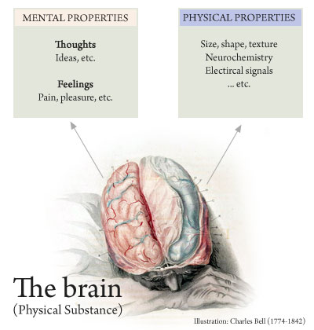
Property Dualism
What you need to know:
There are at least some mental properties that are neither reducible to nor supervenient upon physical properties.
The ‘philosophical zombies’ argument for property dualism (David Chalmers).
Responses including:
a 'philosophical zombie'/a 'zombie' world is not conceivable
what is conceivable may not be metaphysically possible
what is metaphysically possible tells us nothing about the actual world.
The ‘knowledge/Mary’ argument for property dualism (Frank Jackson).
Responses including:
Mary does not gain new propositional knowledge but does gain ability knowledge (the 'ability knowledge' response).
Mary does not gain new propositional knowledge but does gain acquaintance knowledge (the ‘acquaintance knowledge’ response).
Mary gains new propositional knowledge, but this is knowledge of physical facts that she already knew in a different way (the ‘New Knowledge / Old Fact’ response).
Possible Exam Questions
What is meant by property dualism? (3 marks)
What is the difference between substance dualism and property dualism? (3 marks)
What is a philosophical zombie? (3 marks)
Briefly explain the philosophical zombie argument for property dualism. (5 marks)
Briefly outline Chalmer’s ‘philosophical zombies’ argument for property dualism and the issues related to it. (12 marks)
Outline the ‘knowledge’/Mary argument for property dualism. (5 marks)
Briefly outline Jackson’s Mary ‘knowledge’ argument for property dualism based on qualia and the issues related to it. (12 marks)
Are property dualists right to say that at least some mental states are irreducible to physical properties? (25 marks)
Key terms
Property dualism: the claim that humans are composed of just one kind of substance (i.e. matter), but that this substance contains both mental and physical properties. Mental states cannot be reduced to nor our supervenient upon physical states.
Philosophical Zombie: A physical duplicate of a human being, but which has no conscious feelings or experiences.
Propositional knowledge: knowledge of facts and can be expressed in propositions. Knowledge that such and such is the case.
Ability knowledge: knowledge of how to do things, such as ride a bike.
Acquaintance knowledge: knowledge that comes form encountering or experiencing something.
Supervenient: If something supervenes on something else, then it is dependent on that thing

Slide 2
Property Dualism
The Philosophical Zombies Argument for Property Dualism
The Philosophical Zombies argument is an argument against physicalism and in support of property dualism.
P1: Physicalism claims that mental states are ultimately material and are not distinct from the body
P2: However, philosophical zombies are conceivable. PZ are physical duplicates of human beings, but without conscious feelings or experiences.
P3: If something is conceivable, then it is possible.
C1: Philosophical Zombies are possible
P3: If philosophical zombies are possible, mental states can exist independently of brain states.
C: Therefore, mental states are not identical to brain states and physicalism is false
Evaluation of Mary/Knowledge Argument
Acquaintance knowledge response
This objection claims that the knowledge argument confuses two types of knowledge: propositional knowledge and acquaintance knowledge
P1 is true of Mary’s propositional knowledge
P2 is true of her acquaintance knowledge
So C1 doesn’t follow: a complete physical account really does exhaust all the propositional knowledge about colour vision. On leaving the room, Mary has become acquainted with the phenomenal character of colour vision (the qualia), but this new knowledge is not knowledge of new facts.
The ability knowledge response
This objection claims that the knowledge argument confuses two types of knowledge: propositional knowledge and ability knowledge
When Mary leaves the room, she acquires new abilities e.g she knows how to recognise ripe tomatoes by sight.
But new ability knowledge doesn’t mean she has learned any new facts about colour vision. Thus, she gains no new knowledge on leaving the room.
The new knowledge/old facts response
This objection claims that Mary does not gain any new knowledge on leaving the room, but learns the same facts in a different way.
On leaving the room Mary acquires new concepts. This means she can describe the processes of colour vision using concepts she didn’t possess before leaving the room. This represents a difference in the way the same facts are presented. However, Mary does not learn new facts on leaving the room.
The Mary/Knowledge Argument for Property Dualism
Mary, the colour scientist, knows all the physical facts about colour. However, she has been confined from birth to a room that is black and white, and is only allowed to observe the outside world through a black and white monitor. When she is allowed to leave the room, it must be admitted that she learns something about the colour red the first time she sees it — specifically, she learns what it is like to see that colour.
P1:Mary knows everything about the physical processes involved in colour vision
P2: But she learns something new when she experiences colour vision herself
C1: Therefore there is more to know about colour vision than what is given in a complete physical account of it.
C2: So physicalism is false

Slide 3
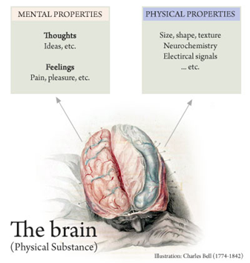
Property Dualism
Evaluation of Philosophical Zombies Argument
A 'philosophical zombie'/a 'zombie' world is not conceivable
P1: According to physicalists, all mental states are reduced to or supervene upon physical states.
P2: Philosophical zombies are physically identical to humans, but without consciousness
P3: However, as all mental states are physical (P1) then a physically identical human will have consciousness. It is like saying, ‘imagine something that is physically identical but not physically identical, which is a contradiction in terms.
C: Philosophical zombies are not conceivable.
What is conceivable may not be metaphysically possible
Putnam gives the example of water: Is it possible to imagine something just like water (transparent liquid, behaves like water) but has a different chemical composition (not H2O)? After all, before we knew the molecular composition of water, people would have surmised that it had a different composition. There is nothing in the idea of water that means it has to be H2O. However, given that water is H2O, there is no possible world in which the stuff composed of H2O is not water.
In the same way, we can conceive of philosophical zombies (i.e. physical duplicates of humans without consciousness). They are logically possible. But if consciousness is something physical, then there can be no possible world in which philosophical zombies exist (i.e. in which physical duplicates of humans exist without consciousness)
What is metaphysically possible tells us nothing about the actual world.
We might concede that there may be some possible worlds containing philosophical zombies, but in the actual world the natural laws are such as to make zombies an impossibility here.

