Slide 1
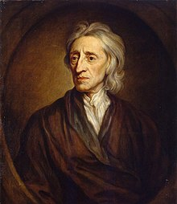
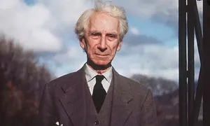
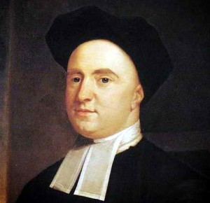
Perception
What you need to know:
Direct realism:
The immediate objects of perception are mind-independent objects and their properties
Issues including:
the argument from illusion
the argument from perceptual variation
the argument from hallucination
the time-lag argument
and responses to these issues.
Indirect realism
The immediate objects of perception are mind-dependent objects (sense-data) that are caused by and represent mind-independent objects.
John Locke's primary/secondary quality distinction.
Issues including:
the argument that it leads to scepticism about the existence of mind-independent objects. Responses including:
Locke's argument from the involuntary nature of our experience
the argument from the coherence of various kinds of experience, as developed by Locke and Catharine Trotter Cockburn.
Bertrand Russell's response that the external world is the 'best hypothesis'
the argument from George Berkeley that we cannot know the nature of mind-independent objects because mind-dependent ideas cannot be like mind-independent objects.
Berkeley's Idealism
The immediate objects of perception (i.e. ordinary objects such as tables, chairs, etc.) are mind-dependent objects.
Arguments for idealism including Berkeley's attack on the primary/secondary quality distinction and his 'Master' argument.
Issues including:
arguments from illusion and hallucination
idealism leads to solipsism
problems with the role played by God in Berkeley's Idealism (including how can Berkeley claim that our ideas exist within God's mind given that he believes that God cannot feel pain or have sensations?)
and responses to these issues.
Key terms
Hallucination | A non– veridical perceptual experience that is not coherently connected with the rest of our perceptual experience.
Illusion | A distortion of sense experience that means what we perceive is different from what exists.
Immediate objects of perception | What we are directly aware of in perception, which may be physical objects or sensations of these.
Mind- dependent | Depending on a mind for existence or definition.
Mind- independent | Not depending on a mind for existence or definition.
Perception | Awareness of apparently external objects through use of the senses
Perceptual variation | Different people perceive the same physical object differently.
Primary quality | Properties that are ‘utterly inseparable’ from the objects, whatever changes it goes through.
Property | An attribute or characteristic of an object.
Secondary quality | Properties that physical objects have that are ‘nothing but powers to produce various sensations in us’.
Sense data | Mental images or representations of what is perceived.
Solipsism | The view that only oneself, one’s mind, exists.
Veridical | A proposition that is true or an experience that represents the world as it actually is.

Slide 2
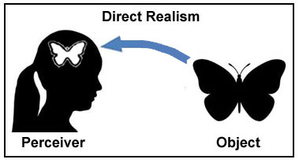
Direct Realism
Support for Direct Realism
What is it?
DR links to common-sense. Russell says we should accept common-sense.
It avoids scepticism, gives us a clear account of how we come to have knowledge of the world, because our senses provide immediate access to its true nature.
If it is true then it explains why I am able to do a whole range of practical actions on a daily basis, for example, find food that I need to survive.
It explains why I perceive what I do. I see a tree as green because the tree is green. My perception of the tree is predictable and regular because there is a real tree that exists beyond my mind, I have no control over what I see when I open my eyes because there really is a mind-independent reality.
It explains why we agree with others about what we perceive, as we occupy the same world as everyone else, therefore, there is a high chance that there will be agreement about what people perceive.
There are only two things in perception: the person perceiving an object and the object itself. There is no third thing mediating between the two.
Direct realism rejects therefore, the notion of sense data (indirect realism).
We immediately perceive physical objects, when we perceive the world we are directly aware of the objects themselves, (no sense data).
How we perceive physical objects
Physical objects are mind independent, this is a realist view as it means that objects exist outside of our minds, so if you close your eyes, it does not cease to exist.
Senses detect properties of objects e.g. colour, shapes etc. which exist in the world, therefore, it is also properties of objects which exist mind-independently.
Objects retain their properties when unperceived, so if you leave an apple in a drawer and forget about it, it remains round, hard, crisp, red, retaining its flavour and smell. When a tree falls in a forest and there is no one there to hear it, it still makes a sound.

Slide 3
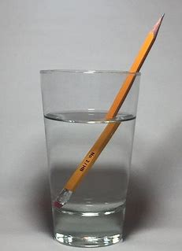
DIRECT REALISM Argument from illusion and hallucination: Criticisms and responses
Illusions
Senses can be subject to illusions, our senses become distorted and so the true nature of physical reality is not the same as what is actually out there in the world. When looking at a straw at a certain angle in water, it appears broken, or bent. We are therefore, directly aware of the bent-looking straw and cannot doubt that this is the way it appears to us, yet, we can also know that the real straw is not broken or bent. If the world appears to us like it can in illusions, then we must conclude that the immediate objects of perception cannot be material objects
P1: We perceive something having property e.g. the straw appears to be bent.
P2: Perceiver is directly aware of the property.
P3: But, the object does not have this property in reality.
C1; So what the perceiver is directly aware of (the bent straw) and what is real (the straight straw) are distinct.
C2: So direct realism is false, we do not perceive physical objects directly.
Response
Direct realists may claim that I am not directly aware of anything distinct from the physical object, as I am still perceiving a physical object.
I am not immediately aware of the straws appearance, as we are directly aware of the real straw and it not being bent. It only appears bent due to the light and angle of which a person perceives it. There is no mediation between the straw and my perception of it.
So objects can appear differently because of the way they relate to the perceiver, therefore there is no need for sense data.
Indirect realists are wrong when they talk about appearance and sense data, as these things are directly observed.
Argument from hallucination
Hallucinations occur when a person perceives something which isn’t actually there, and they cannot distinguish between their hallucination from a truthful perception (veridical one).
If a hallucination and veridical perception are indistinguishable, this must mean they are both in the mind.
So during veridical perception, we are directly perceiving sense data in the mind, we perceive the material world indirectly.
P1: Hallucinations occur when someone perceives something which does not exist outside of the mind.
C: So what they perceive, the hallucination, exists only in their mind.
P2: Hallucinations can be subjectively indistinguishable from veridical perceptions.
P3: But if hallucinations and veridical perceptions are indistinguishable then the person must be aware of something in both cases.
C2: So, from C1, P2 and P3, what they are directly aware of during veridical perceptions must also be in the mind.
C3: Hence we perceive the world indirectly and direct realism is false.
Response
Just because they may be indistinguishable from veridical perceptions, does not show that they are the same phenomenon in reality.
Hallucinations, rather being caused by a physical object impacting on our sense organs, hallucinations are produced by some sort of malfunction in the brain.
Hallucinations and veridical perceptions are not identical phenomena, even if they are indistinguishable to the person subject to them, it does not follow from the fact that hallucinations occur in the mind that veridical perceptions involve a purely mental element.

Slide 4
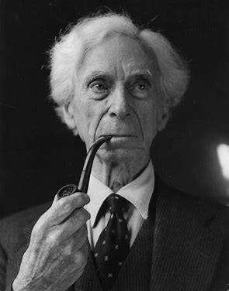
DIRECT REALISM Argument from perceptual variation and responses
Perceptual variation
The appearance of physical objects can vary depending on the conditions in which they are perceived.
Russell’s table example
A table can appear different colours due to light reflecting off of it. Therefore, the table cannot be said to have a particular colour.
The shape can also vary depending on the angle from which I perceive it. Since the table does not change shape, we must distinguish the real table from the one appearing in our minds. Russell says the table is not known to us immediately, but is an inference from what is immediately known to us via our perception.
P1: DR immediate objects of perception are material objects and their properties.
P2: But, the appearance of physical objects when perceived can vary.
P3: The properties of the objects themselves do not vary.
C: So DR is false, the apparent properties are not the same as the real properties of physical objects.
Therefore, the immediate objects of perception are appearances or sense data, so we do not perceive the world directly. As we must infer the existence and the real properties of objects on the direct acquaintance with sense data.
Berkeley's example
If you place one hot hand and one cold hand into a bowl of lukewarm water the water will appear cold to one and hot to the other. He uses this example to show that it is absurd for realists to claim that the perceived qualities exist in matter as they are perceived.
P1: DR claims material objects possess mind-independent properties (such as heat/cold, tastes, smells and colours) which we directly perceive.
P2: But, material objects are perceived to have incompatible properties (for example, cold and hot at the same time).
P3: They cannot possess incompatible properties in reality as it is contradictory.
C; Therefore, DR is false, material objects do not possess such properties.
Russell denying that objects have real properties, as we do not perceive them directly as they are, but Berkeley's conclusion is that the perceived qualities of objects are in the mind, rather than the object.
Response
DR can accept that objects may appear differently to perceivers, but, insist that they are nonetheless directly perceived. Water can appear cold to a perceiver even if it is lukewarm, this does not mean it is not directly perceived.
We have agreed methods for determining the correct temperature of the water or colour of the table. We rarely find ourselves in disagreements about such things, if we are in any doubt, then we can move around the table to avoid any glare to tell the real colour of the table.
We can explain why the colour of the table can vary, this is due to the reflection of light from its surface, also, the water feels warm or cold as this is relative to the temperature of our hands to that of the water.

Slide 5
DIRECT REALISM time-lag argument and responses
Time-lag argument
Light from the sun takes a certain amount of time to travel to Earth, about 8 mins.
So when we look at the sun, we are not seeing the sun as it is now, but as it was 8 mins ago.
So what we are seeing is sense data caused in you by the Sun’s light impacting on your visual system, and not the sun itself.
What is true of distant objects is no less true of objects close to you, it’s just that the time-lag is far shorter.
So we can generalise and say that the immediate objects of perception are sense data, and our perception of all physical objects is indirect.
P1: The light from distant objects (such as the sun) takes time to reach our eyes.
C1: So what we are seeing now may no longer exist.
C2:: so what we are seeing and what is there are different
P2: This is no less true for physical objects at any distance.
C3: And so, what we directly see are appearances not the physical objects, and direct realism is false.
Response
The time-lag does not mean we are seeing objects indirectly, it just means that we are seeing them as they were.
These process of mediation are not sense data and none of this implies that we are directly aware of sense data or that we must use sense data to infer the existence of objects.
Instead once we become aware of an object we are aware of the object itself.

Slide 6
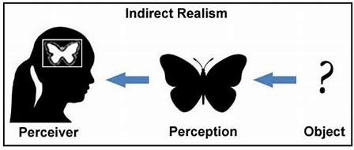
Indirect Realism
What is it?
Locke Primary and secondary qualities
Due to the criticisms of direct realism, many philosophers embrace indirect realism.
It is a realist theory, so maintains the belief that material objects exist independently of the mind.
But, there is a distinction between the reality of these objects and the way they appear.
3 elements in perception 1: the perceiver. 2: the real object. 3: the appearance of the object/s to the perceiver.
We are directly aware of appearances, which Locke terms ideas and Russell, sense data. These are representations of reality.
We infer, on the basis of sense data, the nature of reality, due to this inference, perception is indirect.
Locke: ideas = what the mind perceives in itself, the immediate objects of perception, thought, or understanding is what Locke calls ‘ideas’.
Qualities = the power to produce any idea in our mind
Primary qualities = Real properties are primary qualities, when I look at a tree, my sense data of its size, shape position and motion.
Secondary qualities = such as colour, taste and sound do not correspond directly to the object as these qualities are produced by my mind as they produce a sensation within us or an idea within us.
Primary qualities are inseparable from the object, its parts remain the same no matter if we divide, pound an object, its parts must retain some shape, size, position and so on, even if we can no longer see the parts as without these qualities it would not be material at all.
So primary qualities must be essential to material objects and are retained by them whether or not they are perceived.
Secondary qualities do alter and vanish when not being perceived. Odours are only visible in light and change depending on the light. A pounded almond changes its colour and taste
If we block our noses, or eyes, or do not put an object in our mouths, then it will not make a sound or have any odour or taste.
Secondary qualities depend on the primary qualities and require a mind to appear and so are not in the object themselves as we perceive them.
REMEMBER THE HAND IN THE LUKEWARM WATER EXAMPLE AS THIS EXPLAINS LOCKE’S VIEW AS DOES PERCEPTUAL VARIATION.
Support for Indirect Realism
Criticism of Locke's Primary and secondary qualities
1: It accounts for perceptual variation, illusions, hallucinations, and time-lag.
2: What we directly perceive need not be an accurate representation of reality.
3: Perceptual variations can occur while the real object remains unchanged.
4:Illusions occur when there is no real object corresponding to our sense data, and the time-lag can be explained because what I immediately aware of is not the same as what is really there, so strengths over Direct Realism.
Locke’s examples show that primary and secondary qualities can change.
When an almond is pounded, the shape, taste, smell and colour change. So if change is supposed to show that a quality is secondary , then by Locke's logic we should regard the shape and size of the pieces of almond as mind-dependent.
If secondary qualities depend on the texture of the almond, this does not show that they are purely mind-dependent.
P1: certain properties disappear if we block our senses.
C: So these qualities depend on our sense organs and do not exist as perceived in reality.
But, if we close our eyes, both the primary and secondary qualities disappear.
We can handle objects to feel their shapes, but if we let go then these sense experiences stop, so it looks like primary qualities behave the same as secondary qualities.

Slide 7
Issues with Indirect Realism and responses
Scepticism about the existence of mind-independent objects
The external world is the best hypothesis (RUSSELL).
We must infer the existence of objects beyond the mind, as we are only aware of sense data.
Our senses can deceive us.
Our sense data does not correspond with any material reality, e.g. if I am a brain in a vat, or the Cartesian Demon is deceiving me.
These show that the inferences are not valid, therefore, not sufficient for knowledge.
Since we cannot directly observe reality, we cannot know it exists (THE VEIL OF PERCEPTION) our sense data creates a veil between us and reality which we cannot remove/penetrate to discover the material world.
Russell accepts that no deductive proof of the nature of a material reality is possible.
But, he believes that scepticism can be resisted and offers his best hypothesis or explanation.
His argument is that we have an instinctive belief in the existence of a material reality which corresponds with our sense data, therefore, we should only reject such beliefs if they prove to be incoherent.
So, Russell is putting the issue back onto the sceptic by asking for proof of why believing in a material reality is wrong.
His argument makes good sense of our experiences, it explains why our sense data appear in regular and predictable ways, as Locke pointed out.
RUSSELL’S CAT EXAMPLE: If the cat appears at one moment in one part of the room, and at another in another part, it is natural to suppose that it has moved from the one to the other. But if it is merely a set of sense-data, it cannot have ever been in any place where I did not see it; thus we shall have to suppose that it did not exist at all while I was not looking, but suddenly sprang into being in a new place. If the cat exists whether I see it or not, we can understand from our own experience how it gets hungry between one meal and the next; but if it does not exist when I am not seeing it, it seems odd that appetite should grow during non-existence as fast as during existence. And if the cat consists only of sense-data, it cannot be hungry, since no hunger but my own can be a sense-datum to me. Thus the behaviour of the sense-data which represent the cat to me, though it seems quite natural when regarded as an expression of hunger, becomes utterly inexplicable when regarded as mere movements and changes of patches of colour.
Response to the issue of the existence of mind-independent objects
Involuntary nature of our experience (LOCKE)
We are not in control of our sense data.
Sense data does not come from me.
Therefore the source of it must be external (outside of me).
The coherence of various kinds of experience (LOCKE and COCKBURN)
ISSUE: Ideas cannot be like material objects (BERKELEY)
Our different senses cohere with each other.
We can see a fire and feel a fire.
We can hear and see a bus moving.
Cockburn says we learn to associate the way objects feel to the touch and the way they appear to the eye. I can predict how things may look just by touching them.
The senses offer support for each others testimony, so there is one external cause for both of them.
Locke knows this is not a deductive, valid argument, as just because our senses cohere does not mean that they must be caused by material objects, e.g. dreams do not correspond to a material reality, yet I can feel, hear and see objects. But, Locke hopes his argument for the existence of material objects is reasonable enough and the best explanation for our experiences.
Berkeley argues that Russell’s view is an incoherent one.
All sense data including primary qualities are mind-dependent.
We only have awareness of our own sense data.
The qualities we perceive in objects require a perceiving mind to exist. Since matter is said to be unperceiving, it cannot have such properties.
P1: My idea of a tree has certain sensible qualities, green, tree shaped etc.
P2: But, these sensible qualities depend on the mind.
P3: To say that my idea of a tree resembles the real material tree is like saying something visible can resemble something invisible.
P4: Ideas are changing, whereas material objects are supposed to be permanent and unchanging.
C1: Anything outside of the mind, like matter, cannot have any such qualities.
C2: A supposed material object could not be like or resemble my idea of it.

Slide 8
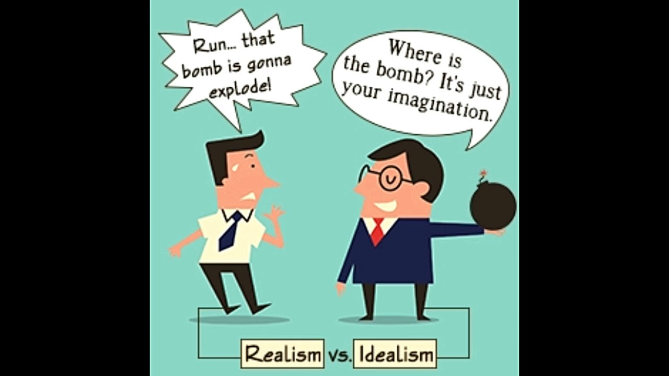
Idealism: Berkeley
What is it?
Berkeley’s attack on the primary and secondary qualities distinction
All that exists are minds and their ideas.
Physical objects therefore do not exist independently of being perceived. They are no more than collections of ideas or sense data appearing in minds.
Berkeley argues that the universe is sustained in existence through being perceived by the infinite mind of God.
God directly causes our ideas or sense data.
Both P and S qualities do not resemble anything beyond the mind.
We can conceive of an object without secondary qualities and therefore these too must be essential to our idea of an object.
Try to imagine an object with only the primary qualities. When we try to do this, we imagine it with colour, therefore we cannot distinguish between primary and secondary qualities, both are equally mind-dependent.
P1: It is impossible to imagine an object with just P qualities.
C1: so our ideas of secondary qualities of an object cannot be separated from those of its primary qualities.
C2: So they must exist together.
P2: Indirect realists accept that our ideas of secondary qualities are mind-dependent.
C3: So our ideas of primary qualities are also mind-dependent.
Perceptual variation for Berkeley shows that P and s qualities are not distinguishable. As shape, size and movement are subject to perceptual changes and so cannot be considered as real properties of external objects.
P1: What looks small to us will look big to a fly.
P2: Material objects cannot be small and big at the same time.
C:Therefore, size cannot be a property of material objects.
P1: The perceived shape of an object changes depending on the angle of observation.
P2: But an object cannot have different shapes at the same time.
C: Therefore, shape cannot be a property of material objects
And so on, Berkeley’s conclusion is that primary qualities are mind-dependent, just like secondary qualities
Criticism of Berkeley’s primary and secondary qualities distinction
Yes, both primary and secondary qualities can vary depending on the position and so forth of the perceiver. But, it does not follow that the qualities themselves cannot be mind-independent.
P1: Apparent size, shape or motion of an object varies.
P2: A material object’s objective properties cannot vary.
C: Therefore, apparent size, shape and motion cannot be objective properties of material objects. But material objects can still have some specific size, shape and motion independent of the mind.

Slide 9
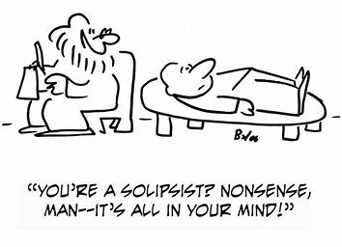
Idealism: Berkeley’s ‘master 'argument and criticisms of idealism
Berkeley’s master argument
Berkeley’s ‘master’ argument tries to show that the very idea of a mind-independent material object is impossible. This is because, when we think about an object we automatically get an image in our head of the object.
P1: Try to conceive of a tree which exists independently of any mind.
P2: In doing so, the tree is being conceived by you.
C: Therefore the tree is in your mind and not independent of any mind after all.
Criticism of Berkeley’s ‘master’ argument.
Issue: Idealism leads to solipsism
Russell argues that Berkeley's error is to confuse the mental act of conceiving a thing with the thing being conceived. So it is true that my idea of a tree must be in my mind, but it doesn’t follow that what my idea is about, the tree itself, must be in my mind.
Berkeley's argument if true, would show that I cannot make sense of an idea existing outside of my mind. It would mean that only my mind could exist and so would lead to solipsism (see key word list). Berkeley's appeal to God’s existence as an eternal perceiver would be undermined and his whole system would collapse.
Berkeley does not fully explain why an idea can only be like another idea. Without being able to compare our ideas with reality we have no way of establishing such resemblance.
If we accept the existence of the external world then it seems reasonable to suppose that there will be a systematic correlation between reality and our perceptions of it.
If ideas of qualities of objects exist in the mind, then I cannot know of the existence of any reality beyond it. The ‘master’ argument says it is impossible to have an idea of a min-independent object. This implies that the world first appeared to me when I was born and will disappear when I die and comes in and out of existence when I shut my eyes and open them.
But, this objection ignores Berkeley’s role of God, as objects exist in God’s mind as a permanent perceiver of the universe when no finite human or animal mind is perceiving it. So objects retain some kind of permanence that common sense would demand.
But can we make sense of the idea of God as Berkeley argues minds can only be aware of their ideas. Since a mind is the possessor of ideas, it is not itself and idea, so we cannot have an idea of a mind, therefore, we cannot have an idea of God’s mind or of any other minds, so we are back into solipsism.
Berkeley’s response to solipsism
He admits that I cannot have an idea of God’s mind. God’s mind is not something that has sensible qualities and so it is something I cannot frame in my mind. But I can form a ‘notion’ of it by ‘intuition’ or ‘reflection’ on myself. As Descartes argued, Berkeley claims that I am aware of a self which possesses my ideas. This self is something unextended and indivisible. Berkeley thinks he has satisfactorily proved the existence of God as the cause of my ideas and what sustains the universe in existence. So I can extend this ‘notion’ of myself by enlarging my own power and subtracting the my imperfections to produce a notion of the mind of God.

Slide 10
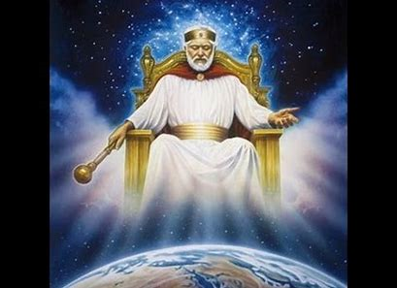
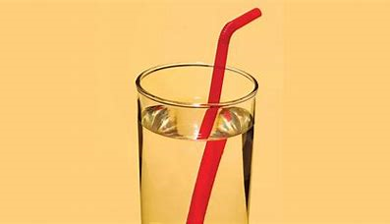
Idealism: Problems with the role played by God, illusions and hallucinations.
Berkeley thinks that the philosophical idea of matter is incoherent and that the only source of our sense data must be something that can itself possess sense data and which has active power to cause them in us.
Matter can do neither as it is not sentient (able to perceive or feel things) or active.
He also agrees with Locke and Russell that the regularity and predictability of our sense data, and that they are not subject to my will and that different senses cohere with each other, shows that the source of them is external to me.
He concludes that the source of sense data must be a mind, a powerful mind.
So, Berkeley does not see it as bringing God in to save his theory, but that his arguments have led to the existence of God as the only possible explanation of our experience.
How can we distinguish between reality and imagined objects if perception is dependent on the mind?
Berkeley responds by saying the imagined is subject to my will, I am in control, I conjure their existence, when I imagine an object it is far less vivid and clear than when I am actually perceiving one.
But, if there is no mind-independent reality, then illusions and hallucinations would appear no different from veridical perceptions, which does not fit with common sense.
Berkeley responds by saying when subject to an illusion, I am not mistaken about the actual sense data or ideas. An illusion and hallucination are subjectively indistinguishable from other sense experiences and it would be nonsense to say we could be wrong about these. They are illusory because they incline us to make false inferences about what we may perceive next. If I try to grab a dagger which see before me, but clutch thin air, then I have been fooled by a hallucination. If I see an oar half bent in water, it will also feel bent to the touch, then I'm making an error.
The error in both cases is with the inference made about further sense data because I judged I would have certain tactile sensations which are not forthcoming.
Can God have sensations?
A problem is that if God is the source of sense experiences and perceives all then God is subject to sensations, including pain and so therefore, God cannot be perfect.
P1: What we perceive is in the mind of God.
C1: It follows that the idea of pain is in the mind of God; God suffers pain.
P2: But if God suffers pain, then he is imperfect.
P3: God is defined as a perfect being.
C2: Therefore, Berkeley’s views lead to contradiction.
Berkeley’s response God knows what it is for us to suffer, but God does not suffer himself. We suffer because pain is caused in us by the laws of nature, we have no control over them. But God does not have a body, so God does not suffer pain or other sensations against his will. God is pure spirit and determines his ideas, he cannot passively ‘suffer’ from pain or any other sensations.
But, there is still a problem, as sensations change and are fleeting, the world perceived by God is also one of change. If God has sensations, then he must change. And if he changes then he cannot be perfect and immutable,

Slide 11
Differences between idealism and indirect realism
Idealism | Indirect realism
Anti-realist theory, objects are mind-dependent. | Form of realism. Objects are mind-independent.
Berkeley’s idealism is a direct theory of perception, physical objects are clusters of sensible qualities directly perceived by the mind. | We perceive the qualities of matter but that these qualities exist in a material substance which is not directly perceived. The existence and nature of material objects must be inferred from their representations in the mind.
Regularity and predictability of our sense experiences and the persistence of objects unperceived by finite minds by appeal to the mind of God as a permanent perceiver and the source of our perceptions. | Matter is the best explanation of experience.
Ideas cannot be like anything but other ideas. | Sense data and ideas are representations of material reality.
No distinction between primary and secondary qualities. | Traditionally, there is a distinction between primary and secondary qualities.

Slide 12
Perception
Direct realism
P1: | All objects are composed of matter, which gives them properties such as size, shape, texture, smell, taste and colour.
P2: | We use our senses to perceive these objects directly.
C: | The external world is as we perceive it.
Indirect realism
P1: | We perceive physical objects which are mind-independent.
P2: | But we do so via, or in virtue of, perceiving mind-dependent sense-data.
P3: | Sense-data are caused by and represent physical objects.
C: | We perceive sense-data immediately, and physical objects indirectly.
The external world as the best hypothesis. Russell
P1 | Either physical objects exist and cause my sense-data or physical objects do not exist nor cause my sense-data.
P2: | I can’t prove either claim is true or false.
C1: | I have to treat both claims as hypotheses.
P3: | The hypothesis that physical objects exist and cause my sense-data is better.
C2: | Physical objects exist and cause my sense-data
Idealism
P1: | Each sense perceives particular types of qualities.
P2: | When we perceive physical objects, we don’t perceive anything in addition to primary or secondary qualities.
P3: | Everything we perceive is either a primary or secondary quality.
P4: | Both primary and secondary qualities are mind- dependent.
C: | Nothing that we perceive exists independently of our mind: the objects of perception are entirely mind-dependent.
Master argument
P1: | We cannot conceive of a mind– dependent object.
P2 | To conceive of a mind– dependent involves thinking about it, and therefore it becomes mind-dependent.
C1: | The idea of a mind-independent object is contradictory
C2: | Any thought of an object outside of any mind can only take place in the mind.
C3: | Only mind-dependent objects exist.
Argument from perceptual variation
P1: | There are variations in perception.
P2: | Our perception varies without corresponding changes in the physical objects we perceive.
C1: | Properties physical objects have and the properties they appear to have are not identical.
C2: | What we are immediately aware of in perception is not exactly the same as what exists independently of our minds.
C3: | We do not perceive physical objects directly.
Argument from illusion
P1: | We perceive something having some property, F
P2: | When we perceive something having some property F, then there is something that has this property.
P3: | In an illusion, the physical object does not have the property F
C | Therefore, what has the property F is something mental, a sense-datum.
Argument from hallucination
P1 | In a hallucination, we perceive something having some property F.
P2: | When we perceive something having some property F, then there is something that has this property.
P3: | In hallucinations we don’t perceive a physical object at all
C: | Therefore, what we perceive must be mental – sense-data.
The time lag argument
P1: | It takes time for light waves, or sound waves, or smells, to get from physical objects to our sense organs.
P2: | We can perceive something even after it ceases to exist (e.g. distant stars).
C: | We aren’t perceiving physical objects directly.
What is direct realism? What is indirect realism? What is perceptual variation? What is a Primary quality?
What is a Secondary quality? What is perceptual variation? 3 marks
Outline and explain Berkeley’s idealism and explain how it leads to solipsism. 5 marks
Explain the distinction between primary and secondary qualities. 5 marks.
Briefly explain direct realism AND Explain how the ‘argument from illusion’ can be used to argue against this view. 5 Marks.
Explain why for Locke extension is a primary quality. 5 marks Briefly explain Berkeley’s master argument. 5 marks
Briefly explain direct realism AND explain how the ‘argument from hallucination’ can be used to argue against this view 12 Marks.
Are direct realists right to claim that the immediate objects of perception are mind-independent? 25 marks
Are indirect realists right to claim that immediate objects of perception are mind-dependent? 25 marks
Is Berkeley right in claiming the immediate objects of perception are mind-dependent? 25 marks
Is Russell right in claiming that the external world is the best hypothesis? 25 marks
Possible exam questions

