Slide 1
Healing + supporting people who are ill
Prescribing medication
doctor
nurse prescriber
Dentist
chiropodists + physiotherapists can prescribe some medication in certain circumstances.
B
Accessing support from specialist agencies
specialist agencies support + promote health + wellbeing of service users.
Support for lifestyle changes
Healthcare professionals such as G.P. , practice ensures + district nurses can assist individuals to set up self help groups.
Surgery
district nurses monitor progress + provide specific treatment.
Physiotherapist + occupational therapists support mobility + promote independence in daily living.
Radiotherapy
Support from G.P. on completion of treatment ensure full healing.
Organ transplant
Support off specialist nurses, Physiotherapist, occupational therapists, counsellor, social worker may provide post-operative support.
Enabling rehabilitation
Providing equipment + adaptations to support people in being more independent
The specific programme will vary according to the person’s physical + psychological needs + their home + family circumstance, including the level of support from their family, friends + carers.
Other support from;
Physiotherapists
Occupational therapists
Counsellors
psychotherapists
Appliance that support daily living activities:
Special cutlery – thick, light handles easy to hold for people with arthritis.
Feeding cups.
Egg cups + plates with suctioned bottoms.
Walk in baths + showers.
IT that support educational achievements:
Computers for visually impaired + blind people.
Wheelchair access to all learning spaces.
Additional time in exams for dyslexic people.
Mobility aid:
Walking sticks
Walking frames
Wheelchairs
Adapted shopping trolleys
Stair lifts
Adapted cars

Slide 2
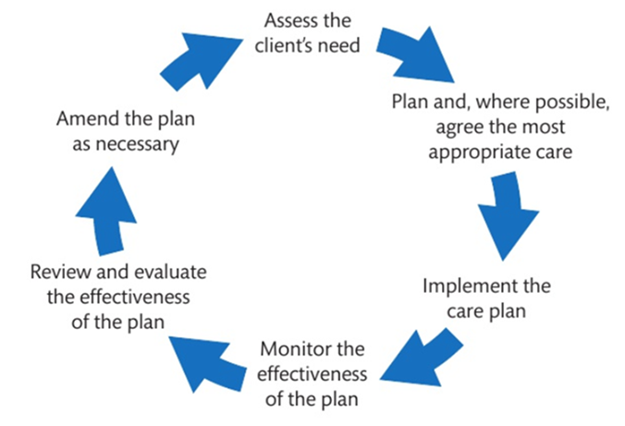
Supporting routines of services users in day to day lives
B
Supporting service users needs.
They can be;
Physical needs
Emotional needs
Social needs
Spiritual needs
Educational needs
Professional need to be aware of their clients information.
Such as;
Community in which client lives.
Their work.
Family circumstances
Financial position
Their interests
Their hobbies.
Their aspirations.
Informal Care
Care + support provided by relatives + friends, normally unpaid + in addition to the care provided by professional health + care providers.
Assessment of Care + Support Planning
Whole person
Health care professional support clients in developing + maintaining a fulfilling + satisfying daily life.
Care planning cycle – approaches:
Assessing individual healthcare needs of their service users
Agreeing a care plan that promotes the service user’s health + wellbeing.
Evaluating the effectiveness of the care implemented.
Planning Care
Professionals assess needs + agree the right care with the service user.
Asking family members + informal carers when appropriate.
Informal carer contribute to review + evaluations of care provision + discuss about alternative strategies.

Slide 3
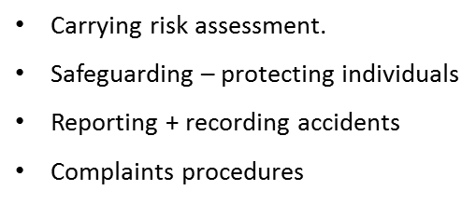
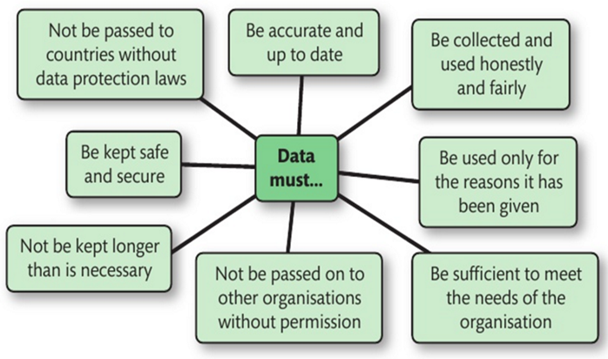
Ensuring Safety in HSC
Information Management + Communication
C
how people who work in health and social care ensure safety for individuals and staff through:
Fostering rights + responsibilities
Supporting a patients right to choose their own lifestyle + helping them to accept their responsibilities.
Example; some religions don’t allow blood injections therefore they will refuse to take them, the professionals will respect their choice.
Smokers outside the hospital, move them from the hospital to a place where they can smoke as they have a right to spoke.
Care value base is a range of standers for health and social care.
3 areas that is fostering equality & diversity, peoples rights & responsibilities + maintaining confidentiality of information.
Use of protective equipment + infection control;
Wash hands before + after any contact.
Wear apron + gloves~ in contact with bodily fluids.
Safe handling + disposal of sharp articles.
Confidentiality of information
Any information patients give you is private and confidential.
Example; professionals aren’t allowed to share information with anyone without your permission.
Employers must take care of own safety and other Health care workers.
Work together to provide the best care for patient.
Not intentionally damage equipment e.g. lifts.
Fostering equality + diversity
Recognising + supporting people’s individual needs.
Involves with giving everyone the same quality of care + support ~ not treating everyone in the same way whilst respecting peoples experiences, lifestyles + backgrounds.
Example; bringing in a translator if an individual who can’t/ who speck little English so they can understand.
Data Protection act 1998
Rules of holding + processing personal information.
Electronic + paper records.

Slide 4
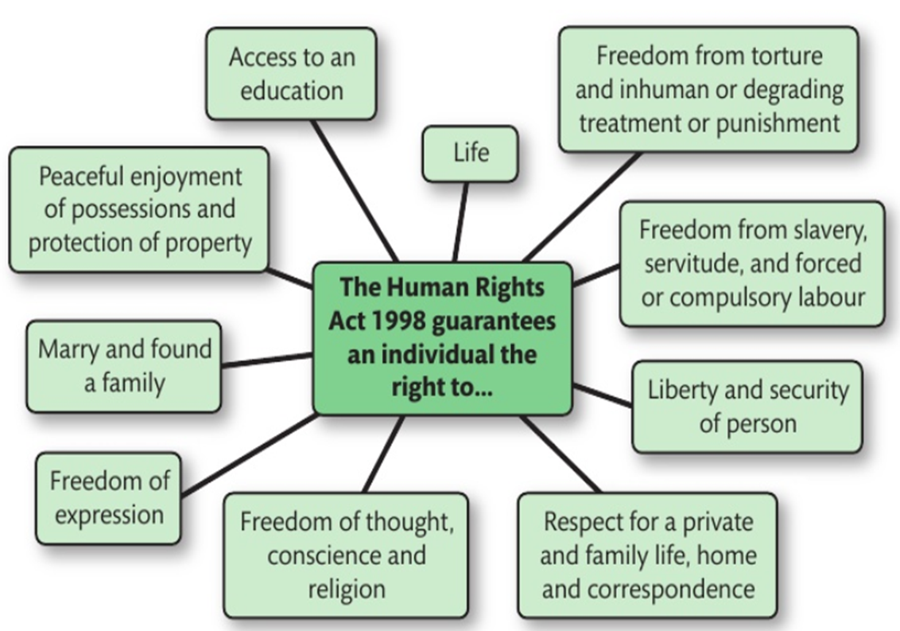
Dealing with conflict in HSC Settings
Empowering Individuals
C
Challenging behaviours are seemed as a risk in HSC Setting as it can hurt anyone.
Promote + support their rights to dignity + independence.
This will boost self-esteem.
Provide support with their beliefs + cultures.
HSC is a multi-cultural society.
Specific needs must be meet;
Languages
Traditions
Beliefs
Diets
Challenges faced;
Patients speak little/no English.
Provide wide range of foods.
Religious observances.
When dealing with conflict care practitioners need to (skills);
Listen carefully.
Stay calm.
Try to see both sides of arguments/issues.
Never resort to aggressive behaviour.
Promote individualised care- care that meets the specific needs of each patient.
Adapting HSC provision for different types of service users
It situation seem to lead to violence then;
Make sure you now where doors/exits are.
Remove anything that can be used as a weapon.
Call for help.
Task:
Research some case studies of discrimination in the workplace. Make a record of the 5 W’s; who, what, where, why, when and how
There still discrimination + prejudices.
Anti-discrimination involves promoting equal opportunities + challenging discrimination at work.
Promoting Anti-discriminatory practice
Anti-discriminatory practice aims to ensure patients care needs regardless of;
Race
Ethnicity
Age
Disability
Sex orientation
Prejudices of staff or other service users are appropriately challenged.
Health + care worker required to do;
Address their own prejudices.
Understand + meet patients needs.
Actively challenge discrimination against patients.
Ensuring setting is welcoming + accessible.
Celebrate contribution of wide range of people.
Compensate for negative effects of discrimination in society.

Slide 5
Accountability to Professional Organisations
C+D
Multidisciplinary: Combining or involving several academic disciplines or professional specializations in an approach to a topic or problem.
Partnership working, to include:
The need for joined-up working with other service providers
Ways service users, carers and advocates are involved in planning, decision-making and support with other service providers
Holistic approaches.
Holistic Approach
Critical information needs to be passed on in order to provide emergency care for the wellbeing of the service.
Healthcare professionals must consider PIES + spiritual while planning.
GMC (Code of Practice):
Helps to protect patients + improve medical education + practice across UK.
How they deliver there role:
Setting the standers for doctors.
Overseeing doctors education and training.
Managing the UK medical register.
Investigating and acting on concerns about doctors.
Helping to raise standards through revalidation.
NMC (Code of Practice):
Standards that patients + members of the public tell us they expect from healthcare professionals. They are:
Respect people’s right to privacy and confidentiality.
Treat people as individuals and uphold their dignity.
Listen to people and respond to their preferences and concerns.
Code of Conduct
Set Standers for social workers.
Helps workers provide high quality, safe + compassionate, care + support.
Outlines behaviours + attitudes ~ who use care + support should rightly expect.
It is mandatory.
Care Certificate
Introduced for HSC workers as they not members of regulated professional bodies.
Benefit: Standers for HSC workers in their daily working life.
Drawback: It no statutory requirement.
Student Tasks:
Can you pick out the key words of this topic? Use flashcards etc.
What could you be asked in the exam, based on this topic? Create some exam questions and answers.

Slide 6
Monitoring the work of People in HSC
E
External Inspections
Ofsted (England)
Reports directly to parliament, by law it must inspect schools with the aim of providing information to parent to promote improvement + hold schools to account.
CQC (England)
Makes HSC service provide people safe, effective, compassionate, high quality care + encourage care services to improve.
HMIe
Responsible for the inspection of public, independent, primary + secondary schools, colleges, community learning, Local Authority Education Departments + teacher education.
Whistleblowing
Is the situation in which an employee reports poor or dangerous practice at their workplace to the press or to another organisation outside their setting.
Service user feedback
Helps them improve the service for patients, so that they can get the best care.
Criminal Investigations
Is extreme circumstances (physical, sexual, emotional, financial abuse).
Line management
Responsible for managing work of individuals + addressing issues with staff to take appropriate action.
Student Task:
Write you answers in the space adjacent.
What are the responsibilities for Ofsted, CQC and HMIe?
Think of a situation when whistle blowing would be used?
Research a case study of a criminal investigation in H&SC.
S&C: Create your own method for monitoring the work of people in HSC.

