Slide 1
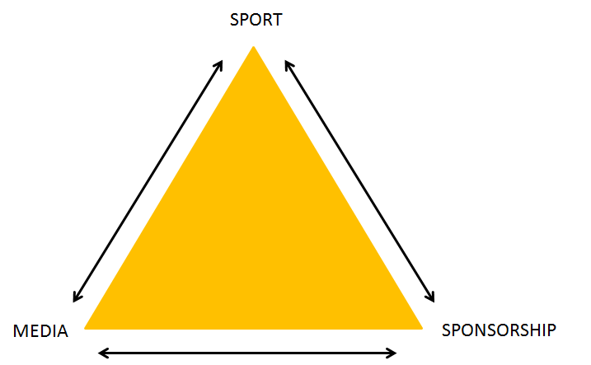
Deviance
Deviance | Behaviour outside of the norms/values of a sport
Violence | The physical force with the intentions of harming someone
Drugs | Used to improve performance
Gambling | Risking money or anything to value on the outcome of something involving payment
Deviance
Deviance is usually a result of a drive to win being blocked, pressure by coaches, sponsorship deals or spectators Examples -Australian cricket team tampering with the ball by using sandpaper to gain an advantage -Lance Armstrong used performance enhancing drugs in all 7 of his Tour de France wins
Key Terms
Legal Supplements | Used to maximise trining and performance in sport
Caffeine | Helps athletes train harder and longer
Recovery Formulas | Speeds up recovery and/or makes it more effective
Bicarbonate | May help to buffer the effects of lactic acid
Carbohydrate Replenishment | Aid energy replenishment
Glucosamine | Maintaining cartilage
Creatine | Improves recovery of ATP/PC energy system
Electrolytes | Stimulate thirst and encourages drinking
Commercialisation
The process of managing or running something principally for financial gain, using sport to make a profit
Sport can generate profit through ticket sales, sponsorship deals, selling media rights, pay per view, merchandise, advertising and membership.
It can be categorised into 4 categories; society, sport, performers and spectators
The Golden Triangle
Drug | Definition | Effects | Case Study
Anabolic Agents | Work by helping the body’s muscles produce more protein which leads to increased muscle size and strength | High blood pressure Acne Liver damage | Roger Clemens used anabolic agents to increase the size and strength of his muscles
Anabolic Steroids | Synthetic variations of the male sex hormone testosterone which boosts muscle growth and increases male sex characteristics | Reduced sperm count Infertility Severe acne | Dwain Chambers a British track sprinter received a 2 year ban after testing positive for THG
Anti-Oestrogenic Activity | A class of drugs which block the effects of estrogens | Excess hair growth Acne Nausea | Jon Jones a UFC fighter tested positive in 2016 and was suspended for a year
Beta Blockers | A prescription only drug that works by slowing down the heart | Tiredness Cold fingers/hands Feeling sick | Kim Jong-Su won silver in the 50m pistol even but tested positive which led to his medal being stripped
Diuretics | Increase the rate of urine flow | Low sodium levels Headaches Dizziness | Veronica Campbell-Brown tested positive for banned diuretics
Masking Agents | Cover up the track of athletes who have taken PEDs by taking more drugs | Muscle cramps Dizziness Low blood pressure | /
Narcotic Analgesics | Medicine used to treat/relieve acute or chronic pain | Constipation Nausea Dizziness | Ambesse Tolosa a log distance runner received a 2 year ban after testing positive
Peptide Hormones -Erythropoietin | Stimulates the production of red blood cells | Blood clots Strokes Increased thickness of blood | Lance Armstrong used EPO during all 7 of his Tour de France wins
Peptide Hormones -Human Growth Hormones | Increases muscle mass and strength | Arthritis Heart failure Abnormal growth in feet and hands | /
Stimulants | A substance that raises levels of psychological or nervous activity in the body | Increased heart rate Heightened blood pressure Very high body temperature | Diego Maradona was caught taking stimulants in the 1994 World Cup
Violence
Intense physical force that is directed towards harming an individual, group or property, this can be either player violence or spectator violence
Causes of Violence
Player & Spectator | Player | Spectator
Frustration Importance of game/result | Provoked/retaliation Nature of the game Dehumanising weapons and kit Drugs | Alcohol/social drugs Poor spectator provision Hooligans Imitating violence on the pitch
Different Types of Media
Television / Visual Internet Newspapers / Magazines Social Media Radio
Influences of Media
Event Time Changes Rule Changes Adapted Versions of Sports Technological Innovations Sponsorship
Media Coverage Has Changed As
Many different types of media More coverage Globalised coverage Increase in amount of pay for/subscription coverage Increasingly important role of social media Wider variety of sport covered Creation of sport stars in the media Technology has helped control real time sport Media has growing control over the sport
Difference Between Broadsheet and Tabloid
Broadsheets include a broader ranger of sports whereas tabloids include smaller range of sport Broadsheets have more in depth analysis of the sport, but tabloids coverage is less detailed Broadsheets are less sensationalised than tabloids
Solutions to Player Violence
Rule Changes | Punishments | Education
By doing this it can minimise violent situations in a sport | By giving stricter punishments and making them mere severe it will prevent violence | Educating on fair play and how the player is a role model will make the player act accordingly
Contemporary Issues in Sport
-Ethics and Deviance, Commercialisation and Media, Routes to Sporting Excellence, Modern Technology in Sport
Types Of Sponsorship
Financial Facilities Clothing and Equipment
Evolutions
All these evolutions have influenced sport to what it is today Internet Television Radio Written press
Implications
Society | Sport | Performers
Sports performers are role models so violence may be copied in society It may put parents off letting their children participate Can lead to violence amongst spectators | Can reduce participation Loss of sponsors Can initiate changes in law and ruled of a sport to make violence less likely | May receive punishment, disciplinary action or even legal action Injuries Loss of sponsors Become a negative role model
Type of Media | Example of Coverage | Coverage in 1980?
TV Terrestrial | FA football cup final on BBC | Yes
TV Subscription | Football Champions League | No (champions league started 1992)
TV pay per view | Test cricket | No
Radio Sport Station | Ashes Test Cricket | No
Newspapers | Wimbledon Tennis Championship | Yes
Internet | Rugby Union | No
Gambling
Advantages | Disadvantages
Financial benefits to the people involved if successful Offer big sponsorship deals in sport Adds excitement to the sport | Rise in illegal betting in sport Can cause corruption in sport through match fixing Players can gin gambling problems Can cause debt/addiction in society Growing volume of gambling sponsor which promotes a negative image Growth of online betting apps makes it easier than ever to get involved
Sponsorship
Clothing
Teams often get a shirt sponsor and individual players will get deals for clothing such as footwear
Equipment
Businesses will sponsor a players or a teams equipment. This is usually the equipment manufacturer
Stadiums
These may be named after the sponsor who has put money towards the building or maintenance
Competitions
Businesses sponsor competitions or leagues and then their name appears on the products related to the competition. Some competitors are names after their sponsor.
Strategies to Stop Illegal Drug Use
Stricter punishments Improved testing Education Legalisation
Legal Supplements
+ | -
Provides a boost to health and well being Can help recovery process Increased chances of success | May contain banned substances May have long term effects Prolonged use can contribute to health issues
Spot Fixing
When a specific aspect of a sports competition is illegally pre-determined
Illegal Betting
When a player is involved in betting in sport which is illegal according to NGB rules
Match Fixing
When the upcoming of a match in organised sports have been manipulated or predetermined

Slide 2
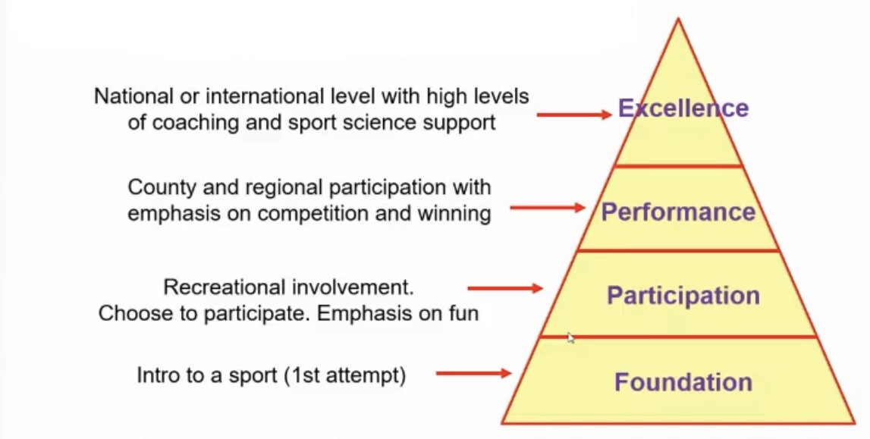
Impacts of Commercialisation on… | Positives | Negatives
Sport | Increase in funding to the sport Increase coverage/exposure of that sport Facilitated globalisation, meaning the sport can grow | Loss of tradition as it can change rules/timings Loss of control because the media can dictate things
Society | Increase in economy Increase in entertainment quality, which keeps society happy Increase in access to spectating sport= society can share in celebration of success | Privately owned, therefore economic benefits will only be felt by very few Loss of tradition as it changes sport, which people don’t like People tend to spectate rather than participate
Performers | Increase income/higher wages Increase in status/fame Allows professionalism Increase standard of play | Pressure to do well Win at all costs may cause deviance Loss of control (forced to play through injury) Ethics; representing sponsors that aren’t ethically correct
Spectators | Increased access to sport (24/7) Increase in media coverage Better media coverage Improved stadia | Privately owned, economic benefits will only be felt by very few Ethics; representing sponsors that aren’t ethically correct Loss of tradition as it changed sport, which people don’t like Win at all costs, causes deviance
UK Sport
This organisation helps with the identification of potential elite performers in sport
This Organisation Develops Elite Athletes by…
Identifying potential talent in sport Supporting an athletes lifestyle Supporting the athletes coaching Supporting through research, sports science and sports medicine Providing a “World Class Programme” or pathway to success
Athletes submit applications then UK Sport invite successful applicants to ‘Phase 1’
Phase 1 | Phase 2 & 3
Physical and skill based testing Sprints Jumps Aerobic fitness Strength tests | Physical and mental screening Performance lifestyle workshops Psychological assessments
Drop – Out Rates
Reasons a Elite Potential may Drop - Out
Funding issues Unable to access elite programmes Media pressure Travel Not quite good enough Demands of training Injury Family commitments Stress Lack of enjoyment
Strategies to Address elite Drop - Out
Identifying Problems - Evaluate athlete to identify potential stressors or difficulties This would allow appropriate intervention to be put in place to take stressors away
Performance Lifestyle Advice – Advice on integration of sporting and personal life, and giving financial advice Take away social and financial pressures
Media Strategies – Teach strategies for dealing with media Enables athletes to deal with the pressure put on personal life
Medical Strategies – Arrange medical intervention e.g physiotherapy Maintain physical health through injury prevention and rehabilitation to allow continued participation
Psychological Support – Give psychological support/teach stress management techniques Take away social and financial pressures
Training Programme – suggest training adaptations To allow appropriate rest and recovery, to meet the changing needs of the athlete and keep them motivated and progressing
Confirmation Phase
All selected athletes train over a 6 – 12 month period They are continuously assessed Progress is recorded Unsuccessful athletes continue sport through the club system
Talent Identification
The testing of both physiological and psychological parameters that help to determine the likelihood of sporting success
Biological Indicators | Mental Indicators
e.g fitness tests, anthropometry, psychological profile | e.g psychological profile, hereditary profile, sociological profile
Modern Technology in Sport
Technological Developments - VAR, Floodlights, 3G, 4G, Running shoes, artificial limbs
Benefits of Technology for Elite Sport
Improved Performance - through training, in competitions, improved recovery Increased Access - disability, all-year round participation Increased Safety - in competition, in training, monitoring health Increased Accuracy - in competitions, monitoring training, talent identification
Modern Technology Reducing Participation
Cost – Expensive which has led to inequality in different levels of teams through equipment/facilities Range of Alternatives – Games consoles have made mor of a sedentary lifestyle as you can virtually play it this is through games such as Fifa
Potential | Support | Increased Inclusion
Tests which sport best suit them Do they have the right physiological make up? | English Institute of Sport, UK Sport Assessing bone density and internal body fat Health screening | Greater accessibility to elite training Prosthetic development Wheelchair devices
Routes to Sporting Excellence in the UK
The Pathway Diagram | A hypothetical representation of a full pathway and is designed to highlight the Performance Pathway and the Talent Pathway
World Class Podium Potential | Designed to support the stage of the pathway immediately beneath Podium
World Class Podium | This programme is designed to support sports and athletes with realistic, medal capabilities at Olympic Games or realistic gold medal capabilities at Paralympic Games, and are a maximum of four years away from the podium
Performance Foundation | Home Nation Talent Pathways where highly talented athletes are first identified, confirmed and prepared to meet the increased demands of the world class environment
Talent Identification
+ | -
Allows athletes to have potential in other sports Opens new opportunities Develops minority sports Perform at high levels Better coaching is available Using national governing money | Can be demotivating Hard for younger kids to do Takes away childhoods A long process period, 6 – 12 months Misses people out May cause people to drop out of their chosen sport if they aren’t picked
Benefits of Technology for General Participation
Increased Opportunity | Enjoyment and Progress | Increased Inclusion
All weather participation All day/year round participation Variety of sports Improvement of sport equipment | Easier to learn skills Safer Increased enjoyment | Adapted sports equipment for mobility/specific needs Equipment to aid safety for disabled athletes Creation of ‘new’ sports using assistive technology Advances in prosthesis
Improvement of Access to Facilities | Increased Motivation | Mass Production
Accessible facilities e.g building and equipment Adapted facilities | Motivation through training Motivation through adherence | Readily available
To reach the top in sport, a considerable amount of planning is required along with funding to pay for training, facilities, travel, equipment and coaching
The Role of UK Sport
Invest National Lottery funds Success is measured by the medals won UK Sport invests 70% of its income in two ways; National Governing Bodies, Athlete Performance Award
Role of Schools in Sporting Excellence
Compulsory PE Learn a range of sports Learn fundamental skills which are transferable motor skills Coaching and facility quality varies Extra-curricular competitive opportunities Provide links to local clubs Widens the base of the pyramid which increases participation
Athlete Performance Award
Funds athletes for their living and personal sporting costs All determined by a certain criteria (level of performance/capabilities) Athletes on podium level can receive up to £28,000
Increasing Fair Outcomes
Measurement – better timing devices for more accurate records (laser beam measures) Officiating – more accurate decision making of officials (Reduces cheating, offside rule) Drug Testing – improved detection of doping (urine samples, blood tests) Overturning – increases accountability of officials (Allows a fair outcome) Inclusion – allows disabled thieves to feel included (prosthetic limbs)
Decreasing Fair Outcomes
Access to modern technology can be limited and cause inequality expense, only available at elite level, developing countries disadvantaged due to cost Performance enhancing drugs Unfair advantage to some athletes, new technology developing drugs, testing technology Pressure on officials Highlight errors, use technology rather than their own decisions, easier to find negligence
Role of Clubs in Sporting Excellence
Competition is frequent to give competitive experience Specialist/Elite/High quality coaching Specialist facilities and equipment Some clubs provide financial concessions Assists in talent identification/scouts Can provide basic medical support
Role of Universities in Sporting Excellence
Combines performance/training with study Many offer sporting scholarship/bursaries High quality competition Specialist facilities Involved in sports science research Provide sport science and medical support
#DiscoverYourPower involves partnership between UK Sport, the English Institute of Sport and British Cycling They Identify future Olympic and Paralympic medal winner
National Institutes
Run by UK Sport, with several of the organisations in each home county specialising in different Olympic Sports
What do they do?
Provide world class facilities to train in Physiological and psychological sports science support Medical support for injuries and illness Run talent ID process Complete research into new sporting technology
World Class Programme
This organisation covers all the sports in the summer and Winter Olympics and Paralympics
2 Levels
Podium Level | Podium Potential Level
Supporting athletes with realistic medal-winning capabilities | For athletes whose performances suggest that they have realistic medal-winning capabilities
Impact on Entertainment in Sport (Hinders)
Constant Interruption – interfere with the flow of a event or game Faulty – technology can break down/delay a game Sports Lose Valuable Revenue – option to watch on TV
Impact on Entertainment in Sport (Enhancing)
Replays – action replays/slow motion can add drama Rewind – rewatch key moments or fast forward through dull moments Cameras – new angles can increase entertainment Screens – giant screens in stadiums increasing the entertainment
Drop – Out Rates
PE in schools means all children participate in physical activity However, as age increases, participation decreases
Participation Drop - Out | Elite Drop – Out Rate
People participating recreationally | People who could have been elite, but dropped out before reaching this
Impact on Entertainment in Sport (Enhancing)
Education – more camera angles/replays improve knowledge of sport Punditry – replays, camera angles facilitates punditry which increases entertainment before, during and after a game

