Slide 1
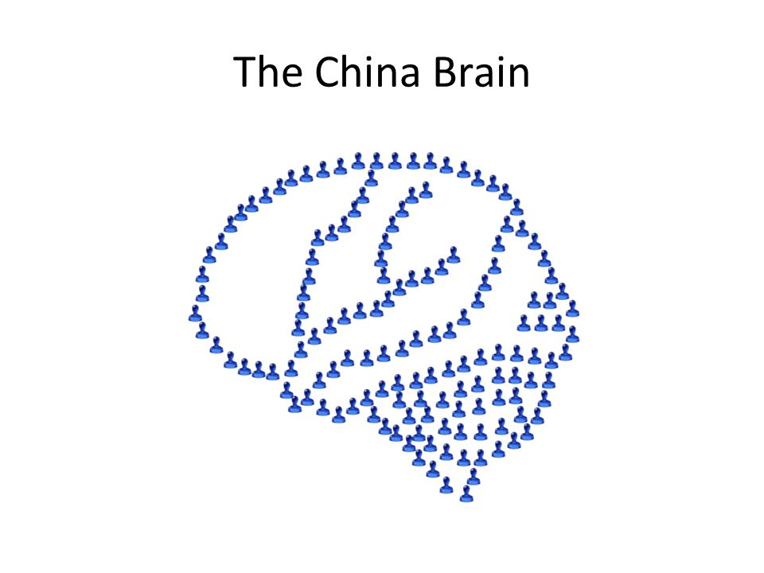
Functionalism
What you need to know:
Functionalism: all mental states can be characterised in terms of functional roles which can be multiply realised.
Issues, including:
•the possibility of a functional duplicate with different qualia (inverted qualia)
•the possibility of a functional duplicate with no mentality/qualia (Ned Block’s China thought experiment)
•the ‘knowledge’/Mary argument can be applied to functional facts (no amount of facts about function suffices to explain qualia).
Possible Exam Questions
What claim does functionalism make regarding statements about mental states? (3 marks)
Briefly outline functionalism (5 marks)
Briefly explain inverted qualia and how it challenges functionalism. (5 marks)
Explain how Block’s China thought experiment can be used to argue against functionalism. (5 marks)
Briefly explain how the ‘knowledge’/Mary argument can challenge functionalism. (5 marks)
Briefly outline functionalism and the issues related to it. (12 marks)
Explain the similarities and differences between functionalism and mind-brain type identity theory. (12 marks)
Explain the similarities and differences between functionalism and analytical behaviourism. (12 marks)
Is the functionalist theory of mental states correct? (25 marks)
Block’s China Brain
It is possible that there are creatures who are functionally identical to humans, but lack qualia.
“Suppose we convert the government of China to functionalism, and we convince its officials to realize a human mind for an hour. We provide each of the billion people in China (I chose China because it has a billion inhabitants) with a specially designed two-way radio that connects them in the appropriate way to other persons and to the artificial body mentioned in the previous example. We replace each of the little men with a citizen of China plus his radio. Instead of a bulletin board, we arrange to have letters displayed on a series of satellites placed so that they can be seen from anywhere in China... The system of a billion people communicating with one another plus satellites plays the role of an external “brain” connected to the artificial body by radio... It is not at all obvious that the China-body system is physically impossible. It could be functionally equivalent to you for a short time, say an hour.”
P1: Consideration of the China thought experiment shows that it is possible for two functional duplicates to differ mentally such that one (the human) has qualia while the other (the population of China) does not.
P2: If it is possible for two functional duplicates to differ mentally such that one has qualia and the other does not then functionalism is false.
C: Therefore functionalism is false.
Functionalism
Mental states are identified with functional roles.
To define something in terms of functional role is to define it in terms of what it does.
In particular, mental states are defined in terms of the role they play in conjunction with environmental inputs, other mental states and outputs.
For example, a pain is that which is caused by damage to the body, causes other mental states, such as anxiety and produces pain behaviour (e.g. groaning).
Since a functional role can be realised by different types of material, functionalism is agnostic over what kinds of substance can instantiate minds.
Because functional roles can be instantiated in different ways, mental states are multiply realisable. An alien with a silicon brain would still have the same types of mental state to us, even though they have a different kind of brain.

Slide 2
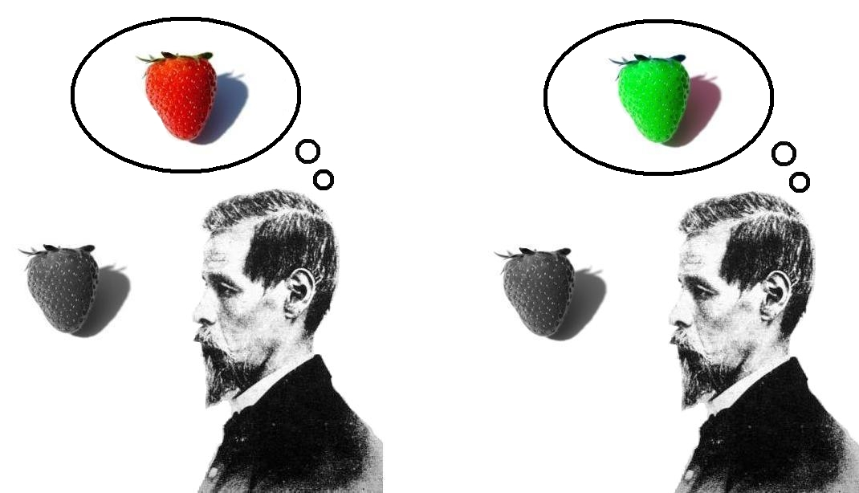
Functionalism
Key terms
Functionalism: all mental states can be characterised in terms of functional roles which can be multiply realised.
Inverted Qualia: to put the subjective aspects of our mental states in the opposite position to someone else.
Agnostic: to not know. Functionalists are agnostic about what kinds of substance instantiate mental states, meaning they do not know or care whether a mental state is instantiated by a silicon chip or a brain.
The Mary/Knowledge Argument can be related to functional facts
P1: Mary knows all the functional facts involved in colour vision.
P2: But she learns something new when she experiences colour vision herself.
C1: Therefore, there is more to know about colour vision that what is given in a complete functional account of it.
C2: So functionalism is false.
Arguments for Functionalism
Unlike behaviourism, functionalism recognises the causal role mental states have with respect to other mental states and behaviour. This accords with common-sense.
Unlike behaviourism, functionalism does not face the circularity objection. This is because functionalism defines mental states in terms of their causal roles.
Unlike Mind Brain Type Identity Theory, it allows for the multiple realisibility of mental states.
Unlike Mind-Brain Token Identity Theory, we are able to explain what a mentatl state type is.
Inverted Qualia
Suppose you and I react in the same way to seeing the colour blue. According to functionalism, we must therefore both have the same mental state, as the colour performs the same function for us.
However, it is possible that our qualitative experience of blue is different. So, when you experience the quale of blue, I experience the quale of yellow.
Therefore, functionalism cannot account for the intrinsic qualitative nature of qualia.

