Slide 1
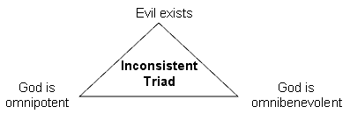
The Problem of Evil
What you need to know:
Whether God’s attributes can be reconciled with the existence of evil.
The nature of moral evil and natural evil.
The logical and evidential forms of the problem of evil.
Responses to these issues and issues arising from these responses, including:
the Free Will Defence (including Alvin Plantinga)
soul-making (including John Hick).
Plantinga’s Free Will Defence
P1: A world containing significantly free creatures is better than a world without such creatures (and better than no world at all).
C1: Therefore, if God creates a world, then it must be a world with significantly free creatures.
P2: If a world contains significantly free creatures, then moral evil is possible in that world.
C2: Therefore, if God creates a world, then it must be a world in which moral evil is possible.
C3: Therefore, the existence of moral evil is compatible with the existence of God.
The Logical Problem of Evil
If God exists, then God is omnipotent, omniscient and morally perfect.
If God is omnipotent, then God has the power to eliminate evil.
If God is omniscient, then God knows when evil exists.
If God is morally perfect, then God has the desire to eliminate all evil.
Evil exists.
So either God does not have the power to eliminate all evil (so is not omnipotent) or God does not know when evil exists (so is not omniscient) or God does not have the desire to eliminate all evil (so is not morally perfect) or God does not exist.
Hick’s Soul-making defence
P1: A world containing evil is required for humans to be capable of moral development, including the acquisition of certain virtues (e.g. compassion, courage, charity)
P2: A supremely good God would want his creatures to be capable of moral development, including the acquisition of such virtues, as we strive for perfection / to be like God (a process which continues after our physical death)
C1: Therefore, if God creates a world, then it must be a world with evil
The Evidential Problem of Evil
The quantity (and quality and distribution) of evil/suffering, although logically consistent with the existence of an omnibenevolent and omnipotent God, counts against the existence of such a God by lowering the probability that such a God exists. His being omnipotent means that he has the capacity to reduce the amount of suffering and his being omnibenevolent means that he has the desire to do so. Such a God would want to and be able to (and therefore would) reduce the amount of suffering to the absolute minimum.

Slide 2
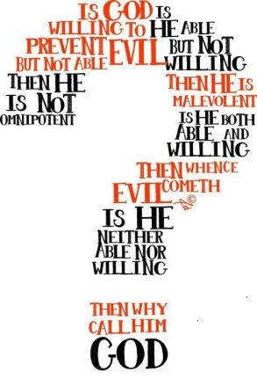
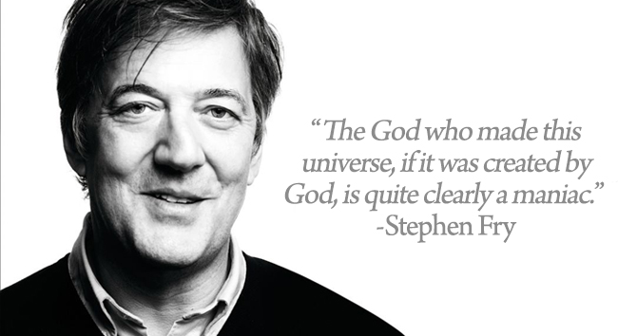
The Problem of Evil (A02)
Evaluation
Key terms
The Free Will defence only applies to moral evil not physical evil.
Physical evil is also the responsibility of humans, because it is the fair punishment of God for their sins. (Augustine)
God could have made a world in which everyone has a good character and so would choose only good things (Flew)
There is no difference between Flew’s ‘naturally good’ people and robots?
A God who manipulates the end results, in the way Flew describes, is a God who is not worthy of worship.
If God is omnipotent, he can create any logically possible world, including one in which people are free. But always choose good. (Mackie)
All virtues such as compassion, altruism, courage and generosity become void of meaning if all choices are of equal worth.
It may be possible for God to have made humans who freely choose the good, as Flew & Mackie suggest but God could never make humans who always freely choose a filial relationship. (Hick)
Free Will is necessary in order to develop perfection. (Hick)
Heaven must be sufficiently good to justify the magnitude of evils suffered in this world & others. (Hick)
Suffering doesn’t always improve people. It sometimes make people bitter.
There is no good worth the suffering of children. (Dostoyevsky)
Free Will doesn’t exist anyway – we are simply the product of our genes and our environment.
Moral evil refers to the harm or suffering (intentionally) caused by the actions of free agents/human beings.
Natural evil refers to harm or suffering not (intentionally) caused by the actions of human beings but is rather the result of natural/physical events and processes.
The logical problem of evil: God’s omnipotence, omniscience and supreme goodness and the existence of evil are inconsistent. (Mackie & Flew)
The evidential problem of evil: the existence of God is incompatible with the extent/distribution/ amount of evil. (Rowe)
Epistemic Distance: the idea that God made knowledge of himself less obvious in order to give us genuine free will.
Omnipotent: God is all-powerful. There is nothing God cannot do.
Omniscient: God is all-knowing. There is nothing God does not know.
Omni-benevolent: God is all-good.
Possible Exam Questions
What is the difference between moral and natural evil? (3 marks)
Briefly explain the logical and evidential forms of the problem of evil. (12 marks)
Explain the evidential problem of evil. (5 marks)
Explain how the Free Will Defence responds to the problem of evil. (12 marks)
Briefly outline Hick’s soul-making theodicy. (5 marks)
Outline the problem of evil and explain Hick’s soul-making response to it. (12 marks)
Does the existence of evil mean that an omnipotent, omniscient and supremely good God does not exist? (25 marks)

