Slide 1
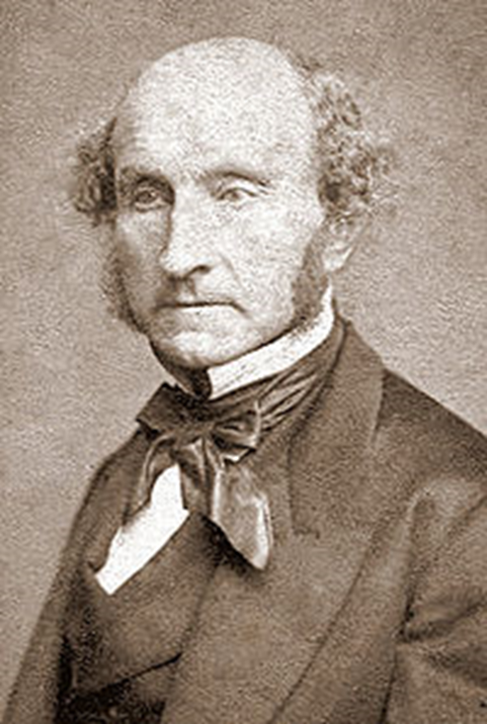
Mill & Singer’s Utilitarianism
What you need to know:
Mill’s qualitative hedonistic utilitarianism
Mill agreed with Bentham that:
The moral value of any act is calculated by considering its consequences (hence it is a consequentialist theory).
Good acts are those that apply the principle of utility: the greatest happiness for the greatest number.
Good acts maximise pleasure and minimise pain.
However, Mill believed there was a difference between higher pleasures and lower pleasures. Higher pleasures are pleasures of the mind, such as reading, art, music, whereas lower pleasures are pleasures of the body. Mill believed we should seek higher pleasures rather than lower pleasures.
John Stuart Mill’s qualitative hedonistic utilitarianism (higher and lower pleasures) and his ‘proof’ of the greatest happiness principle
act utilitarianism and rule utilitarianism
non-hedonistic utilitarianism (including preference utilitarianism)
Key terms
Higher Pleasures: Pleasures of the mind and superior to physical pleasures, they last longer. Examples reading, listening to high quality music.
Lower Pleasures: Pleasures of the body, short lasting. Sex, eating chocolate and taking drugs.
Act utilitarianism: an action is good if it brings about more pleasure than pain.
Rule utilitarianism: you should follow general rules, which brings about more pleasure than pain e.g. ‘do not kill’, ‘do not steal’.
Strong Rule Utilitarianism: you should follow the rule no matter the consequences of breaking the rule in a particular circumstance.
Weak Rule Utilitarianism: allows that there may be exceptions to the rule and sometimes the rule needs to be broken to maximize happiness.
Non-hedonistic utilitarianism: a form of utilitarianism that seeks to maximise something. However, it is not only pleasure that is maximised.
Manifest preference: what people say they prefer
Idealized preference: what people would prefer if they had all the information.
Criticisms of Mill
Are we really still trying to maximize pleasure? Mill calls himself a utilitarian (we should seek the greatest pleasure) but really Mill is saying we should seek things that give less pleasure if they are a more worthy pleasure.
Utilitarianism loses its simplicity
Cultural Snobbery: do ‘higher pleasures’ really just means ‘the things that Mill and his friends like to do’?
Possible Exam Questions
Singer’s Preference Utilitarianism
Preference Utilitarianism is a consequentialist theory. It states that an action should be judged by how it conforms to the preferences of all those affected by the action (and its consequences). A good act is one which maximises the satisfaction of the preferences of all those involved.
What is the difference between higher and lower pleasures? (3 marks)
Outline Mill’s qualitative hedonistic utilitarianism. (5 marks)
Outline Mill’s ‘proof’ of the greatest happiness principle. (5 marks)
What is the difference between act and rule utilitarianism? (3 marks)
Explain the similarities and differences between Bentham and Mill’s Utilitarianism. (12 marks)
Explain Mill’s qualitative Utilitarianism and the criticism of elitism/cultural snobbery. (12 marks)
Outline non-hedonistic utilitarianism (5 marks)
Outline preference utilitarianism (5 marks)
How convincing is utilitarianism as an account of what makes an action morally right? (25 marks)

Slide 2
Mill & Singer’s Utilitarianism
Mill’s ‘proof’ of the greatest happiness principle
Mill claimed that the ultimate principles of morality, like all first principles cannot be proven, but reasons/facts can be given for believing these principles. His ‘proof’ looks like this:
The only evidence that something is visible is that it can actually be seen
Similarly, the only evidence that something is desirable is that it is actually desired.
Each person desires their own happiness
Therefore, each person’s happiness is desirable.
If each person’s happiness is desirable, then the general happiness is desirable.
In this way Mill shows that:
Happiness is a good
Each person’s happiness is good to that person
The general happiness is good to the aggregate of all persons
Criticisms of Mill’s Proof
Hume’s ‘is/ought’ fallacy; you cannot derive an ‘ought’ (how one should behave) from an ‘is’ (what is factually true) as an ‘ought’ is a judgement of value and an ‘is’ is a judgement of reason. Judgements of reason and value are different to each other.
Equivocation (Moore): ‘desirable’ is being used by Mill in two different ways:
Desirable = that which is able to be desired (this could be anything, even paedophilia, owning slaves, global domination)
Desirable = that which ought to be desired e.g. Reducing class sizes in schools is a desirable aim. it's regarded as a highly desirable job, the house is in a very desirable area of the city.
Fallacy of Composition: just because it is good for each of us to be happy, it does not follow that it is good for humanity to be happy. Humanity doesn’t have desires.
Singer’s argument from marginal cases
This argument is not in the specification, so you will not get a question on it. However, it is useful to be aware of this argument in any discussion on eating animals (see Applied Ethics)
P1: If only humans have full and equal moral status, there must be some special quality that all humans share that enables this.
P2: All humans-specific qualities will be a quality that some humans lack (eg. Intelligence)
P3: The only possible qualities will be qualities that other animals have too.
C: We cannot argue that only human beings deserve moral status.
Singer on eating animals
Beings that have rationality or self-consciousness are more important than mere sentient beings.
If you had to choose to save a child or a dog, you should save the higher "person" - the child.
For Singer, not all persons are humans, and some humans are definitely not persons. An adult chimpanzee can exhibit more self-consciousness, more personhood, than a newborn human infant.
If the choice was between saving a newborn baby who had no family and a mature chimpanzee and could only save one of them, the chimp should be saved.
Singer believed animals do not have a conscious preference to stay alive, as they cannot conceive of non-existence. They do, however, have a conscious preference to avoid pain. So painlessly killing animals is not wrong. However, most forms of farming cause suffering to animals, so it would be wrong to eat meat if we could gain our food in other ways. If farms treated animals well, however, there would be nothing wrong with eat animals.

