Slide 1
Issues Facing Dualism
What you need to know:
Issues facing dualism, including:
• The problem of other minds
Responses including:
the argument from analogy
the existence of other minds is the best hypothesis.
Dualism makes a "category mistake" (Gilbert Ryle)
Issues facing interactionist dualism, including:
• the conceptual interaction problem (as articulated by Elisabeth, Princess of Bohemia)
• the empirical interaction problem.
Issues facing epiphenomenalist dualism, including:
• the challenge posed by introspective self-knowledge
• the challenge posed by the phenomenology of our mental life (ie as involving causal connections, both psychological and psycho-physical)
• the challenge posed by natural selection/evolution.
Possible Exam Questions
What did Ryle mean when he said dualism makes a ‘category mistake’?
Briefly outline the problem of other minds for dualism (5 marks)
Briefly outline Mill’s argument from analogy (5 marks)
Explain the problem of other minds facing dualism and how the argument from analogy responds to this. (12 marks)
Explain the problem of other minds facing dualism and responses to it. (12 marks)
Explain the problem of other minds facing dualism and Ryle’s response to it. (12 marks)
What is interactionist dualism? (3 marks)
Explain the conceptual causation issue and the empirical causation issue as problems facing interactionist dualism. (12 marks)
What is epiphenomenal dualism? (3 marks)
Briefly outline the problems facing epiphenomenal dualism (5 marks)
Briefly outline epiphenomenal dualism and the issues relating to it. (12 marks)
Briefly explain how the argument from introspective self-knowledge might challenge epiphenomenal dualism. (5 marks)
Briefly explain the challenge posed by the phenomenology of our mental life might challenge epiphenomenal dualism. (5 marks)
Briefly explain the challenge posed by natural selection/evolution to epiphenomenal dualism. (5 marks)
What are the similarities and differences between interactionist dualism and epiphenomenalist dualism? (12 marks)
Does epiphenomenal dualism give the correct account of mental states? (25 marks)
Key Terms
The Conceptual Interaction Problem
Physical things are only moved if they are pushed.
Only something that is extended and can touch the thing that is moved can exert such a force.
But the mind has no extension, so can’t touch the body.
Therefore, the mind can’t move the body.
Solipsism: The view or theory that self is the only thing that is real.
Introspection: the process of looking into your own mind. The direct awareness each of us has of his or her own mental state.
Analogy: to compare two things
Interactionist dualism: the view that mind and body mental states can cause bodily states and bodily states can cause mental states
Epiphenomenal dualism: The view that mental states are caused by physical states, but mental states are causally impotent. They have no causal effect, either on other mental states or on physical states. Mental states are by-products of the physical processes that go in the body which govern our actions.
The Empirical Interaction Problem
The physical universe is a closed system.
In any closed system, energy must be conserved.
Mind and body causally interact
But causation involves the transfer of energy
Therefore, the mind must be physical.

Slide 2
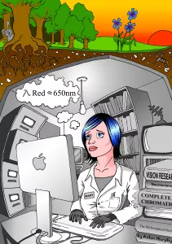
Issues facing Dualism
The Problem of Other Minds
The problem of other minds questions whether knowledge is possible of minds other than one’s own.
I have direct and privileged access to my own mind via introspection
By contrast, I am not able directly to inspect the contents of anyone else’ mind.
Because I cannot directly observe other minds, I must infer the mental states of others from what I can observe from their behaviour.
However, the behavioural evidence is insufficient to establish for certain what others’ mental states are, or indeed that they have minds at all.
Evaluation of Philosophical Zombies Argument
a 'philosophical zombie'/a 'zombie' world is not conceivable
what is conceivable may not be metaphysically possible
what is metaphysically possible tells us nothing about the actual world.
The Argument from Analogy
Mill argues that we can infer that other people have mental states by use of analogy.
P1: I observe that I have a mind
P2: I also observe that my mental states are systematically connected with my behaviour and the states of the body (e.g. acts of will cause bodily movements and damage to my body causing pain).
P3: I observe that other people who have bodies like mine behave similarly to me.
C1: It is likely that their bodies and behaviour are connected to mental states too.
C2: It is likely that others have minds.
Dualism makes a ‘category mistake’ (Ryle)
Substance dualism is the view that the mind and the body (brain) are two separate ‘substances’ or ‘things’
To make a category mistake is to assign a concept to a logical category to which it doesn’t belong (eg… )
Ryle claims that substance dualism (a) assigns ‘mind’ (and mental states’) to “the categories of ‘thing,’ ‘stuff,’ ‘attribute,’ ‘state,’ ‘process,’ ‘change,’ cause,’ and ‘effect.’” and (b) conceives of them as non-physical and ‘ghostly.’
Ryle gives a number of analogies to explain his point. For example, he gives the example of a foreigner visiting a university. He sees the colleges, lecture theatres and libraries, but asks ‘where is the university?’. In this instance, the foreigner is making a category mistake.
Each of Ryle’s analogies have the following feature: once one has a complete description of the component parts of some designated phenomena and how they work together (eg the ‘colleges’, ‘lecture theatres’, and ‘libraries’ of a university) it is a mistake to look for something ‘over and above’ those constitutive features.
Ryle argues that to talk about ‘the mind’ and ‘mental states’ is to talk about publicly observable behaviour or behavioural dispositions.
Evaluation of Mary/Knowledge Argument
Mary does not gain new propositional knowledge but does gain ability knowledge (the 'ability knowledge' response).
Mary does not gain new propositional knowledge but does gain acquaintance knowledge (the ‘acquaintance knowledge’ response).
Mary gains new propositional knowledge, but this is knowledge of physical facts that she already knew in a different way (the ‘New Knowledge / Old Fact’ response).
There is more than one way of knowing the same fact
Qualia do not exist and so Mary gains no new propositional knowledge.

Slide 3
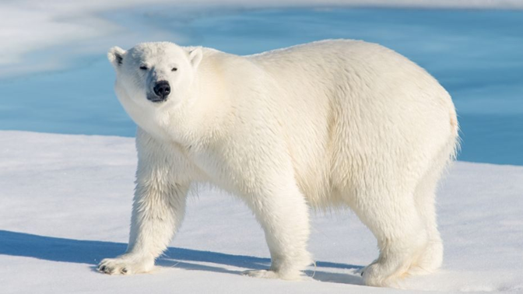
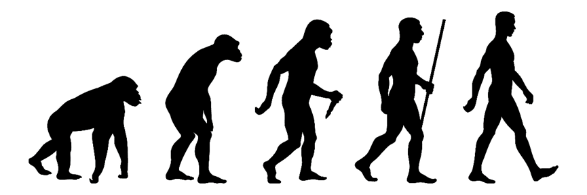
Issues facing Dualism
Challenges facing epiphenomenal dualism
The challenge posed by introspective self-knowledge: The mind does appear to cause physical action. E.g. You can choose between reaching out for a cup of tea or coffee.
The challenge posed by the phenomenology of our mental life: It appears self-evident that my conscious act of will, causes my actions. Also, when we think about what epiphenomenalism means for talk about mental states, it appears counter-intuitive. e.g. If you complain to your dentist about toothache, according to ED, the decay in the tooth causes you to say you have a toothache, the pain itself doesn’t cause you to say it. This means all talk about mental states lacks content or meaning. E.g. If I say, “I believe” or “I desire x”, I cannot be talking about my own mental state, since the mental states are not what has caused me to use the words
In response, supporters of epiphenomenal dualism point out that although there is a correlation between our vocalisation, “I am in pain” and the conscious awareness of being in pain, this is not the same as cause. If we understood the cause, we would be aware of nerves moving (all the intermediate steps from volition to act) and we would understand why we can move our hand but not our ears or our liver.
The challenge posed by natural selection/evolution. According to evolution, characteristics of species evolve because they confer an advantage to those creatures. If they not confer an advantage the traits would die out. However, according to epiphenomenalism, consciousness has no causal influence on the physical and so can offer no evolutionary advantage. So, consciousness should be a trait that has died out. The fact that conscious states do exist, suggests that they do confer a survival advantage and so must have some influence on the physical realm.
Frank Jackson’s responds by giving the example of the polar bear coat. The polar bear’s coat is very heavy. The additional weight is a disadvantage to the polar bear. However, it would be wrong to suggest that the heaviness should have been de-selected by evolution. This is because the heaviness is an inevitable by-product of evolving a warm coat (a warm coat clearly does have evolutionary advantages) In the same way, consciousness may be an inevitable by-product of the development of a complex brain. A complex brain helps us survive. So, consciousness may not be de-selected.

