Slide 1
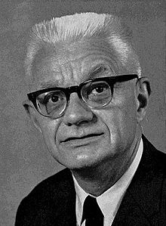
Philosophical (Analytical) Behaviourism
What you need to know:
Physicalism: Everything is physical or supervenes upon the physical (this includes properties, events, objects and any substance(s) that exist).
Philosophical behaviourism:
'Hard' behaviourism: all propositions about mental states can be reduced without loss of meaning to propositions that exclusively use the language of physics to talk about bodily states/movements (including Carl Hempel).
'Soft' behaviourism: propositions about mental states are propositions about behavioural dispositions (ie propositions that use ordinary language) (including Gilbert Ryle).
Issues including:
dualist arguments applied to philosophical behaviourism
the distinctness of mental states from behaviour (including Hilary Putnam's 'Super-Spartans' and perfect actors)
issues defining mental states satisfactorily due to (a) circularity and (b) the multiple realisability of mental states in behaviour
the asymmetry between self-knowledge and knowledge of other people’s mental states.
Possible Exam Questions
What is physicalism? (3 marks)
What is hard behaviourism? (3 marks)
What is soft behaviourism? (3 marks)
What is the difference between hard and soft behaviourism? (3 marks)
What is analytic reduction? (3 marks)
What claim do logical/analytical behaviourists make regarding statements about mental states? (3 marks)
Briefly outline philosophical behaviourism (5 marks)
Explain dualist responses to philosophical behaviourism. (5 marks)
Explain the distinctiveness of mental states from behaviour (Putnam’s super-Spartans) (5 marks)
Explain issues of circularity and the multiple realisability of mental states for logical/analytic behaviourism. (5 marks)
Explain how the asymmetry between self-knowledge and knowledge of other people’s mental states might cause an issue for logical/analytic behaviourism (5 marks)
Briefly outline analytic/logical behaviourism and the issues related to it. (12 marks)
Explain the issue of circularity that logical/analytical behaviourists face when defining mental states. (12 marks)
Does philosophical behaviourism give the correct account of mental states? (25 marks)
Issue with behaviourism: Circularity
Logical/analytical behaviourists claim that all statements about mental states can be analytically reduced without loss of meaning to statements about behaviour (or behavioural dispositions).
Mental states cannot be analysed without reference to other mental states, so mental states are being analysed in terms of mental states, which is circular.
For example: the logical behaviourist may try to reduce someone’s ‘desire for A’ to the ‘disposition to do B when A is available’, but whether someone is actually ‘disposed to do B’ will depend on other mental states: e.g. whether someone ‘believes that A is available and is not fearful of C’.
So a complete analysis of statements about mental states does not translate (without remainder) to statements about behaviour or dispositions to behave: the analysis always comes back ‘mental states’.
Issue with behaviourism: Multiple Realisibility
Particular mental states may be realised by different behaviours. For example, the belief that it is raining could lead you to stay at home, go out with your umbrella, or with a hat or a raincoat.
A complete analysis of all the possible ways mental states might be realised in behaviour would be infinitely long and so could not be completed.

Slide 2
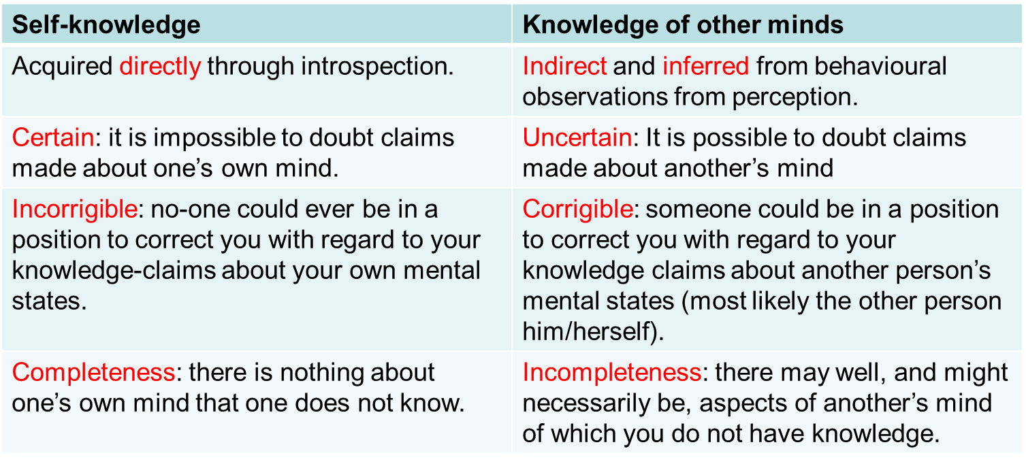
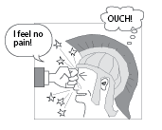
Philosophical (Analytical) Behaviourism
Arguments for behaviourism
It does not have any of the problems associated with dualism (e.g. the problem of interaction and the problem of other minds)
We only have access to the behaviour of others, so other’s behaviour must be the basis for all language about other people. (Ayer)
Words gain their meaning publicly (there is no private language). However, given that we have little difficulty ascribing mental states to people, we must be talking about what is publicly observable (i.e. behaviour) – Wittgenstein.
Issue with behaviourism: Asymmetry
I determine what mental state someone else has differently to the way I determine my own mental state. I determine another’s mental state by observing their behaviour. However, I determine my own mental state through introspection. However, behaviourism cannot explain this asymmetry. It suggests that knowledge of my own mental state is arrived at in the same way as is knowledge of others’ mental states (through observation of behaviour) The fact that I don’t need to observe my behaviour in order to know what mental state I am in shows that behaviourism is false.
A full list of the asymmetry between self-knowledge and knowledge of other minds is outlined below:
Key terms
Physicalism: Everything is physical or supervenes upon the physical (this includes properties, events, objects and any substance(s) that exist).
'Hard' behaviourism: all propositions about mental states can be reduced without loss of meaning to propositions that exclusively use the language of physics to talk about bodily states/movements (including Carl Hempel).
'Soft' behaviourism: propositions about mental states are propositions about behavioural dispositions (i.e. propositions that use ordinary language) (including Gilbert Ryle).
Analytical / Logical / Philosophical behaviourism: all statements about mental states can analytically be reduced to statements about behaviour (without loss of meaning)
Super-Spartans: people who are able to suppress all outward signs of pain.
Disposition: state of mind, attitude, inclination
Multiple Realisibility: the same type of mental state can be instantiated in different ways.
Analytic Reduction: to reduce one phenomenon to another by explaining one in terms of the other. It is concerned with the meaning of the language we use to talk about the phenomena and claims that all that is said about one phenomenon can be translated into talk about another without loss of meaning.
Asymmetry: where two things do not match.
Issue with behaviourism: the distinctness of mental states from behaviour (Super-Spartans)
Putnam asks us to imagine a race of Super-Spartans who feel pain just like ordinary mortals but who are able to suppress any behaviourial manifestation of their pain. Thus, it would seem that our concept of pain cannot be reduced to behaviourial concepts. Putnam concludes that rather than pain behaviour constituting pain, it is, rather, a symptom of being in pain.

