Slide 1
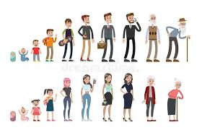
Growth and development are different concepts:
Principles of growth – growth is variable across different parts of the body and is measured using height, weight and dimensions
principles of development – development follows an orderly sequence and is the acquisition of skills and abilities.
A1 Physical development across the life stages
A2 Intellectual development across the life stages
In adolescence (9–18 years), the changes surrounding puberty:
development of primary and secondary sexual characteristics
the role of hormones in sexual maturity
In infancy and early childhood there is rapid growth in intellectual and language skills:
Piaget’s model of how children’s logic and reasoning develops – stages of cognitive development, the development of schemas, his tests of conservation, egocentrism and how his model may explain children’s thoughts and actions
Chomsky’s model in relation to how children acquire language – Language Acquisition Device (LAD), the concept of a critical period during which children may learn language, which may explain how children seem to instinctively gain language.
In early adulthood (19–45 years), the individual reaches physical maturity:
physical strength peaks, pregnancy and lactation occur perimenopause – oestrogen levels decrease, causing the ovaries to stop producing an egg each month.
The reduction in oestrogen causes physical and emotional symptoms, to include hot flushes, night sweats, mood swings, loss of libido and vaginal dryness.
In infancy (0–2 years), the individual develops gross and fine motor skills:
the development of gross motor skills the development of fine motor skills
milestones set for the development of the infant – sitting up, standing, cruising, walking.
In early adulthood, thinking becomes realistic and pragmatic, with expert knowledge about the practical aspects of life that permits judgement about important matters.
Relationship-marriage
family-direct and indirect
housing-renting, mortgage
job-promotion,
children-creating a family
Travel-holidays, backpacking etc.
In middle adulthood (46–65 years), the female enters menopause:
causes and effects of female menopause and the role of hormones in this effects of the ageing process in middle adulthood
In early childhood (3–8 years), the individual further develops gross and fine motor skills:
riding a tricycle, running forwards and backwards, walking on a line, hopping on one foot, hops, skips and jumps
confidently turns pages of a book, buttons and unbuttons clothing, writes own name, joins up writing.
In later adulthood (65+ years), there are many effects of ageing:
health and intellectual abilities can deteriorate
The effects of age on the functions of memory:
memory loss in later adulthood.

Slide 2
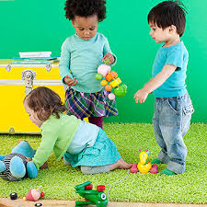
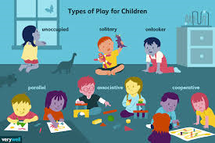
A3 Emotional development across the life stages
B Factors affecting human growth and development
Attachment to care-giver in infancy and early childhood:
theories of attachment, to include types of attachment and disruptions to attachment.
B1 The nature/nurture debate related to factors
Development across the lifespan is a result of genetic or inherited factors – Gesell’s maturation theory.
• Development across the lifespan is a result of environmental factors – Bandura’s social
learning theory.
• Both factors may play a part – stress-diathesis model..
The development and importance of self-concept:
definitions and factors involved in the development of a positive or negative self-esteem
definitions and factors involved in the development of a positive or negative self-image
B2 Genetic factors that affect development
• Genetic predispositions/disorders to particular conditions – cystic fibrosis, brittle bone disease, phenylketonuria (PKU), Huntington’s disease, Klinefelter’s syndrome, Down’s syndrome, colour blindness, Duchenne muscular dystrophy, susceptibility to diseases such as cancer, high blood cholesterol and diabetes.
• Biological factors that affect development – foetal alcohol syndrome, effects of maternal infections and lifestyle/diet during pregnancy, congenital defects.
A4 Social development across the life stages
The stages of play in infancy and early childhood:
solo play, parallel play and co-operative play.
The importance of friendships and friendship groups:
the social benefits of friendships
the effects of peer pressure on social development.
The development of relationships with others.
The development of independence through the life stages:
peer influence in adolescence, starting employment, leaving home, starting a family.
B3 Environmental factors that affect development
Exposure to pollution – respiratory disorders, cardiovascular problems, allergies.
• Poor housing conditions – respiratory disorders, cardio vascular problems, hypothermia,
and anxiety and depression.
• Access to health and social care services – availability of transport, opening hours of
services, ability to understand the needs and requirements of particular services.
B4 Social factors that affect development
Family dysfunction – parental divorce or separation, sibling rivalry, parenting style.
• Bullying – effects of bullying on self-esteem, self-harm, suicide.
• Effects of culture, religion and belief – beliefs that may prevent medical intervention, dietary restrictions.

Slide 3
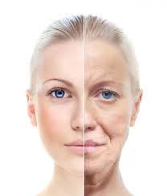
B5 Economic factors that affect development
The effects of life events on health.
Holmes-Rahe social readjustment rating scale and the effects of life events on a person’s stress levels and health.
Income and expenditure.
• Employment status.
• Education.
• Lifestyle.
C Effects of ageing
C1 The physical changes of ageing
• Cardiovascular disease – age can increase the risks of cardiovascular disease. This can be exacerbated by lifestyle choices.
• The degeneration of the nervous tissue.
• Osteoarthritis.
• Degeneration of the sense organs.
• The reduced absorption of nutrients.
• Dementia, to include Alzheimer’s disease.
• Effects of illnesses that are common in ageing..
B6 Major life events that affect development
Predictable events:
these are events that are expected to happen at a particular time. While expected, they may still have an effect on a person’s health and wellbeing. This effect can be positive or negative, regardless of the event.
Unpredictable events:
these are events that happen unexpectedly and can have serious physical and psychological effects on an individual. These effects can be positive or negative, regardless of the event.
C2 The psychological changes of ageing
Effects on confidence and self-esteem.
Effects of social change:
role changes
loss of a partner
loss of friends
increase in leisure time.
Financial concerns.
Effects of culture religion and beliefs.
Social disengagement theory.
Activity theory..
Many events can be either predictable or unpredictable depending on the life course of the
individual. They can include:
o starting school/nursery
o moving house
o marriage and divorce
o starting a family
o beginning employment
o retirement
o death of a relative/partner/friend
o accidents or injury
o changing employment
o leaving home
o promotion or redundancy
o serious illness.
C3 The societal effects of an ageing population
• Health and social care provision for the aged.
• Economic effects of an ageing population.

