Slide 1
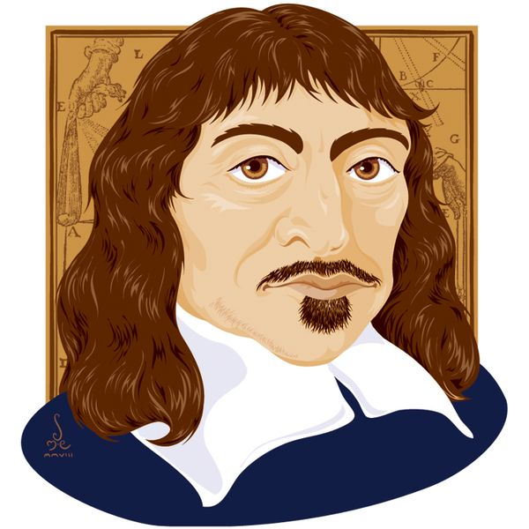
Limits of knowledge
What you need to know:
Possible Exam Questions
Particular nature of philosophical scepticism and the distinction between philosophical scepticism and normal incredulity.
The role/function of philosophical scepticism within epistemology
The distinction between local and global scepticism and the (possible) global application of philosophical scepticism
Descartes’ sceptical arguments (the three ‘waves of doubt’)
Responses to scepticism: the application of the following as responses to the challenge of scepticism:
Descartes' own response
empiricist responses (Locke, Berkeley and Russell)
reliabilism.
What is philosophical scepticism? [3 marks]
Explain Descartes method of doubt. 5 marks
Explain Descartes’ use of philosophical scepticism and how it leads to global scepticism. 5 marks
Explain Descartes third wave of doubt ( the evil demon argument 5 marks
Explain the difference between local and global scepticism. 12 marks
Outline and explain two differences between philosophical scepticism and normal incredulity. 12 marks
Outline Descartes’ evil deceiver argument and explain what he then says about his knowledge of his own existence 12 marks.
Normal incredulity
Happens when we encounter ordinary evidence which challenges a belief or makes it appear unlikely.
Philosophical scepticism
Happens when evidence makes a belief very unlikely to be true, involves a radical sceptical scenario. Tests the justification for our knowledge claims and to develop our understanding of the nature of our knowledge.
Local scepticism
Knowledge is impossible in a particular area or belief, like religious claim, they do not raise doubts about knowledge as a whole. .
Global scepticism
Knowledge in any area is impossible, it undermines 0our whole belief system.
Descartes method of doubt
Eliminate error from his system of beliefs and to establish truth.
To do this he will; destroy all his previous opinions by rejecting any that have the slightest grounds for doubt.
He will destroy all the principles’ or most basic beliefs he has.
Whatever beliefs survive this method must be true and so he can build his foundation for knowledge around them.
Empiricist responses to scepticism
Locke, Hume and Russell try to limit scepticism by accepting that we have knowledge without certainty.
Berkeley tries to remove the distinction between appearance and reality and that we have unmediated access to the eternal world.

Slide 2
Limits of knowledge
Key terms
The dreaming argument
If I can have dreams that seem like real life then how do I know I am not dreaming?
If I cannot know that I am dreaming, any belief that I have about what I perceive could be false.
Issues
Dreams can be distinguished from waking life, it is easy to tell the difference.
There are certain signs or criteria that tell me this,. E.g. pinching myself to see if I feel pain.
Dreams must come from waking life, the concept of a dram is that of a kind of copy of waking life as the content of my dreams come from my waking life.
How can Descartes even know that he has dreams which are indistinguishable from waking life? Surely if you know this then they are indistinguishable?
A priori – knowledge known via reason independent of experience.
Clear and distinct ideas – Self-justifying beliefs, vivid beliefs based on reason and known with the mind alone.
Deductive argument - an argument where the truth of the conclusions guaranteed by the truth of the premises.
Intuition - the normal function of the mind.
Scepticism – Raising doubts about our claim to know anything.
Cogito ergo sum – I think therefore I am
It is impossible to doubt your own existence, it can known to be true just by thinking it. It does not depend on anything else for its truth.
But what does the word I mean? What am I? what is the self? He has not yet established the existence of himself as a human being due to the evil demon, but he concludes that he must be something, a conscious, thinking thing.
Issues
Clarity and distinctness do not guarantee a belief is true.
How can we be sure which beliefs really are clear and distinct?
Desecrate has to prove that God exists to dispel his doubts.
The Cartesian circle, he tries to prove that there are such things as clear and distinct ideas, but then needs clear and distinct ideas to prove the existence of God, circularity.
No enduring thinker
No thinker at all
The evil demon argument
An all powerful God could be deceiving Descartes about the existence of physical objects and the universe, as there can be nothing to stop this being making the world appear as it does.
God would be able to deceive me in thinking that what I believe and what I perceive is right and so I would know no difference.
But our concept of God is one that is supremely good, so the belief that God is good and would deceive me cannot both be true.
Descartes abandons this notion of a deceiver God, maybe God does not exist and so Descartes is not being deceived. But, an evil demon could be deceiving him instead, as his perceptions could be part of the demons perceptions.
Issues
Surely if we are being deceived by an evil demon then how can we make knowledge claims that we are being deceived? Surely everything we make is an inference, such as the inference of a supremely good being. So if the demon could make me think 2+3=5 then he could fool me in thinking that God would not deceive me.
Reliabilism
An alternative definition of knowledge could overcome scepticism. Beliefs need to be produced in a reliable way in order to produce true beliefs. It rejects the need for justification and the need for evidence for it to count as knowledge. As long as the process which produces a belief reliably produces true beliefs, then it is to count as knowledge, irrespective of whether I am aware that the process is reliable or that I can provide any justification for my belief.
Brain in a vat
A brain in a jar of chemicals connected to wires in a computer which feeding images, sounds, sensations etc. to the brain. So the brain thinks it is alibiing person. Does this mean we cannot be 100% certain of anything?

