Slide 1
Kant’s Deontological Ethics
What you need to know:
Key terms
Immanuel Kant’s account of what is meant by a ‘good will’.
The distinction between acting in accordance with duty and acting out of duty.
The distinction between hypothetical imperatives and categorical imperatives.
The first formulation of the categorical imperative (including the distinction between a contradiction in conception and a contradiction in will).
The second formulation of the categorical imperative.
Issues, including:
clashing/competing duties
not all universalisable maxims are distinctly moral; not all non-universalisable maxims are immoral
the view that consequences of actions determine their moral value
Kant ignores the value of certain motives, eg love, friendship, kindness
morality is a system of hypothetical, rather than categorical, imperatives (Philippa Foot).
Deontological ethics: a type of ethical theory that views the moral value of an action as having dutiful motives. Generally, deontologists propose certain rules, which guide us as to which actions are right and which are wrong.
Acting out of duty: doing something because it is the right thing to do.
Acting in accordance with duty: doing the right thing, but from the wrong motive.
Hypothetical imperatives: a conditional, non-universalisable ‘ought’ (e.g. I ought to boil the kettle if I want to make a cup of tea)
Categorical imperatives: an unconditional, universalisable ‘ought’ (e.g. I to keep my promises)
Good will
Most people pursue ends that we think of as ‘good’ e.g. happiness, intelligence, money
Each of these supposed ‘goods’ can sometimes be bad e.g. someone can gain happiness from torture.
The only pure good is one that arises out of good will
A good will is one which acts out of duty
Possible Exam Questions
What does it mean to say that an ethical theory is deontological? (3 marks)
Explain the difference between acting out of duty and acting in accordance with duty. (5 marks)
What is the difference between hypothetical and categorical imperatives? (3 marks)
Outline the first formulation of the categorical imperative, including the distinction between a contradiction in conception and a contradiction in will. (5 marks)
What is the difference between a contradiction in conception and a contradiction in will? (5 marks)
Outline the second formulation of the categorical imperative. (5 marks)
Explain Kant’s account of what he meant by ‘good will’. (5 marks)
Critically Evaluate Kant’s Moral Philosophy (25 marks)
Is Kant’s deontological ethics practical as an ethical theory? (25 marks)
Is Kant’s approach to moral ethics successful? (25 marks)
The first formulation of the categorical imperative: universalisability
“Act only according to that maxim by which you can at the same time will that it should become a universal law”
Acting on a maxim which does not pass this test (ie cannot be so willed) is morally wrong.
Maxims that pass this test (ie can be so willed) are morally permissible (NB: they are not morally obligatory).
A maxim fails the test of the Categorical Imperative if universalising it leads to a contradiction.
There are two types of contradictions that Kant discusses:
a contradiction in conception (a logical contradiction) which leads to perfect duties (which are duties to never X)
a contradiction in the will (i.e. they contradict something that we rationally must will) which leads to imperfect duties (which are duties to do Y to at least some extent).

Slide 2
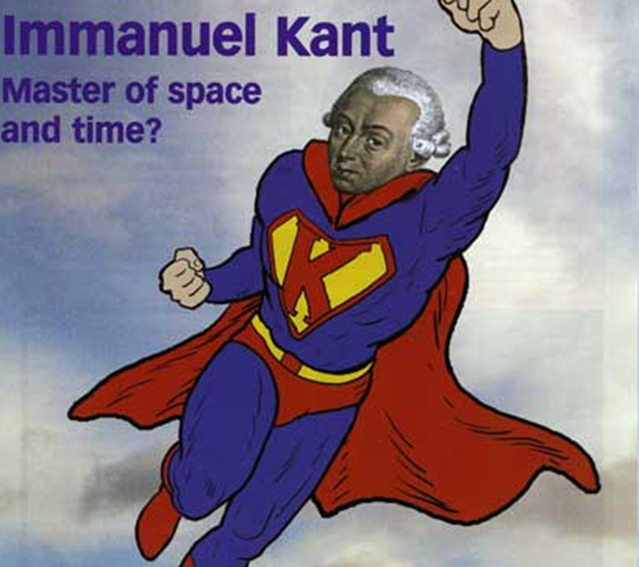
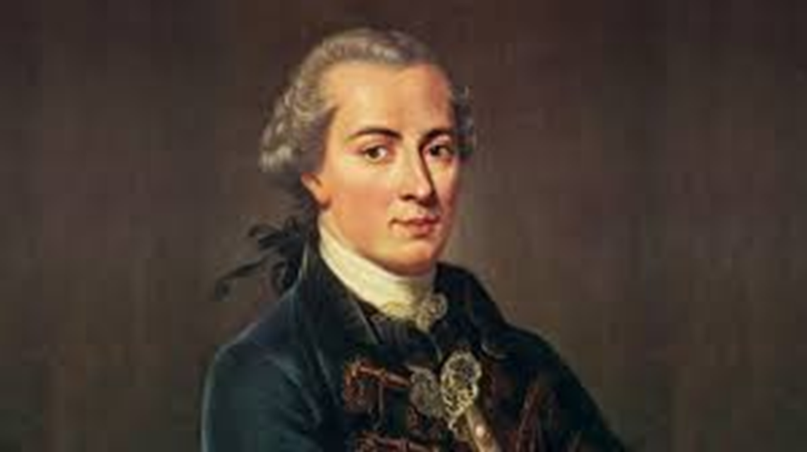
Kant’s Deontological Ethics
The second formulation of the categorical imperative: ‘Ends not Means’
It is always wrong to treat a person in a way that involves them in an action that they do not to consent to.
This doesn’t mean I can never use people as a means:
Every time I take a taxi or call a plumber, I use a person to further my ends. However, this person has consented, and they are using me as a mean to an end (i.e. to make money)
You use someone as a means to an end, when there is no consent. For example:
A woman buys your old bass guitar with fake £20 notes. Lying, deceit, drugging, kidnapping, slavery, murder are intrinsically wrong because they use people as means to an end.
Issue 3: morality is a system of hypothetical, rather than categorical, imperatives (Philippa Foot)
Foot believes (unlike Kant) that with hypothetical imperatives: there is a clear reason to be moral, whereas with categorical imperatives there is no clear reason to be moral (e.g. why is it wrong to steal?)
Issue 4: the view that consequences of actions determine their moral value
For example: A friend has asked if he can stay with you for a few days. On the first night, a deranged-looking man with an axe knocks at the door and asks if your friend is staying with you. Do you tell the truth?
Most people would have no hesitation in lying. This is because we place some moral value in the consequences of an action.
Kant wants us to act as though everyone is moral and treats people as ends. However, in the real world, people are not like that – there are axemen! Some argue that because the world is not ideal, we need to look at consequences. Kant seems more concerned with us being morally consistent, than whether someone is murdered by an axeman!
Issue 5: Kant ignores the value of certain motives, eg love, friendship, kindness
If a father looks after his son out of love, Kant thinks his actions do not have moral value. However, our intuition places moral value on love, compassion, guilt, sympathy, pride, jealousy. See the mark scheme for Oct 2022 Y13 trial exam!!
Issue 1: clashing/competing duties
Kant does not offer much guidance when duties conflict. He believes that when imperfect duties clash with perfect duties, perfect duties should always take precedence. He also does not believe perfect duties ever clash. He believes to promise never to tell a lie is a promise that should never have been made. However, imperfect duties can clash. Satre gives the example of my duty to my country to fight in a war and my duty to stay at home to look after my elderly mother. When obligations compete, utilitarianism has an advantage, as you simply apply the principle of utility.
Issue 2: not all universalisable maxims are distinctly moral; not all non-universalisable maxims are immoral
not all universalisable maxims are moral e.g. ‘I will chew food 32 times before eating, to aid digestion.’
not all non-universalisable maxims are immoral e.g. When taking an exam, I will come in the top 50%; I always help the poor when I can afford to, to ease their plight; On trick or treat nights, I will go and collect sweets, but will not provide any at my house, to save money.

